Slide 1
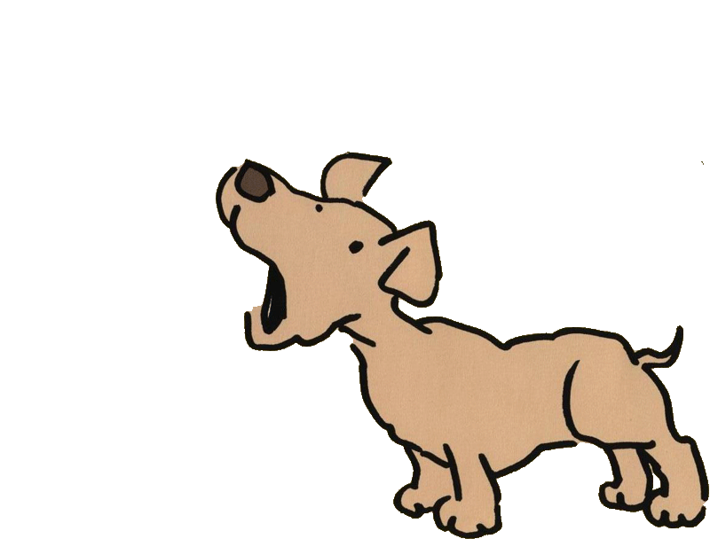
Animal Sounds

Slide 2
Listen and guess
What is it?

Slide 3
It’s a cat.
Meow!

Slide 4
Listen and guess
What is it?

Slide 5
It’s a dog.
woof!

Slide 6
Listen and guess
What is it?

Slide 7
It’s a bird.
Tweet!

Slide 8
Listen and guess
What is it?

Slide 9
It’s a cow.
Moo!

Slide 10
Listen and guess
What is it?

Slide 11
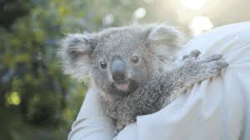
It’s a koala.
Bello

Slide 12
Listen and guess
What is it?

Slide 13
It’s a pig.
Oink!

Slide 14
Listen and guess
What is it?

Slide 15
It’s a duck.
Quack!

Slide 16
Listen and guess
What is it?

Slide 17
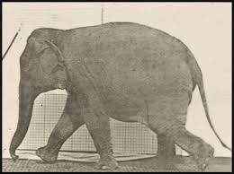
It’s an elephant.
trumpet!

Slide 18
Listen and guess
What is it?

Slide 19
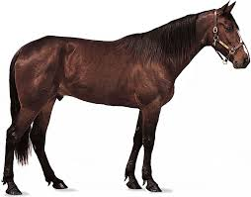
It’s a horse.
neigh!

Slide 20
Listen and guess
What is it?

Slide 21
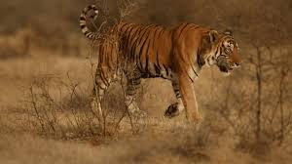
It’s a tiger.

Slide 22
Listen and guess
What is it?

Slide 23
It’s a mouse.
Squeak!

Slide 24
Listen and guess
What is it?

Slide 25
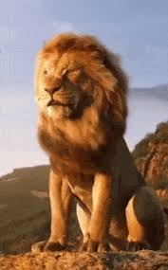
It’s a lion.

