Slide 1
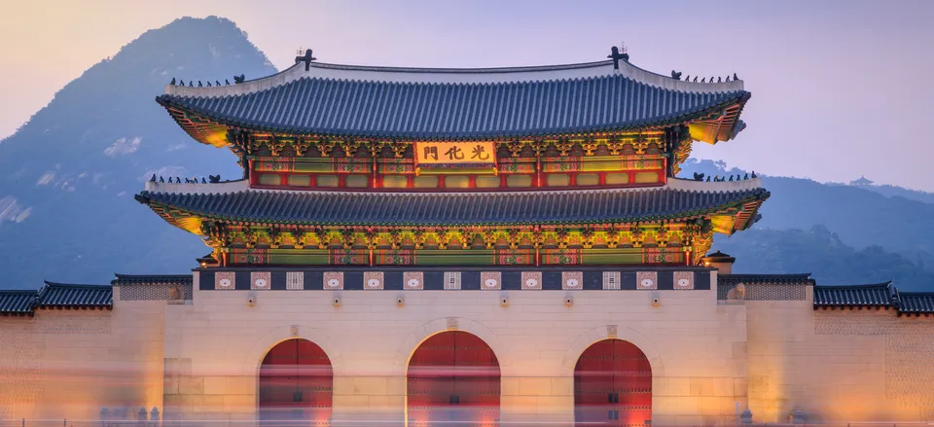
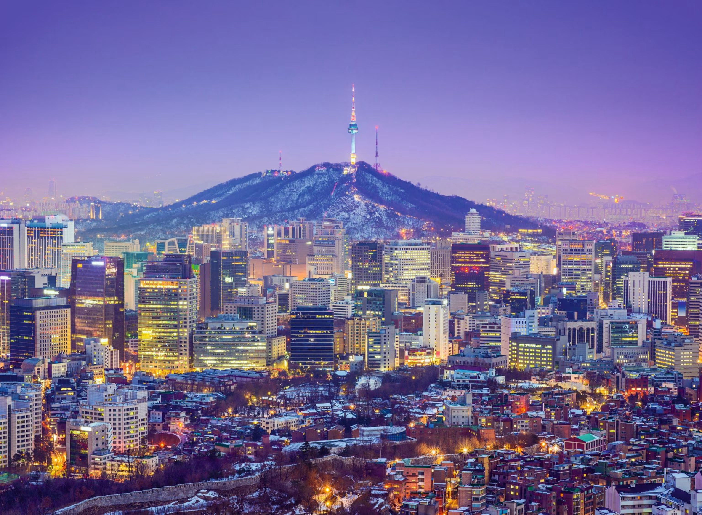
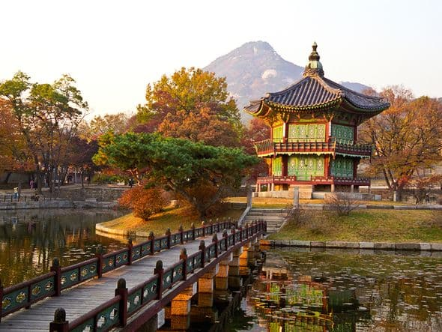
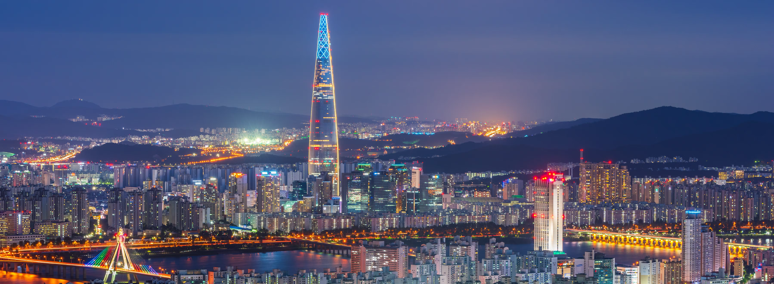
DO YOU KNOW WHERE IS THIS?

Slide 2
We are going to… SOUTH KOREA
Where are we going?

Slide 3
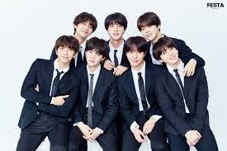
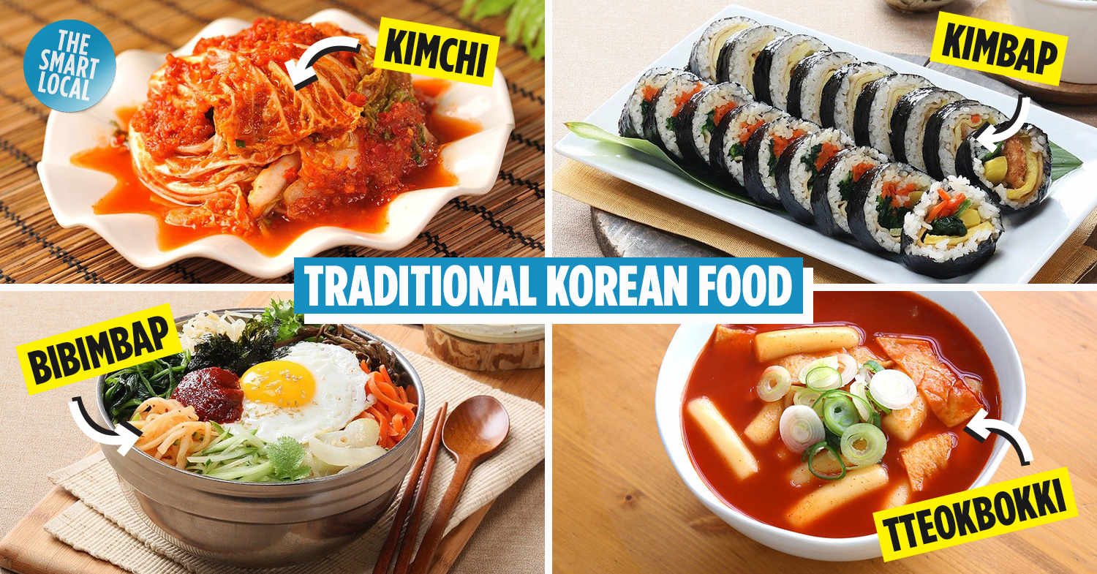
What do you know about South Korea?

Slide 4
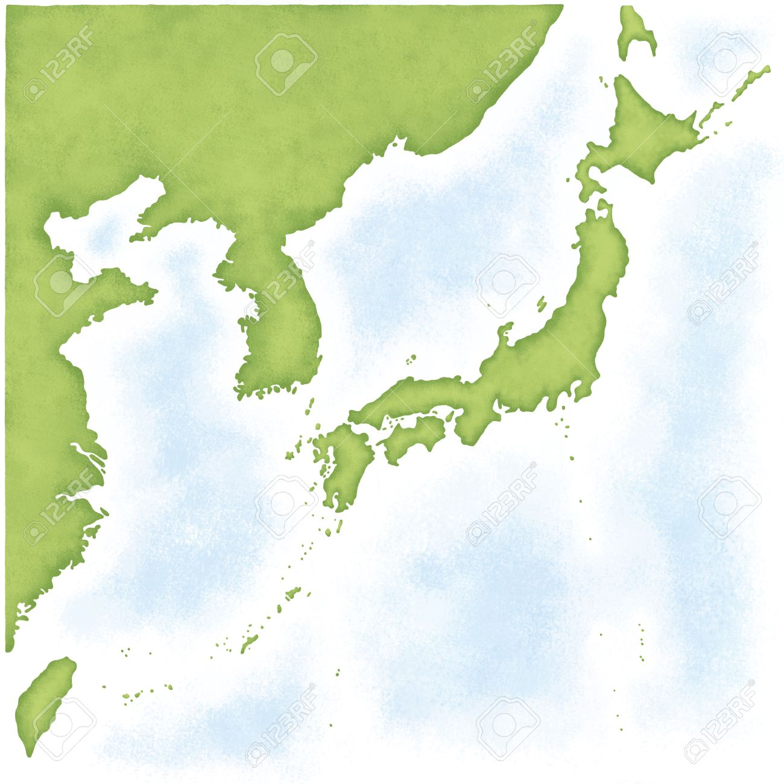
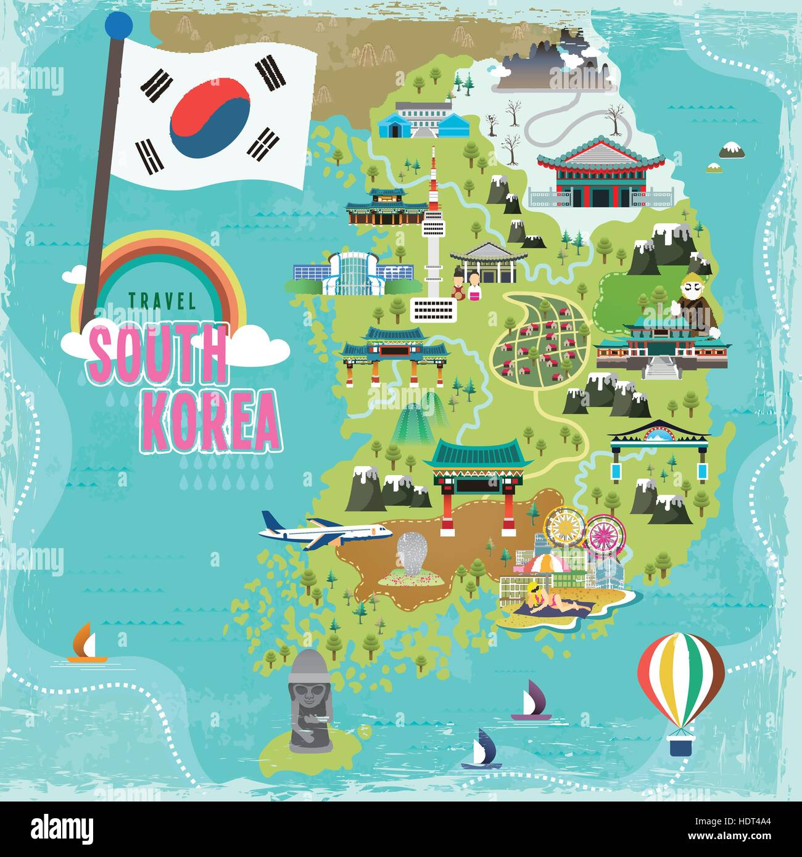
NORTH
KOREA
SOUTH
KOREA
JAPAN
TAIWAN

Slide 5
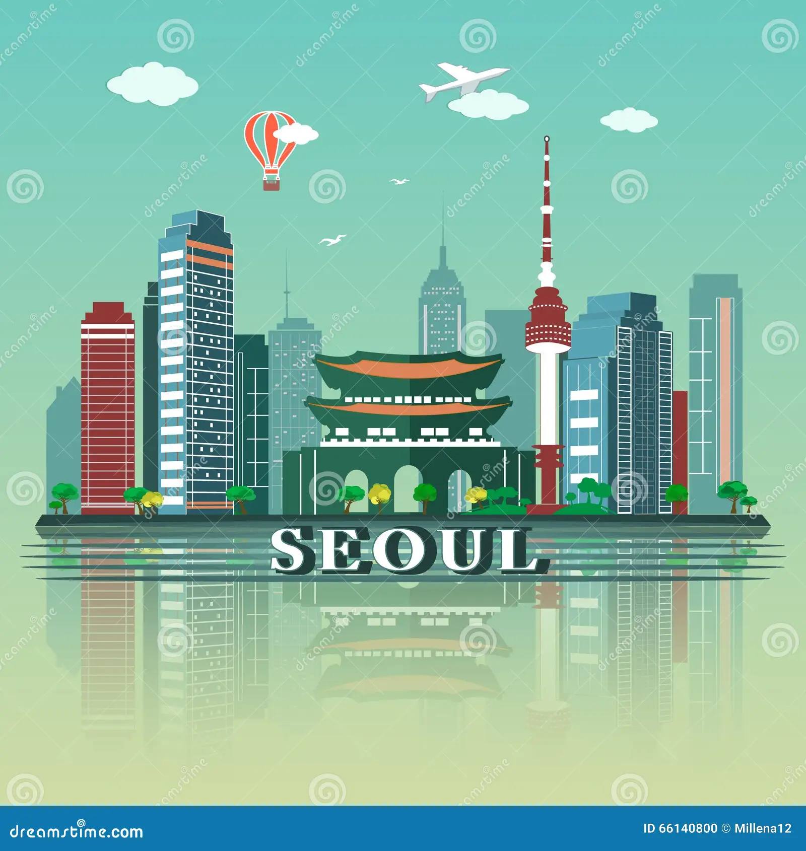
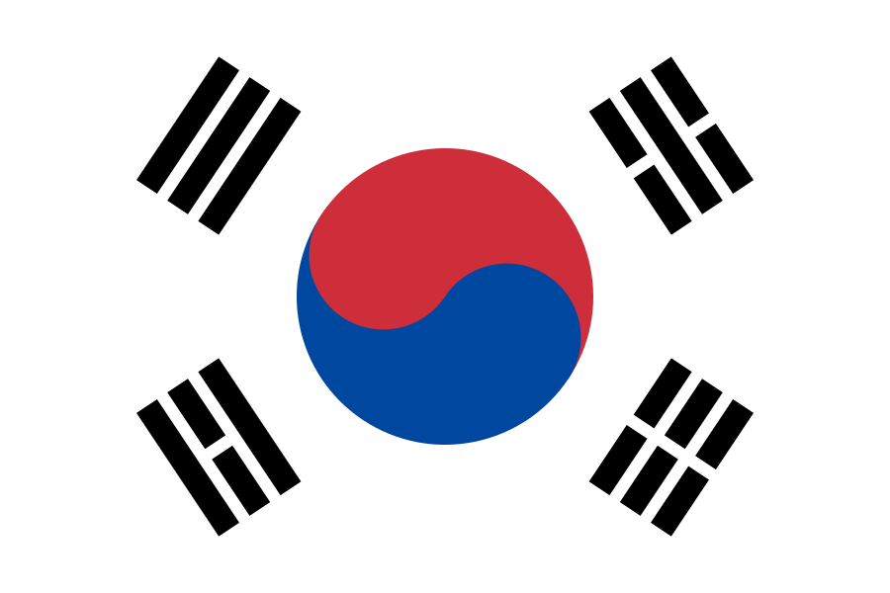
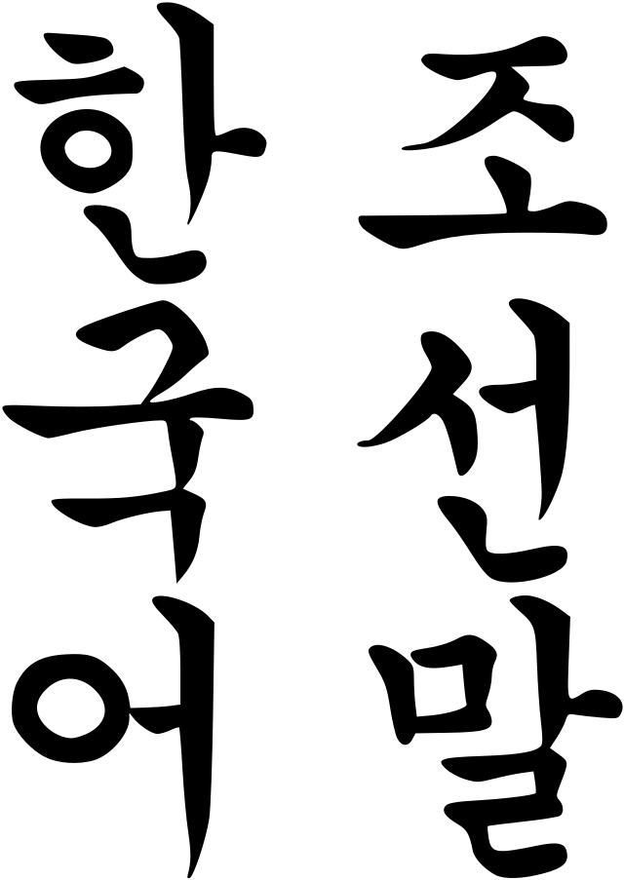
SOUTH KOREA
01
02
03
04
05
NATIONAL LANGUANGE
SEOUL CITY
FLAG
HANGUL

Slide 6
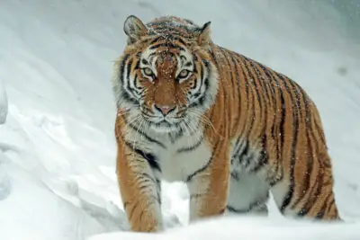
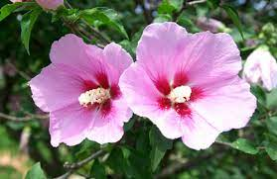
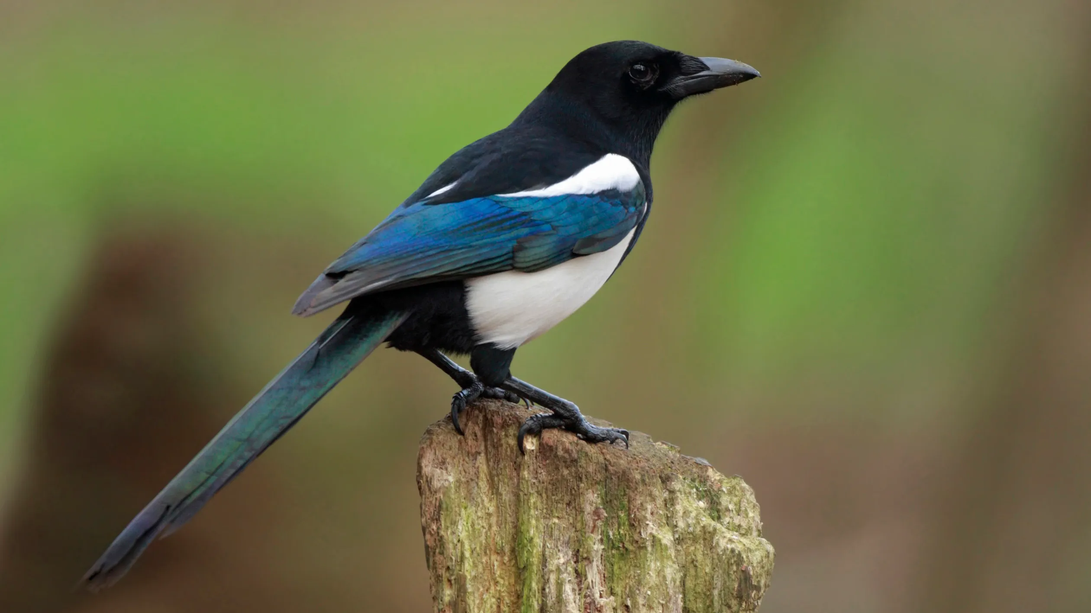
SOUTH KOREA
04
05
06
04
05
NATIONAL ANIMAL
NATIONAL FLOWER
NATIONAL BIRD
SIBERIAN TIGER
HIBISCUS
MAGPIE

Slide 7
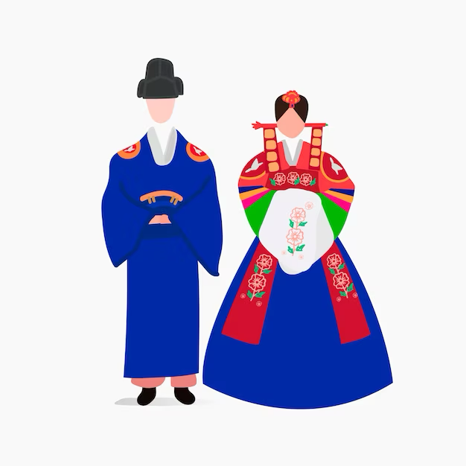
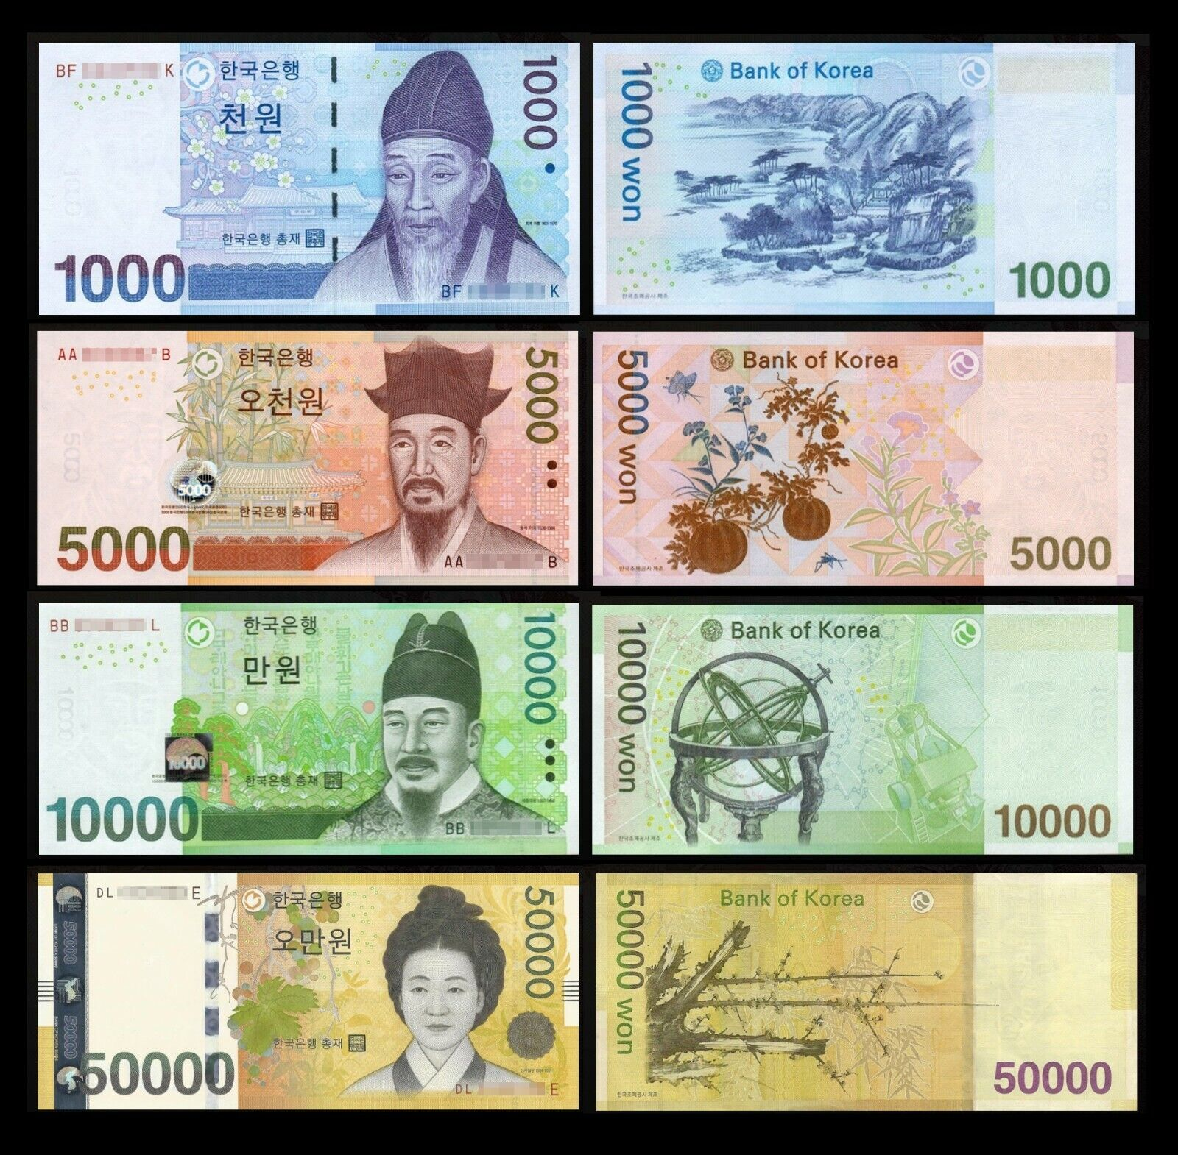
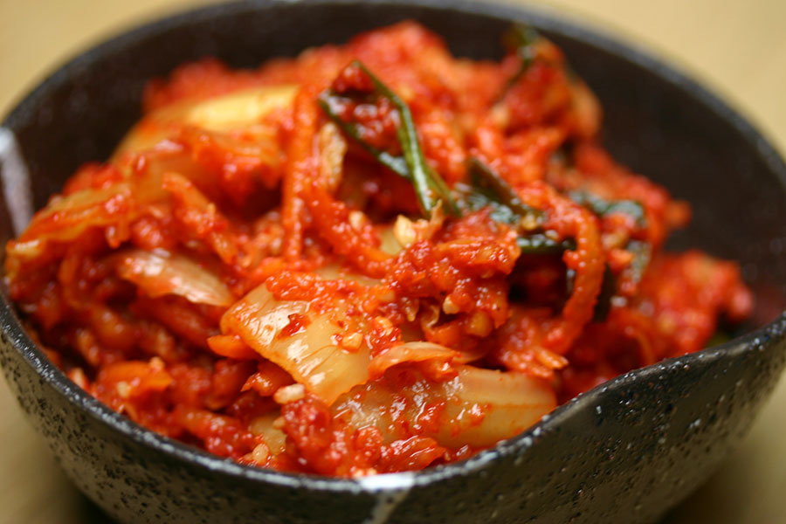
SOUTH KOREA
07
08
09
05
NATIONAL DRESS
NATIONAL FOOD
MONEY
HANBUK
KIMCHI

Slide 8
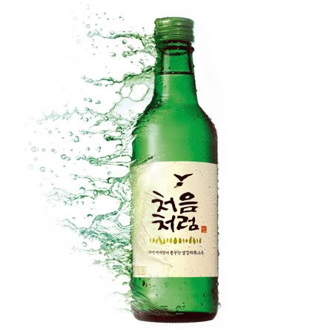
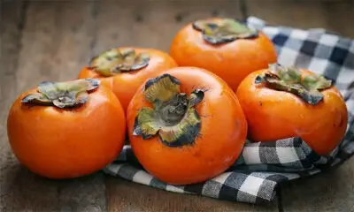
SOUTH KOREA
10
11
03
05
NATIONAL DRINK
NATIONAL FRUIT
PERSIMMON
SOJU

Slide 9
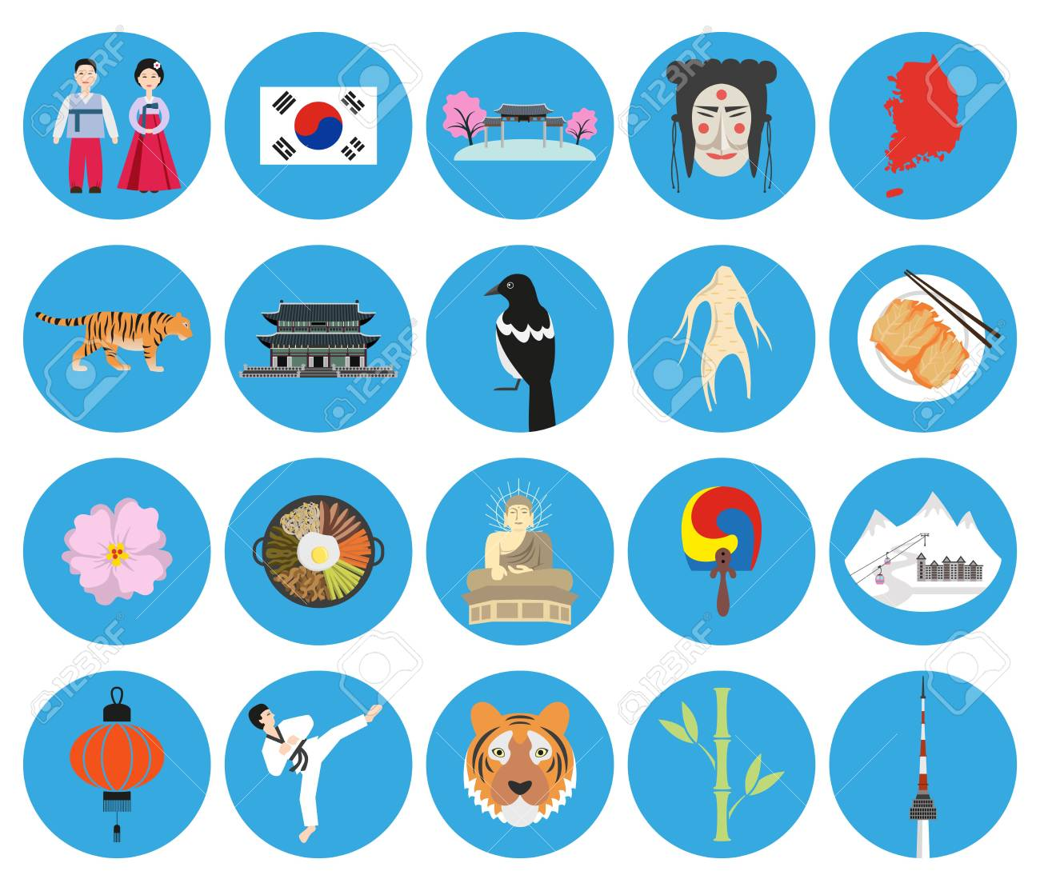
WHERE IS THE MAP OF SOUTH KOREA?
WHAT IS THE NATIONAL FOOD OF SOUTH KOREA?
WHERE IS THE NATIONAL FLOWER OF SOUTH KOREA?
WHERE IS THE HANBUK?
WHAT IS THE NATIONAL ANIMAL OF SOUTH KOREA?
WHAT IS THE FLAG OF SOUTH KOREA?
WHAT IS THE NATIONAL BIRD OF SOUTH KOREA?
WHAT IS THE NATIONAL SPORT OF SOUTH KOREA?

Slide 10
01
AWESOME PLACES
Come visit South Korea… Travel and Explore

Slide 11
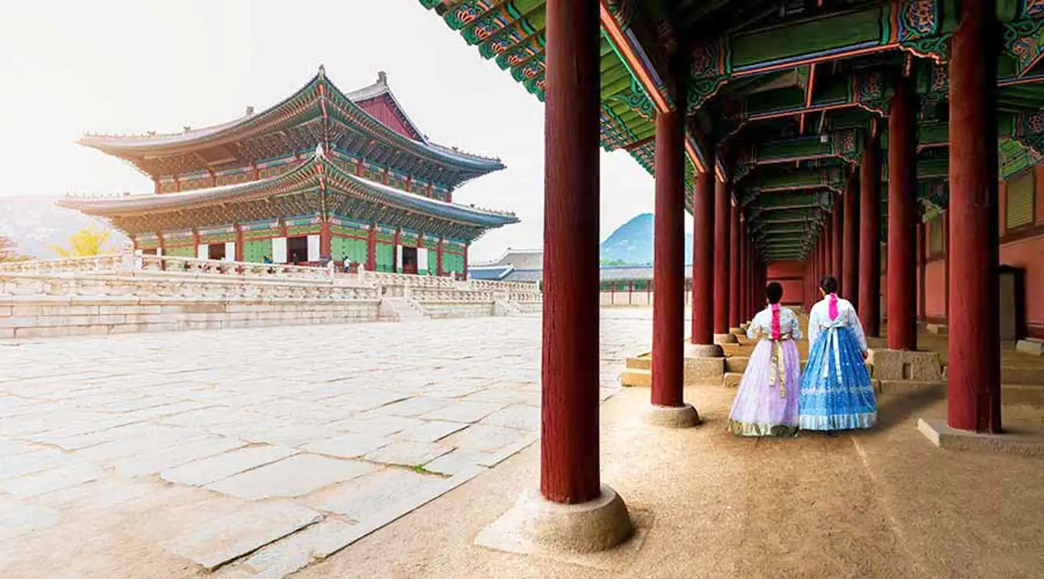
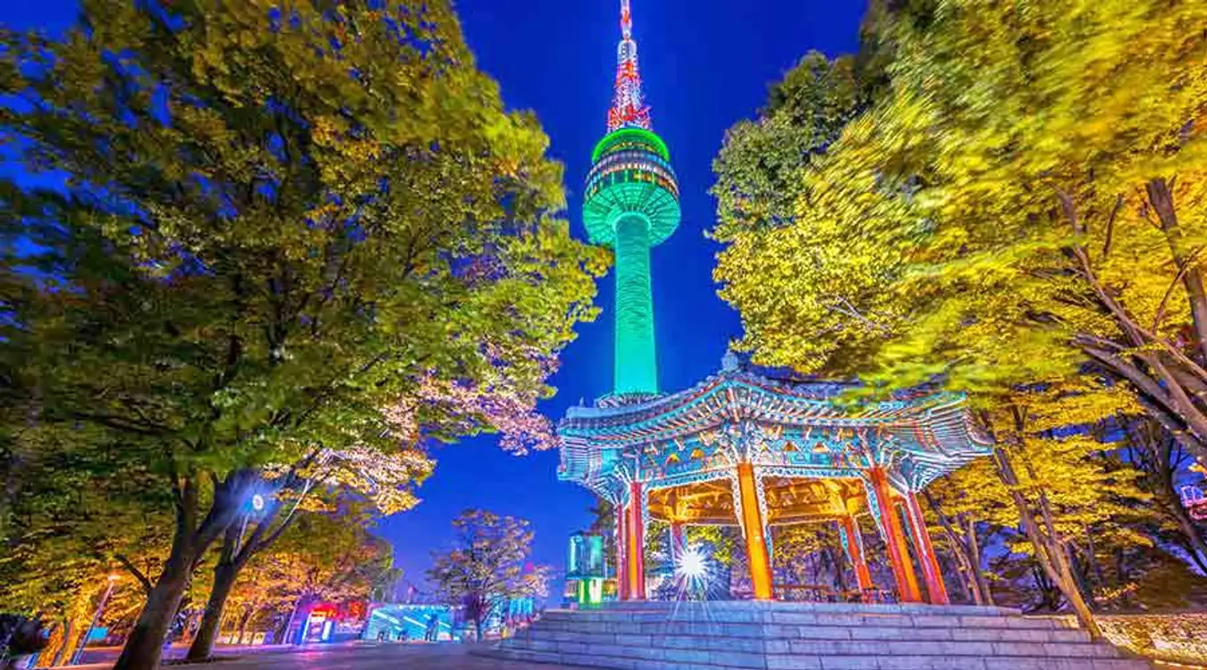
Gyeongbokgung Palace
N Seoul Tower

Slide 12
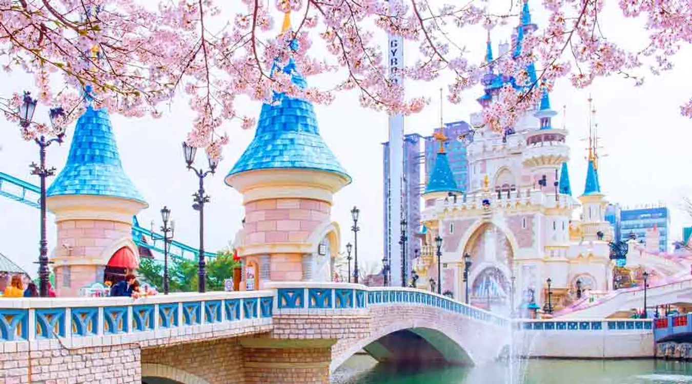
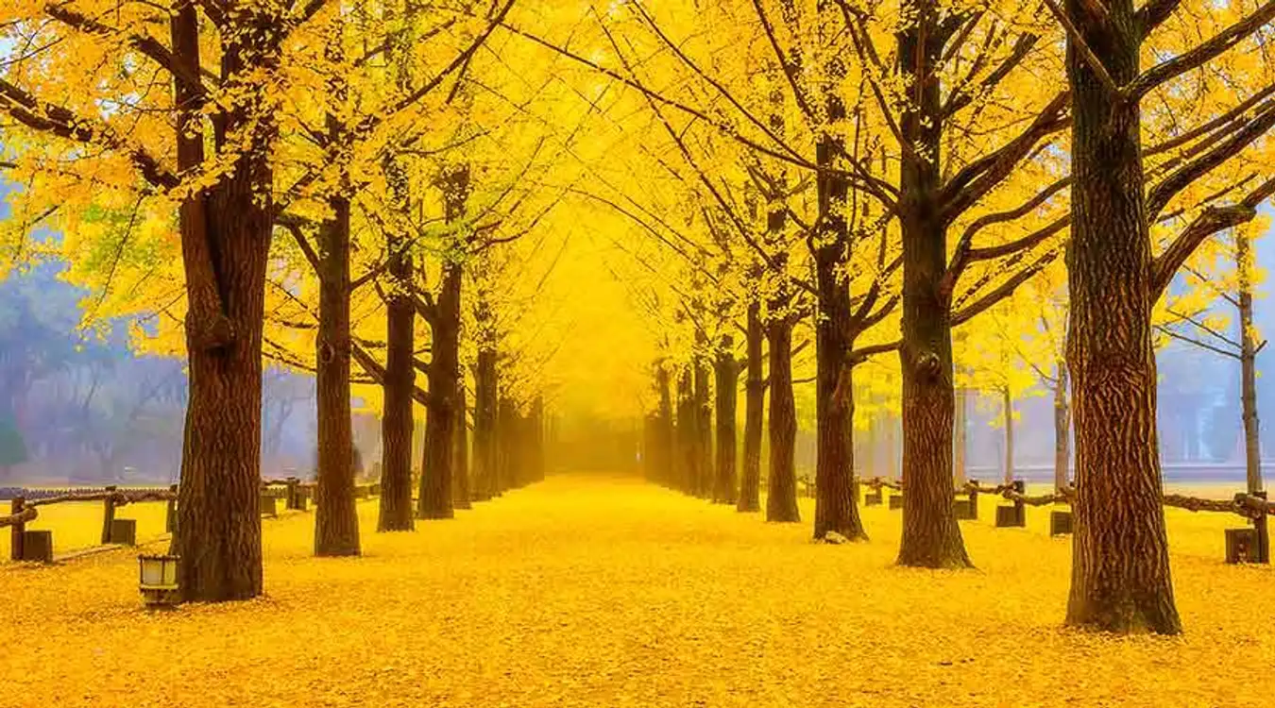
Lotte World
Namiseom Island

Slide 13
02
KOREAN FOOD
It is so delicious! It is healthy and tasty.

Slide 14
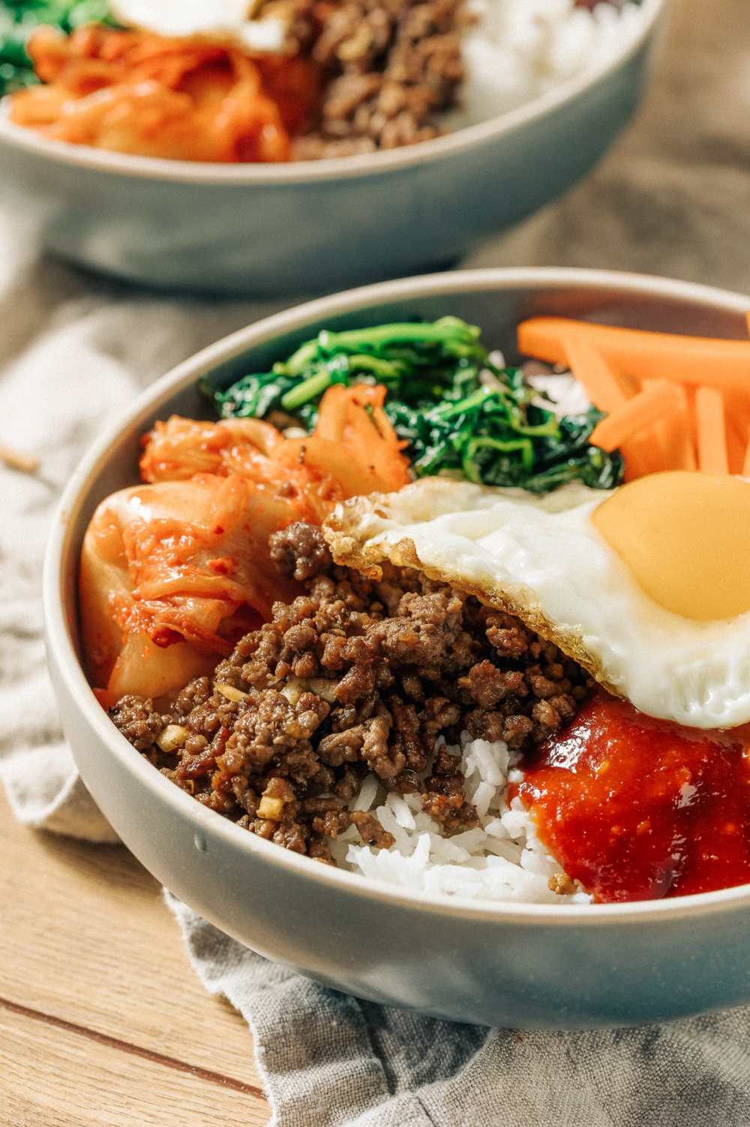
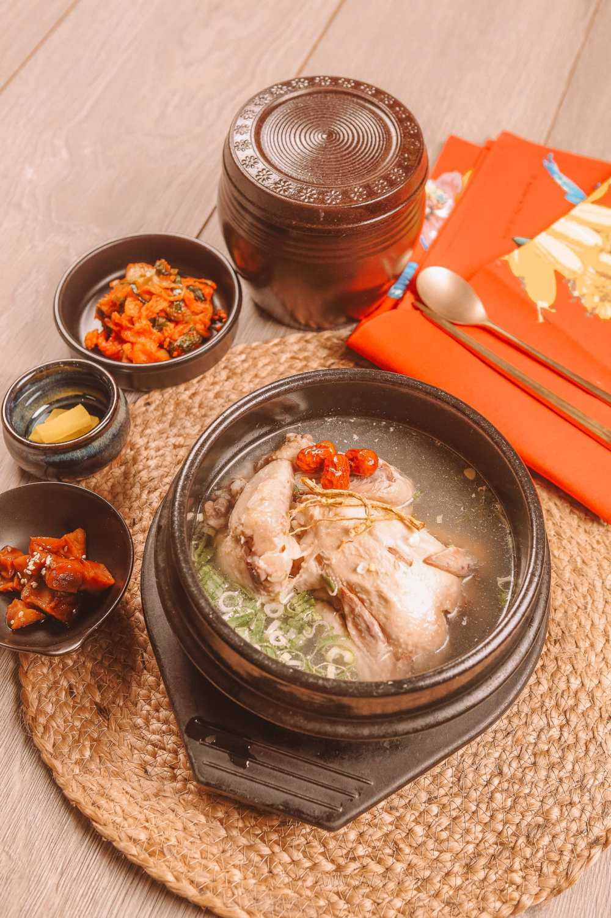
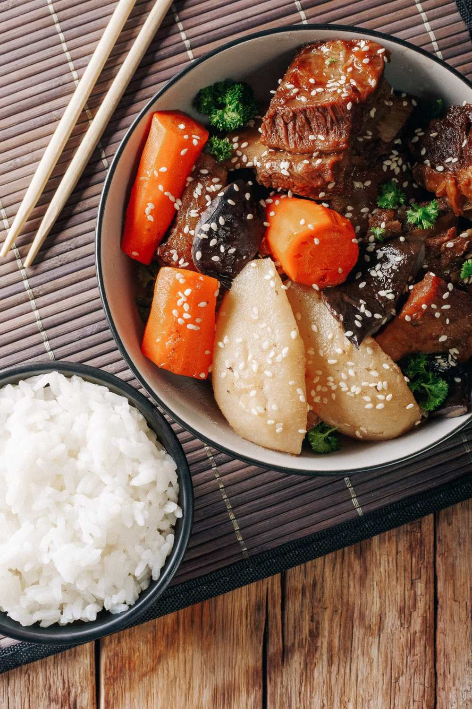
SAMGYETANG
BIBIMBAP
GALBI

Slide 15
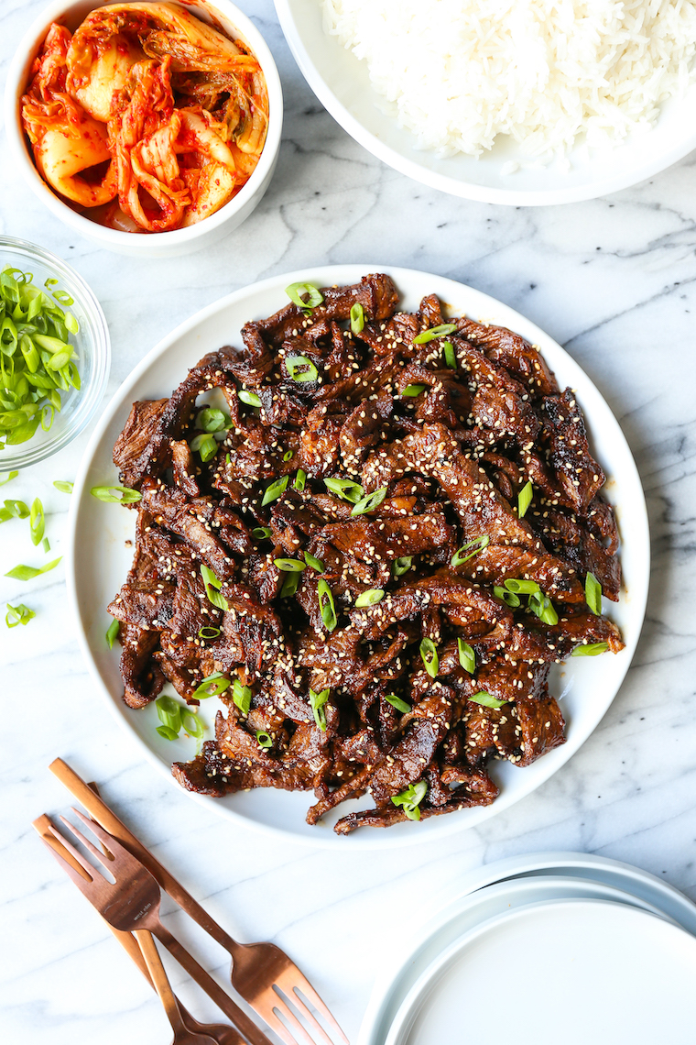
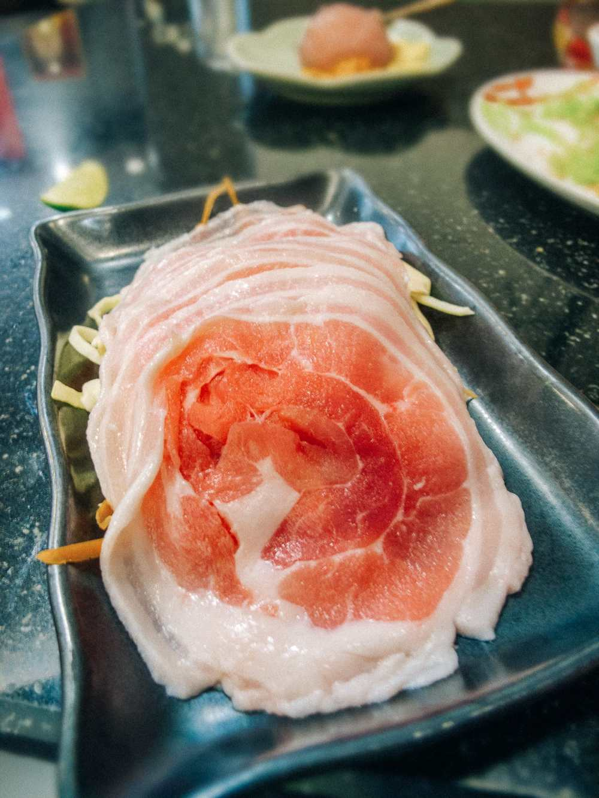
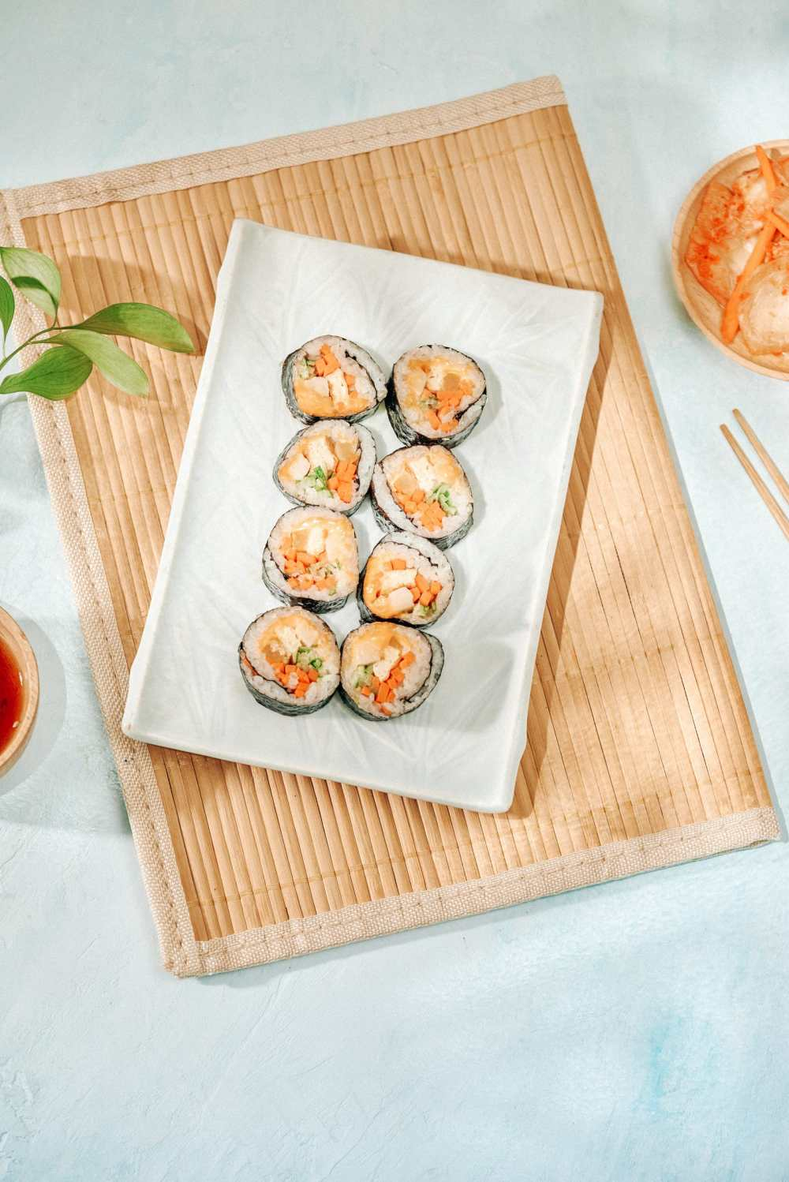
BULGOGI
SAMGYEOPSAL
GIMBAP

Slide 16
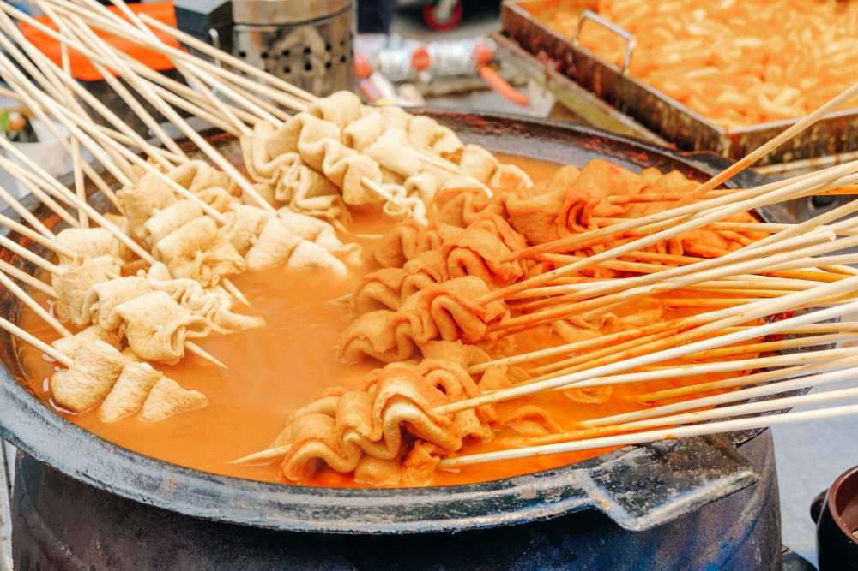
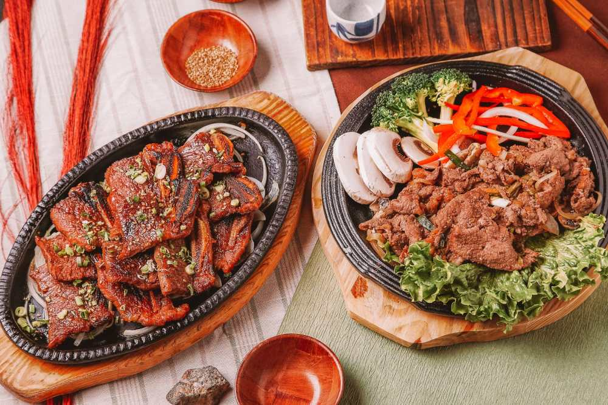
POJANGMACHA
BOSSAM

Slide 17
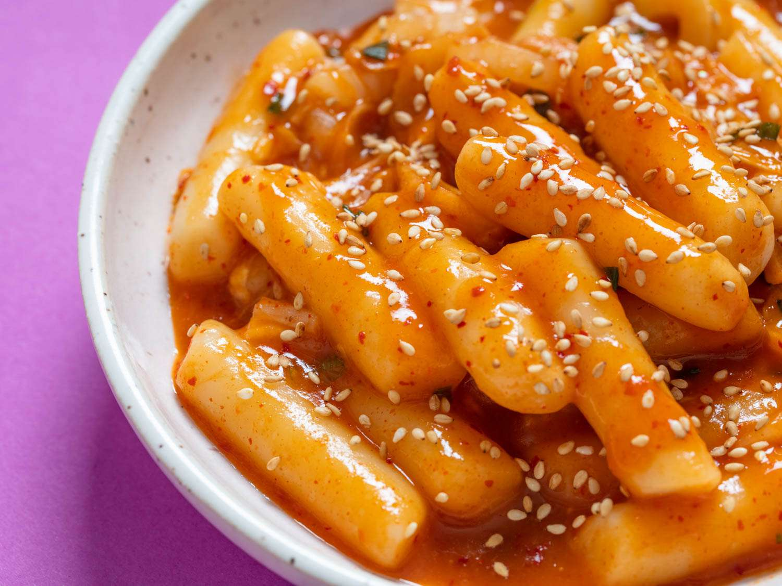
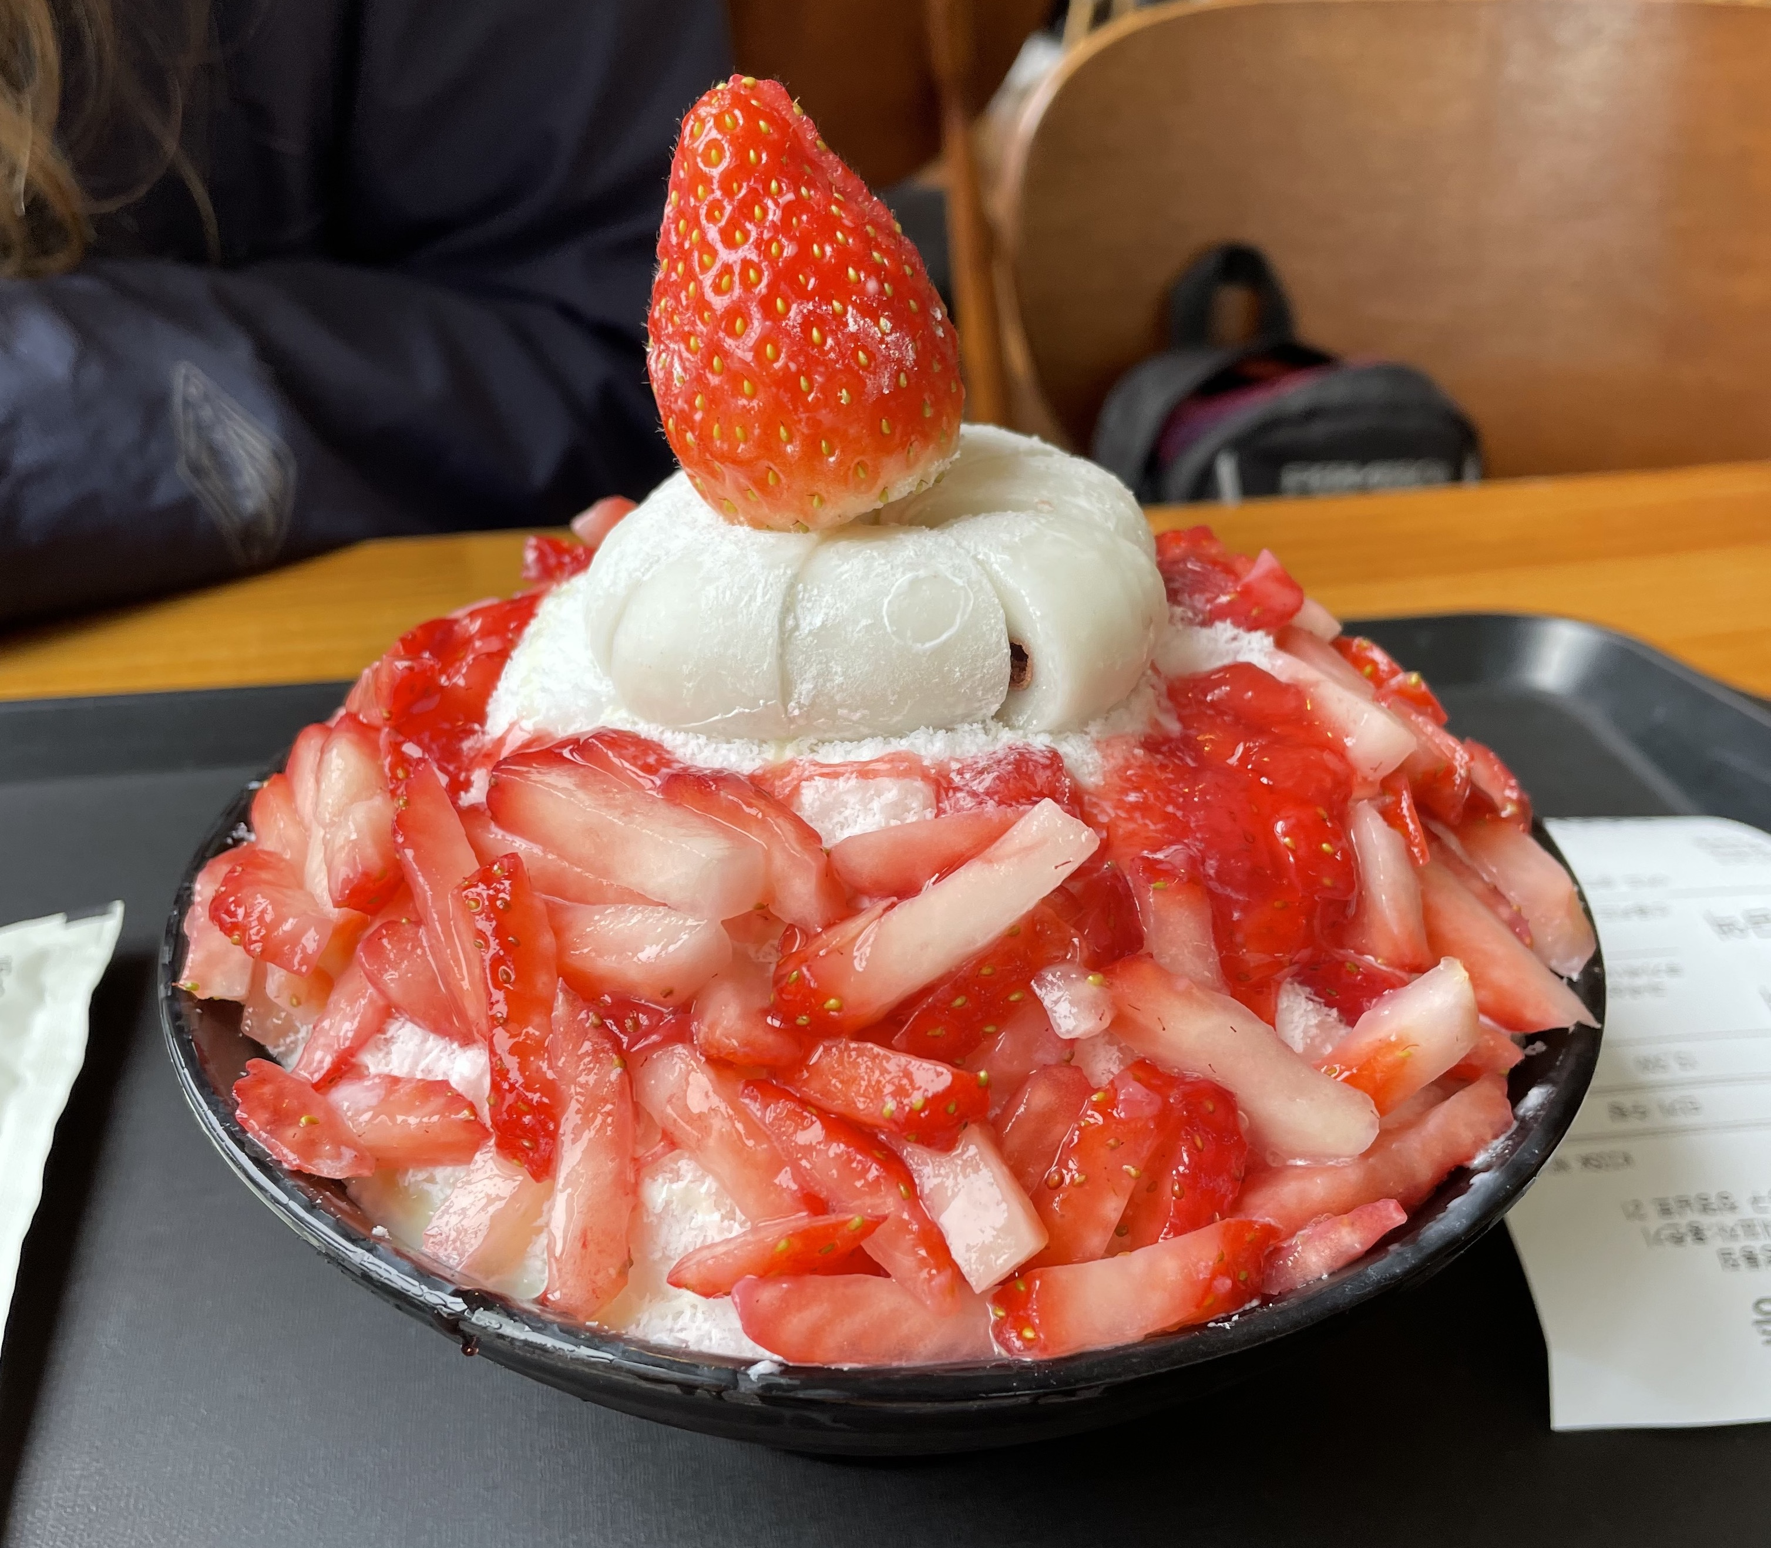
BINGSU
TTEOKBOKKI

Slide 18
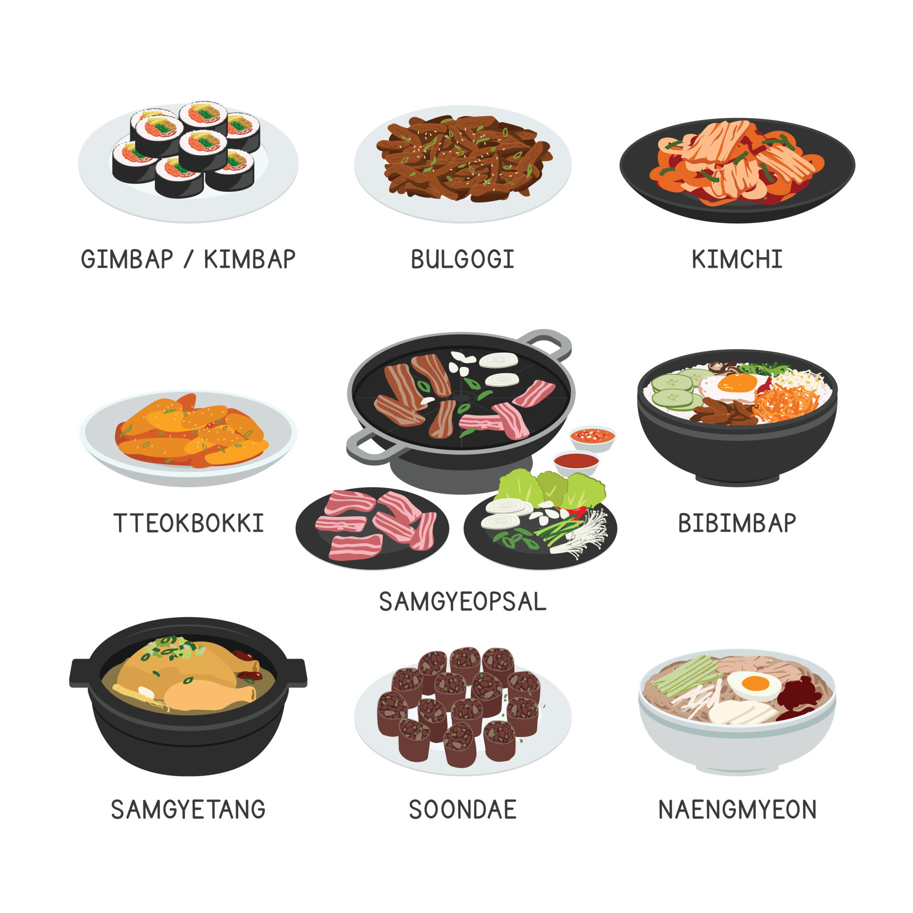
GIMBAP
KI
KI
KI
TTEOKBOKKI
SAMGYETANG
BULGOGI
SAMGYEOPSAL
KI
KI
KI
KIMCHI
BIBIMBAP
KI
KI
KI

Slide 19
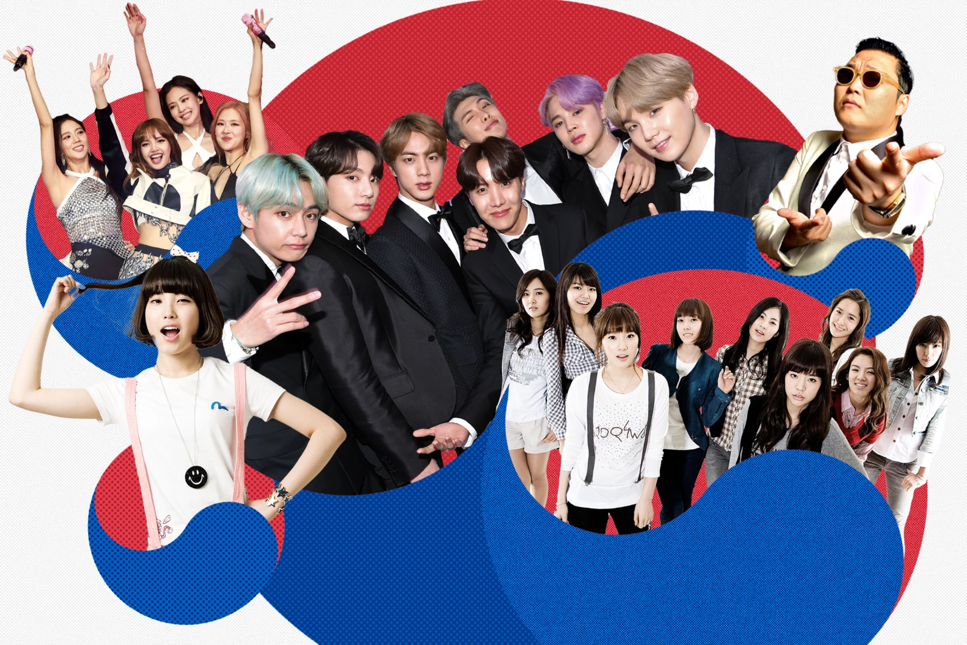
03
K-POP
Idols, Music, Dance

Slide 20
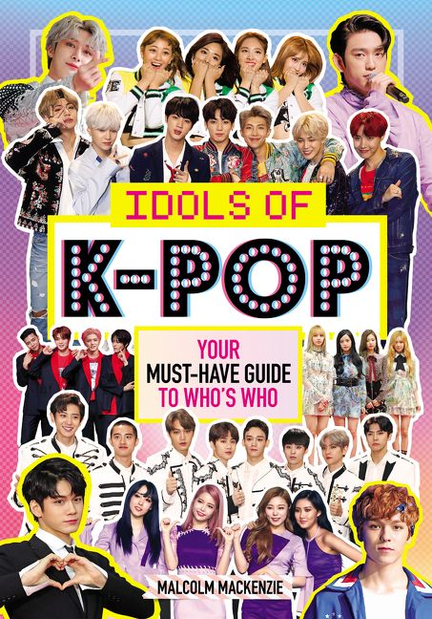

Slide 21
04
Kamsahamnida
Thank you

Slide 22
QUESTIONS
What food do you want to eat in South Korea?
What places you want to visit in South Korea?
How many colors are in South Korea’s flag?
I want to visit South Korea because ____________?

