Slide 1

Guess the Flag
Japan

Slide 2
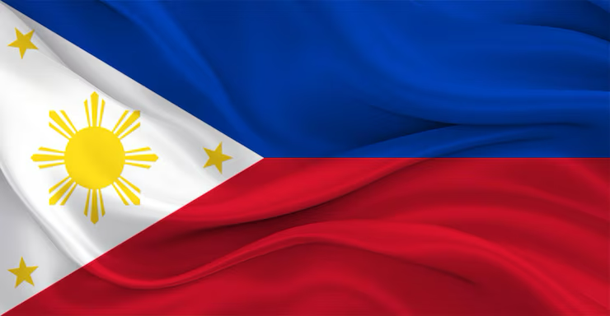
Philippines

Slide 3

USA

Slide 4

the UK

Slide 5
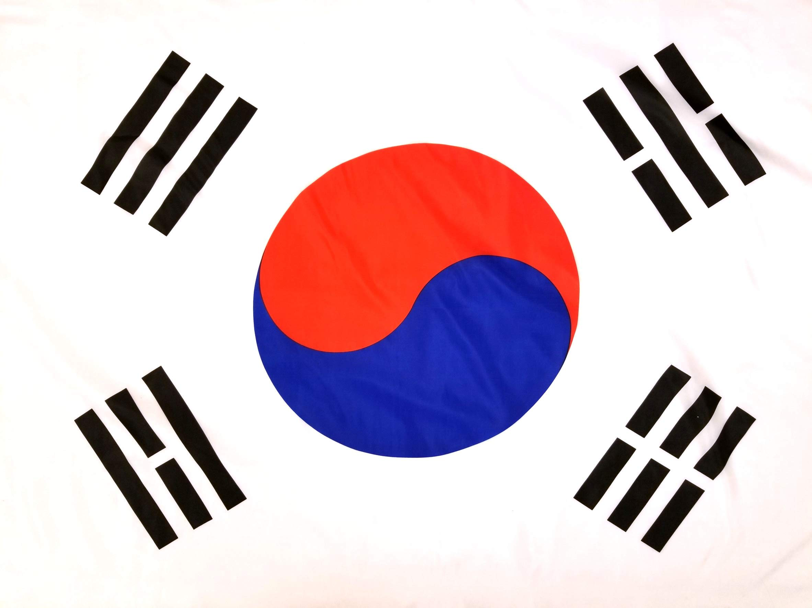
South Korea

Slide 6
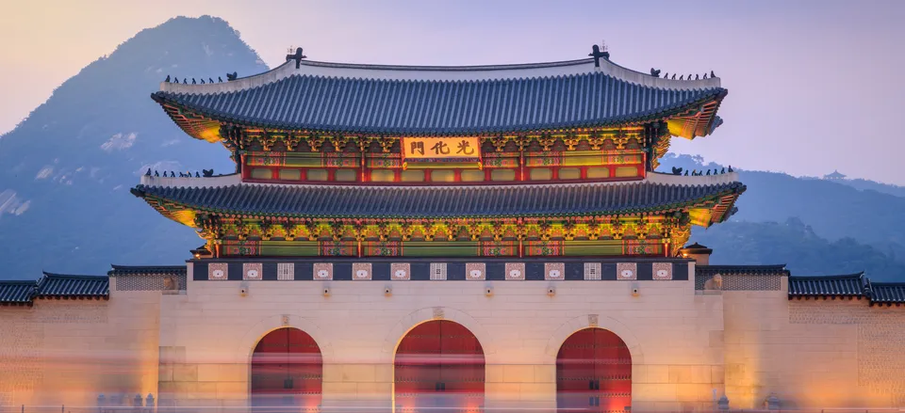
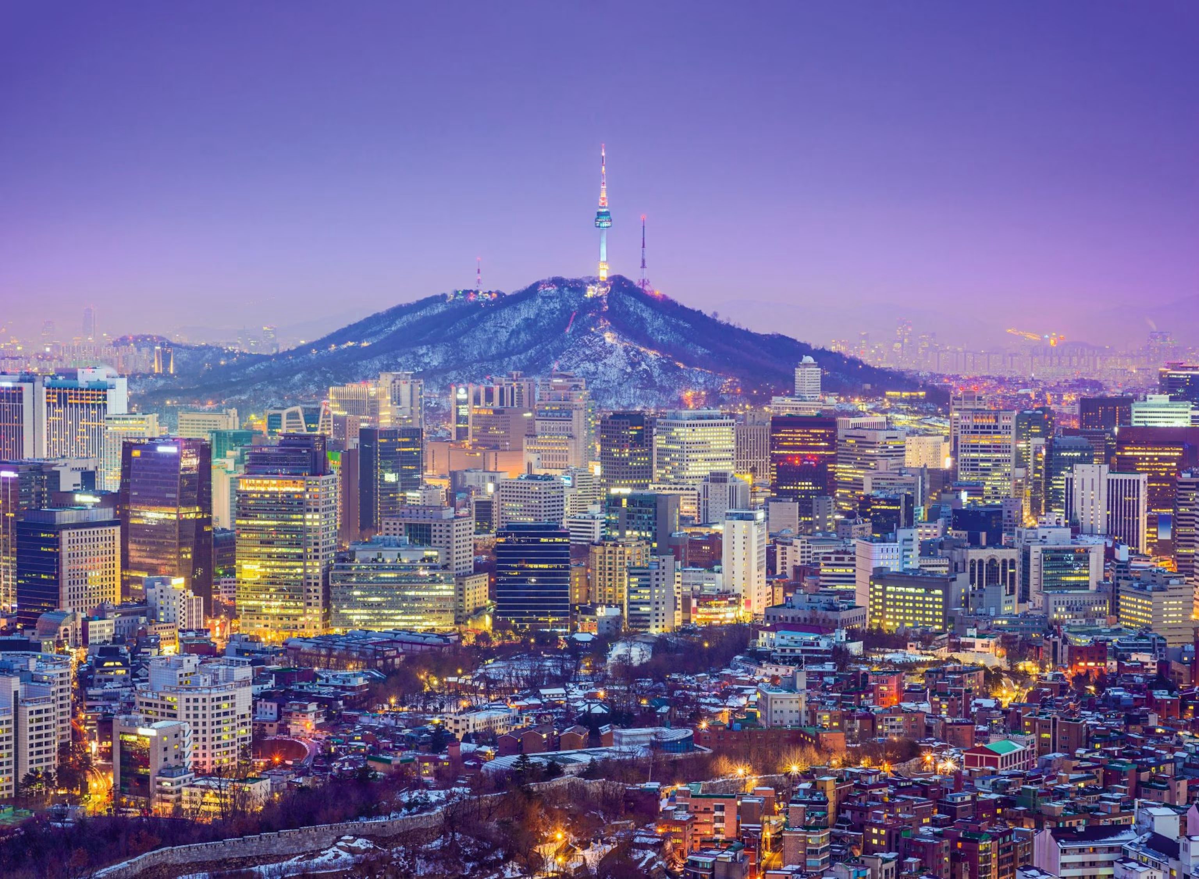
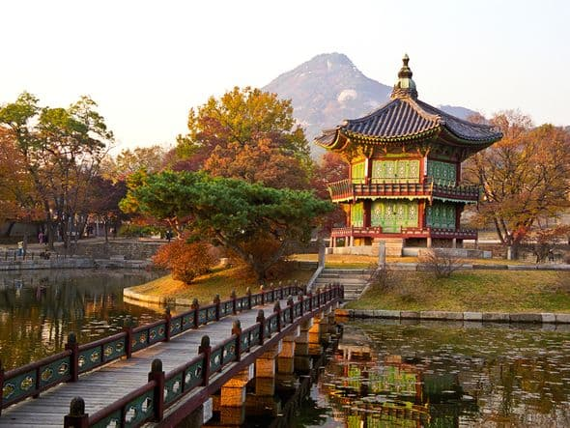
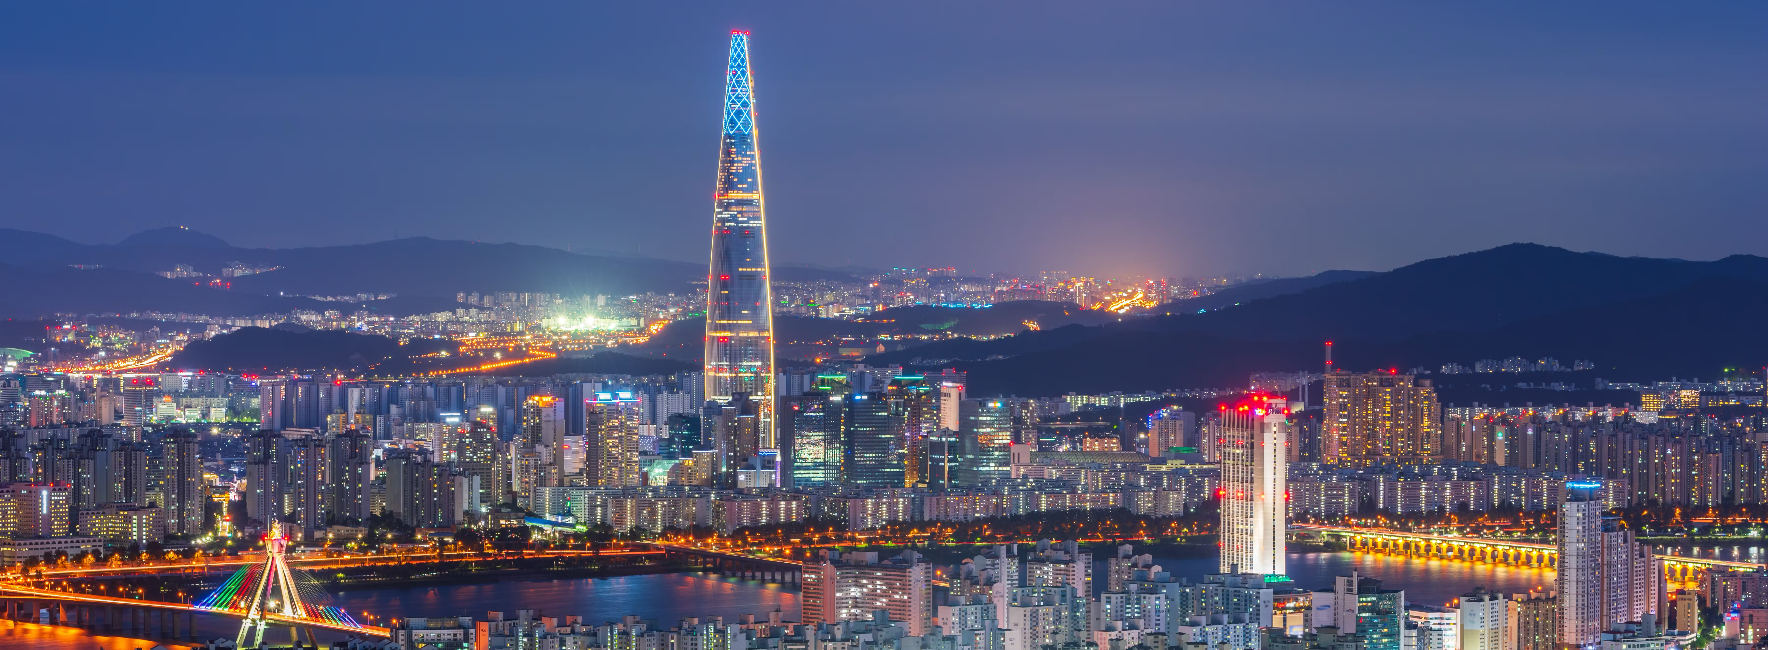
DO YOU KNOW WHERE IS THIS?

Slide 7
We are going to… SOUTH KOREA
Where are we going?

Slide 8
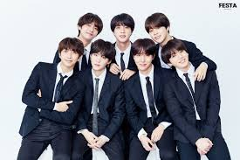

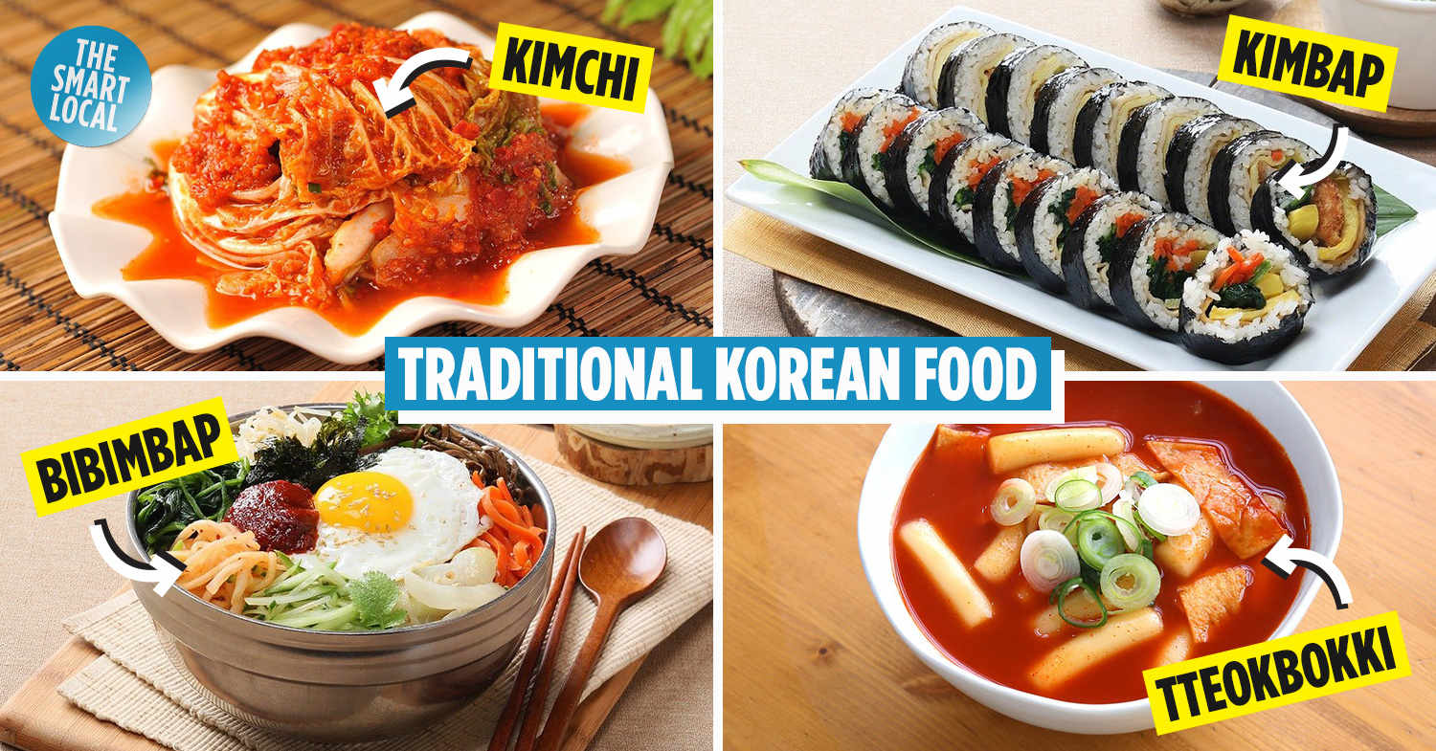
What do you know about South Korea?

Slide 9
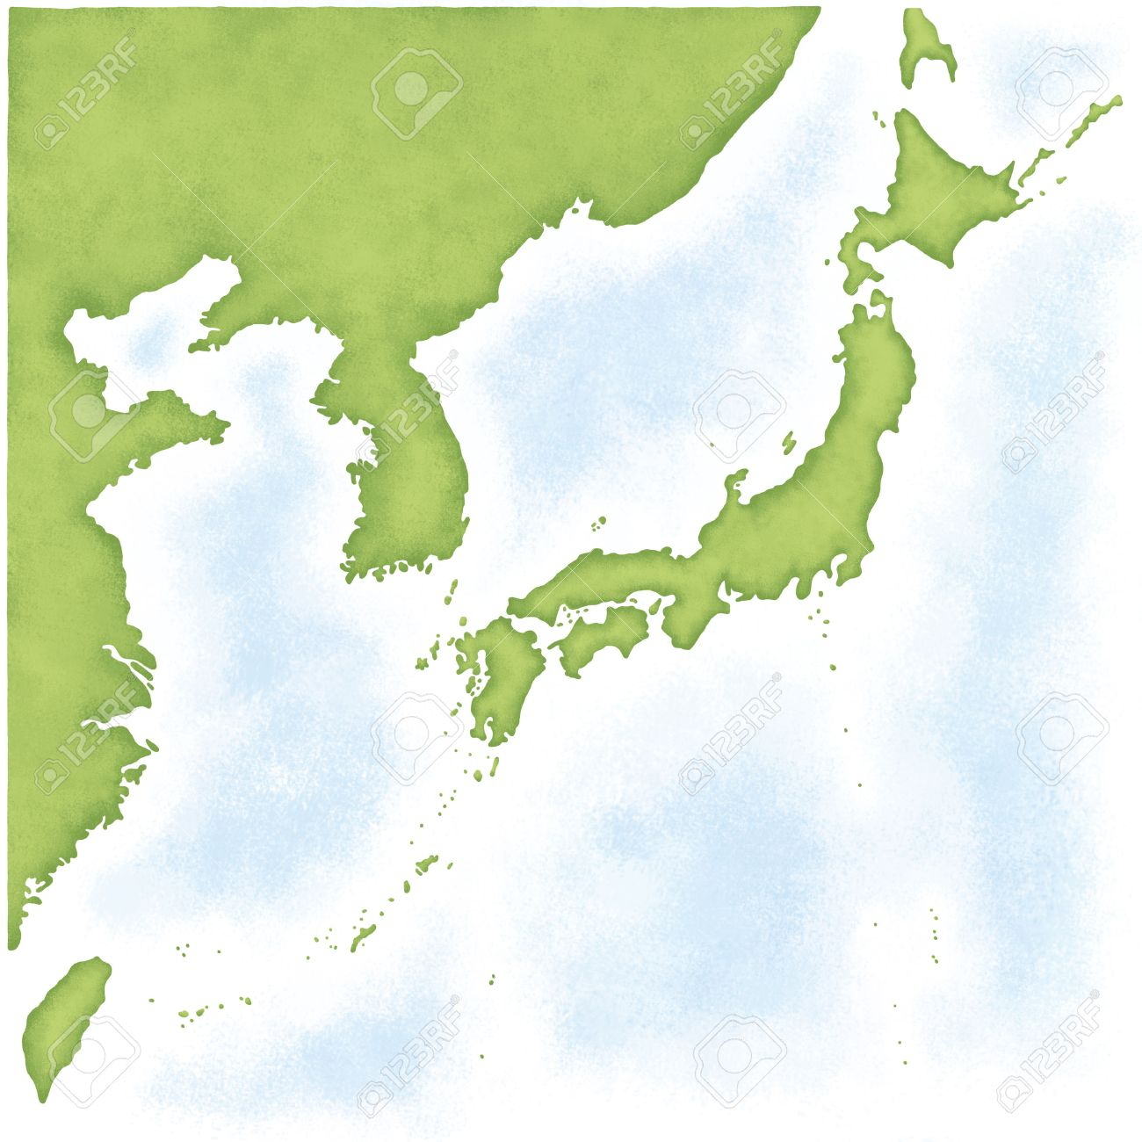
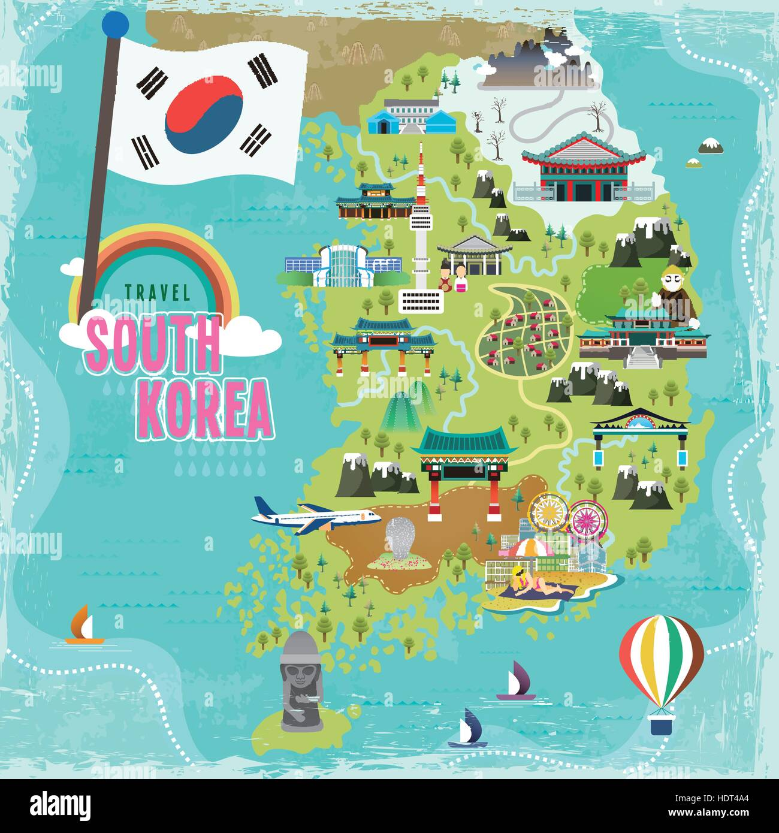
NORTH
KOREA
SOUTH
KOREA
JAPAN
TAIWAN

Slide 10
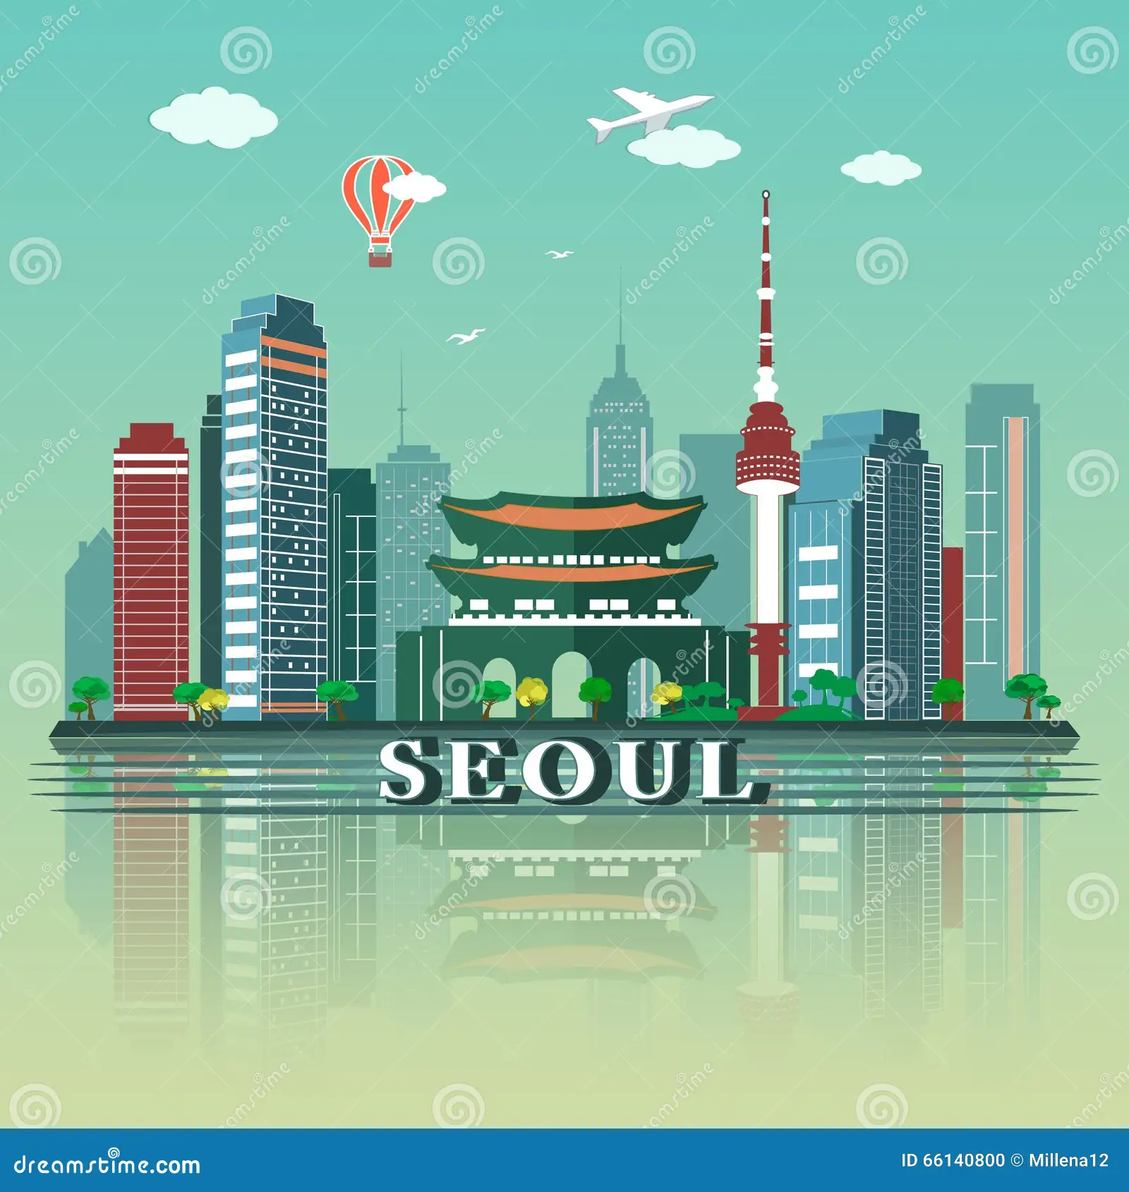


SOUTH KOREA
01
02
03
04
05
NATIONAL LANGUANGE
SEOUL CITY
FLAG
HANGUL

Slide 11
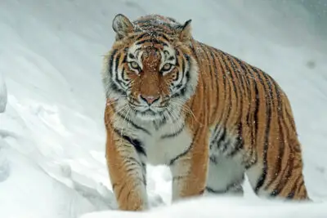
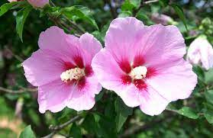
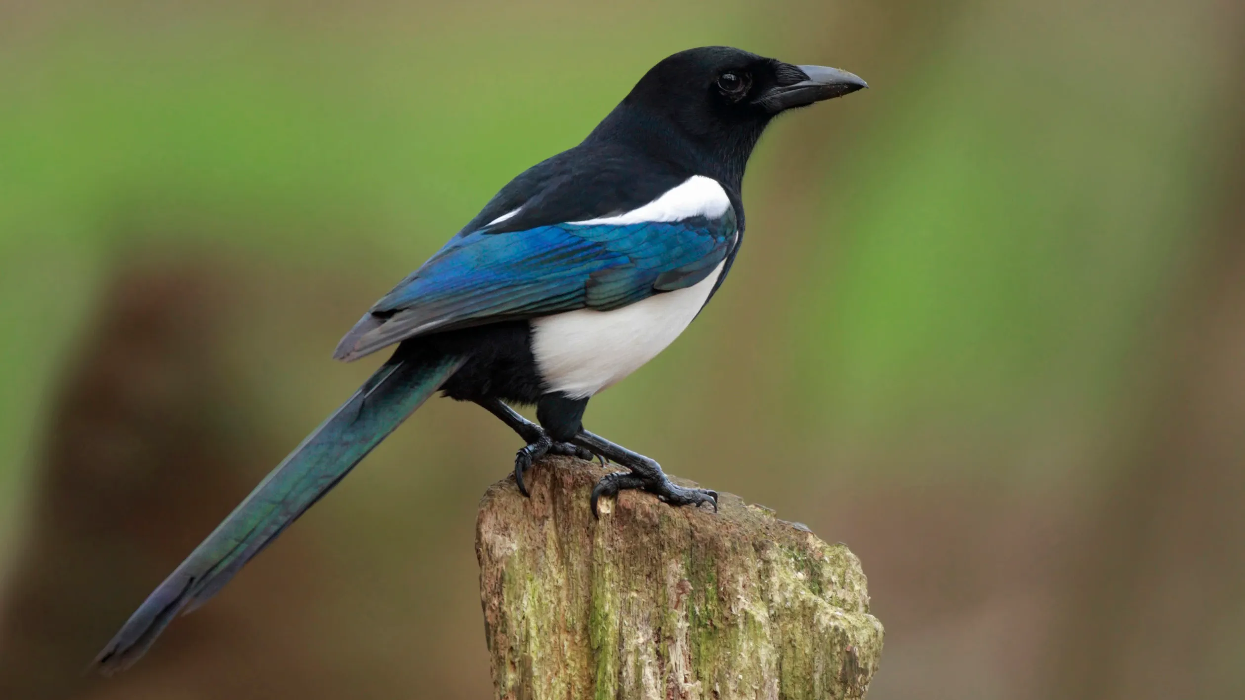
SOUTH KOREA
04
05
06
04
05
NATIONAL ANIMAL
NATIONAL FLOWER
NATIONAL BIRD
SIBERIAN TIGER
HIBISCUS
MAGPIE

Slide 12
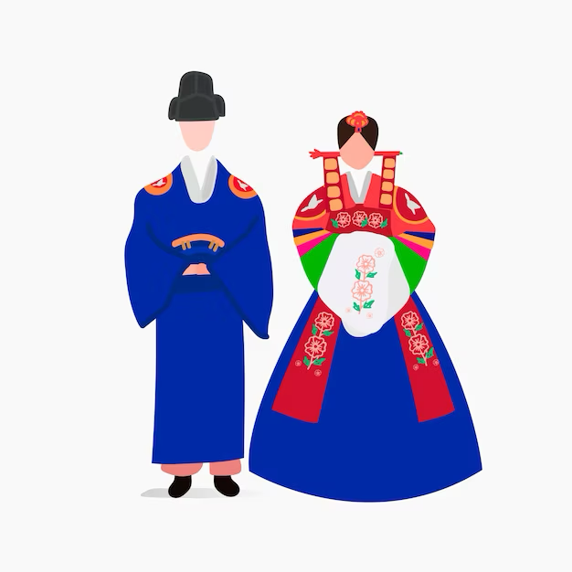
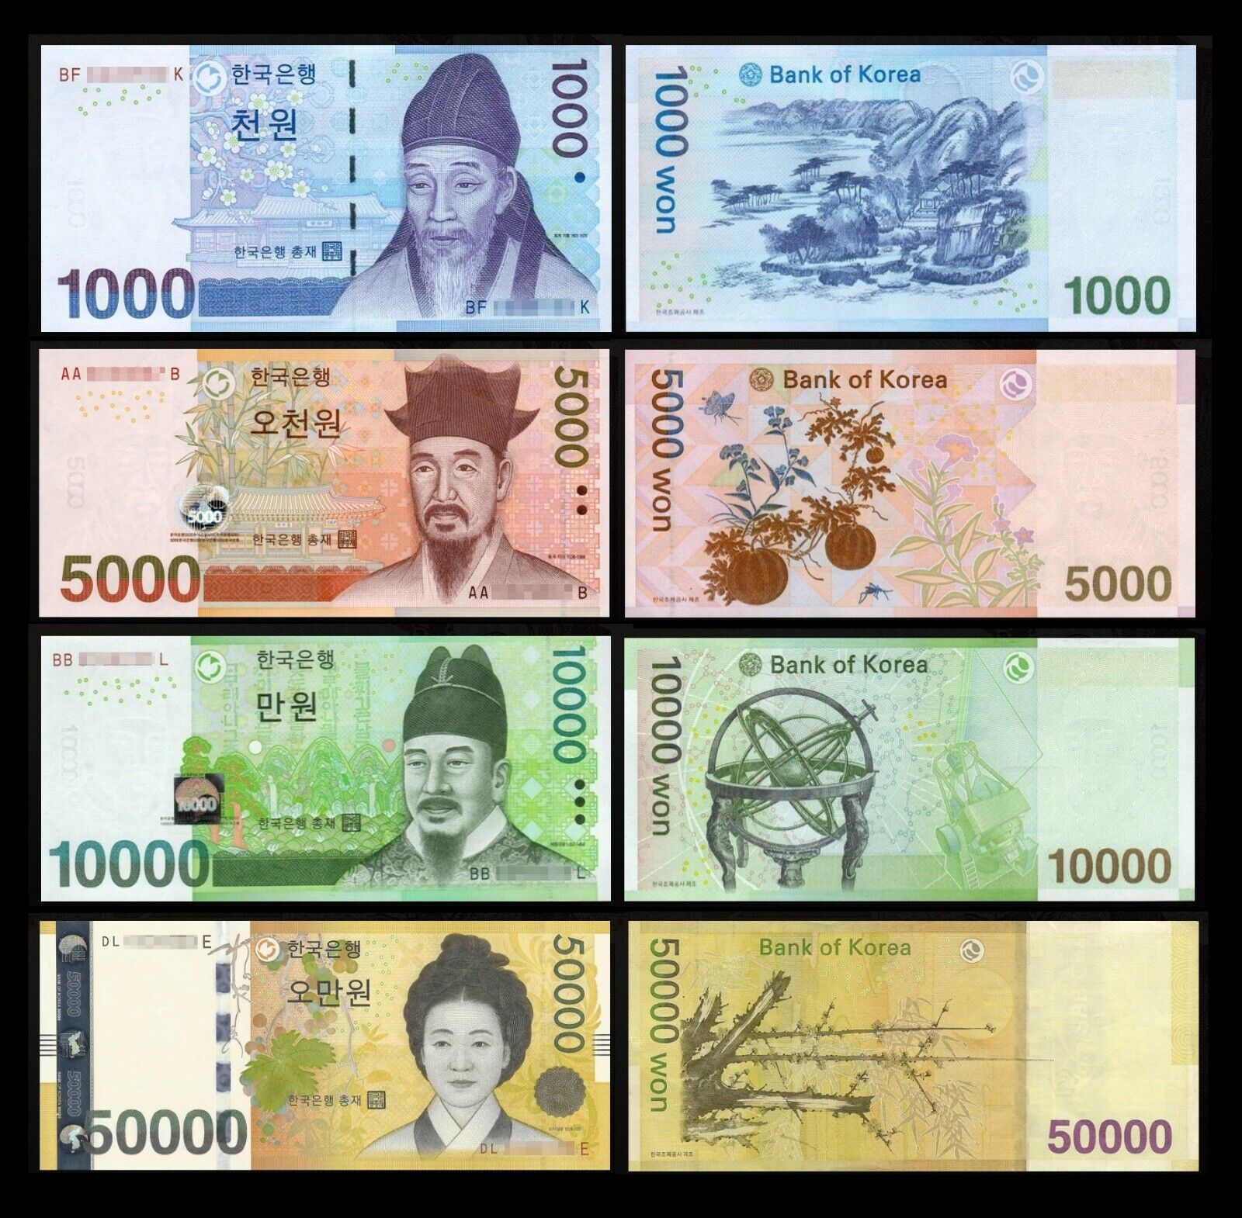
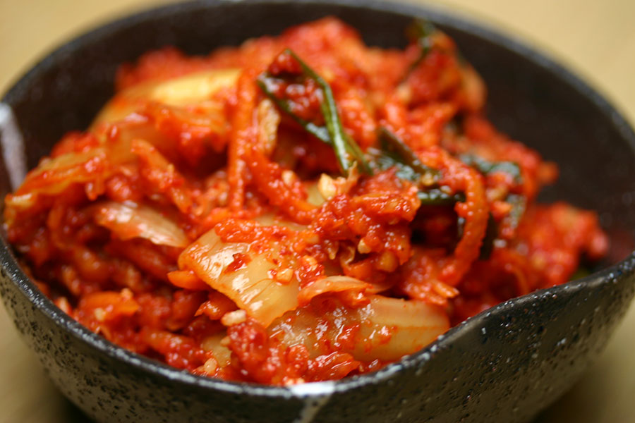
SOUTH KOREA
07
08
09
05
NATIONAL DRESS
NATIONAL FOOD
MONEY
HANBUK
KIMCHI

Slide 13
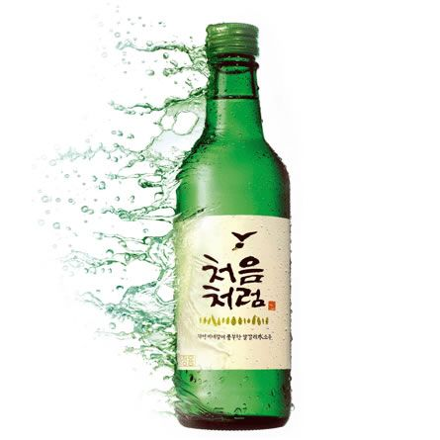
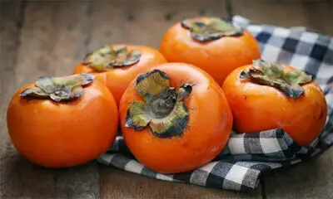
SOUTH KOREA
10
11
03
05
NATIONAL DRINK
NATIONAL FRUIT
PERSIMMON
SOJU

Slide 14
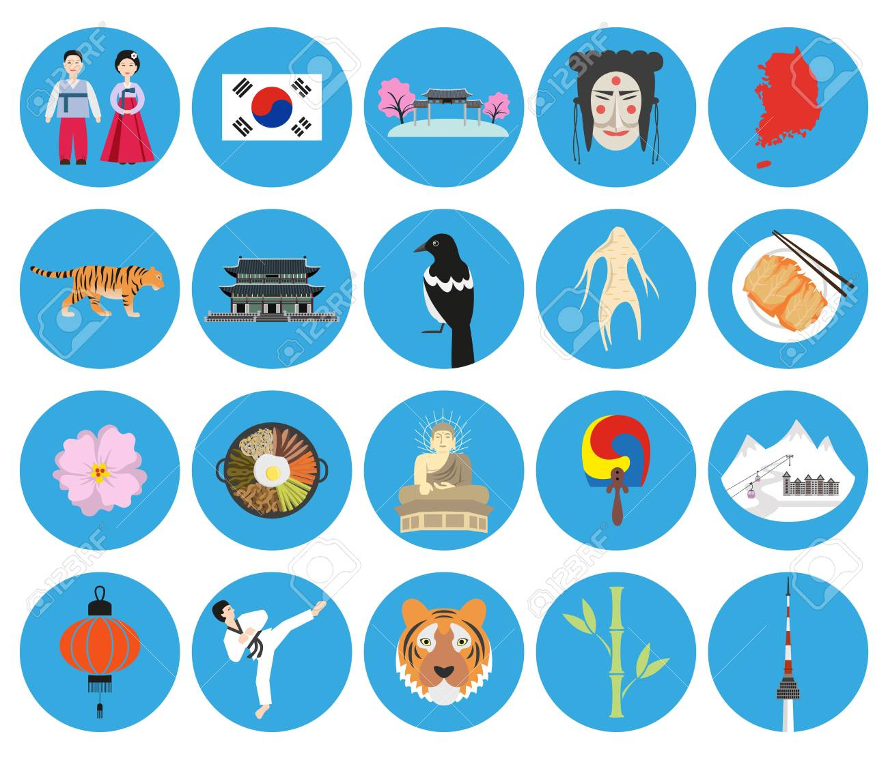
WHERE IS THE MAP OF SOUTH KOREA?
WHAT IS THE NATIONAL FOOD OF SOUTH KOREA?
WHERE IS THE NATIONAL FLOWER OF SOUTH KOREA?
WHERE IS THE HANBUK?
WHAT IS THE NATIONAL ANIMAL OF SOUTH KOREA?
WHAT IS THE FLAG OF SOUTH KOREA?
WHAT IS THE NATIONAL BIRD OF SOUTH KOREA?
WHAT IS THE NATIONAL SPORT OF SOUTH KOREA?

Slide 15
01
AWESOME PLACES
Come visit South Korea… Travel and Explore

Slide 16
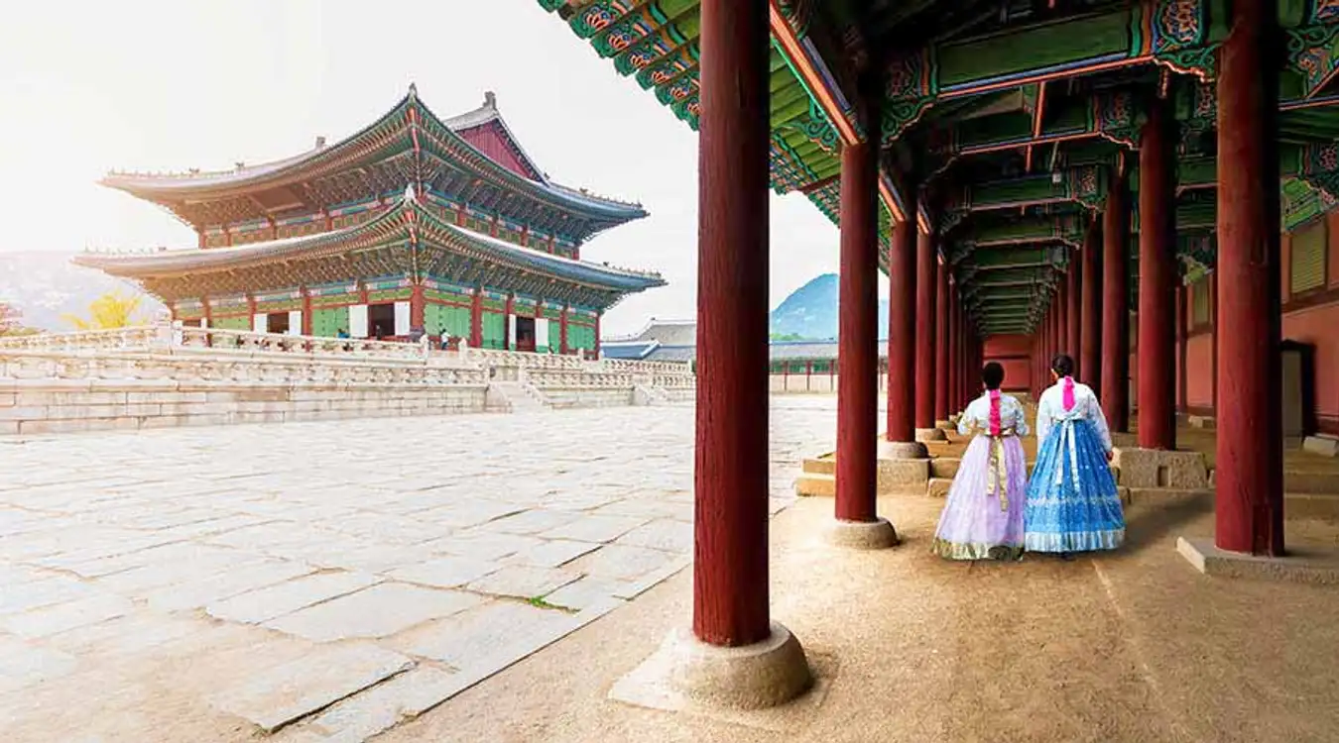
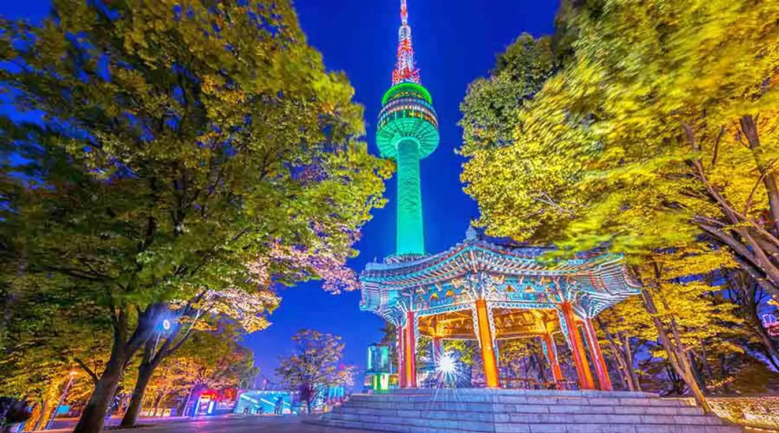
Gyeongbokgung Palace
N Seoul Tower

Slide 17
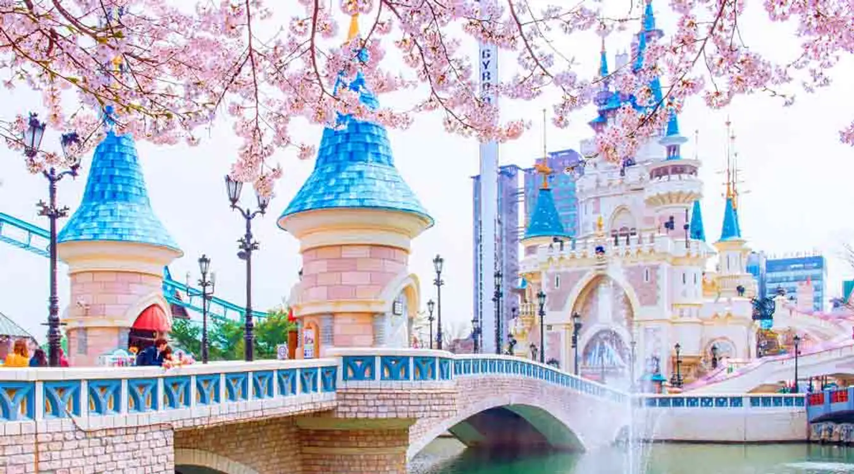
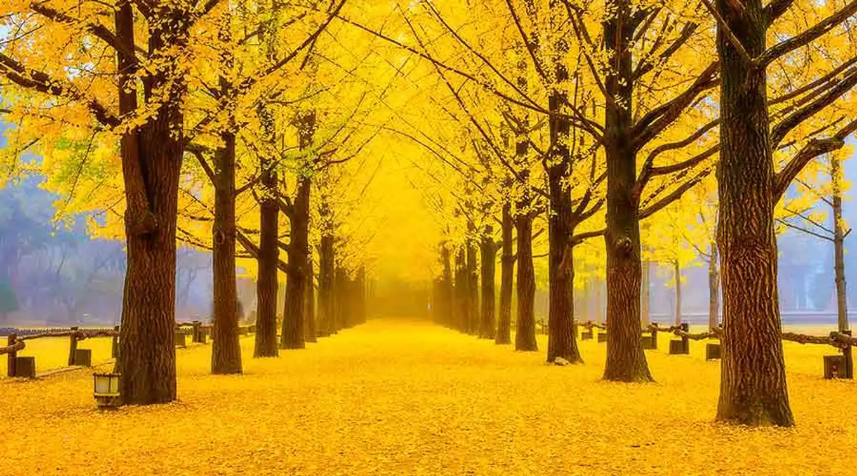
Lotte World
Namiseom Island

Slide 18
02
KOREAN FOOD
It is so delicious! It is healthy and tasty.

Slide 19
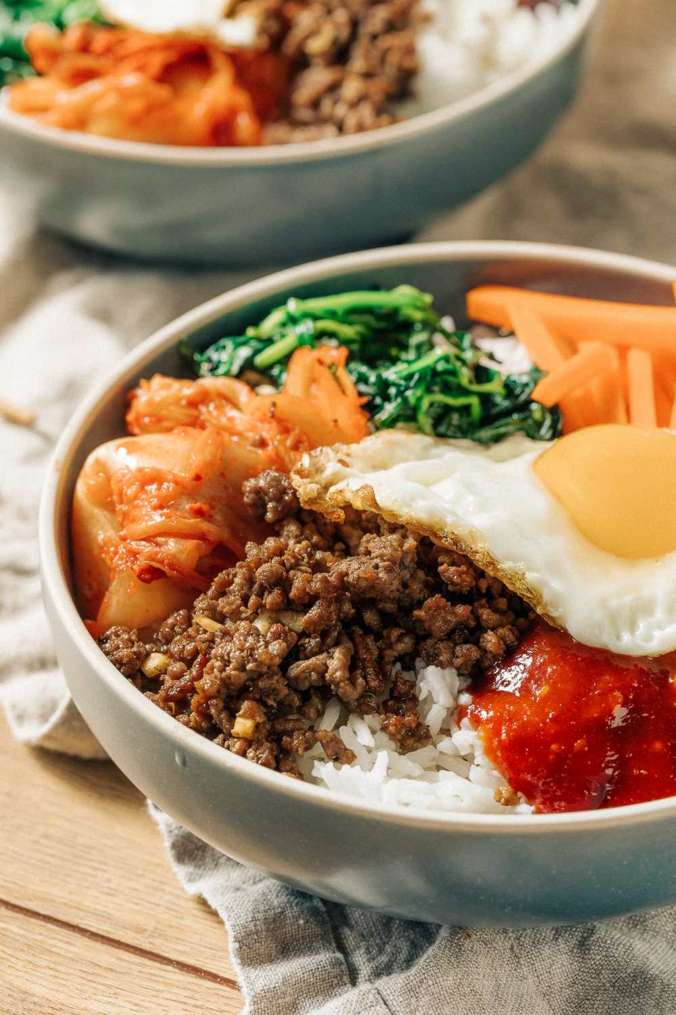
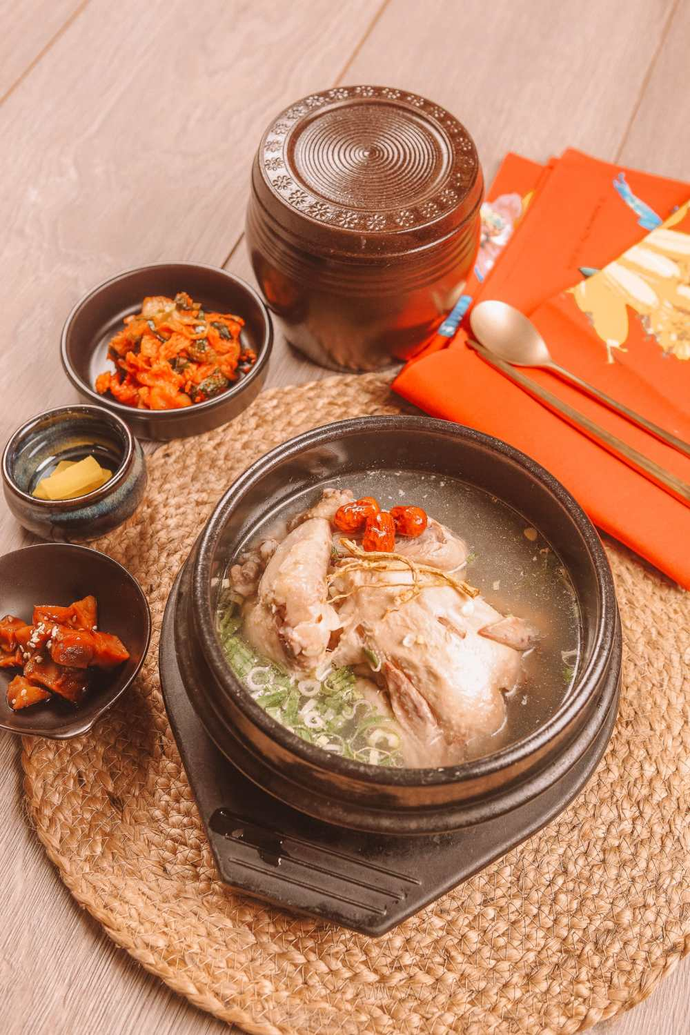
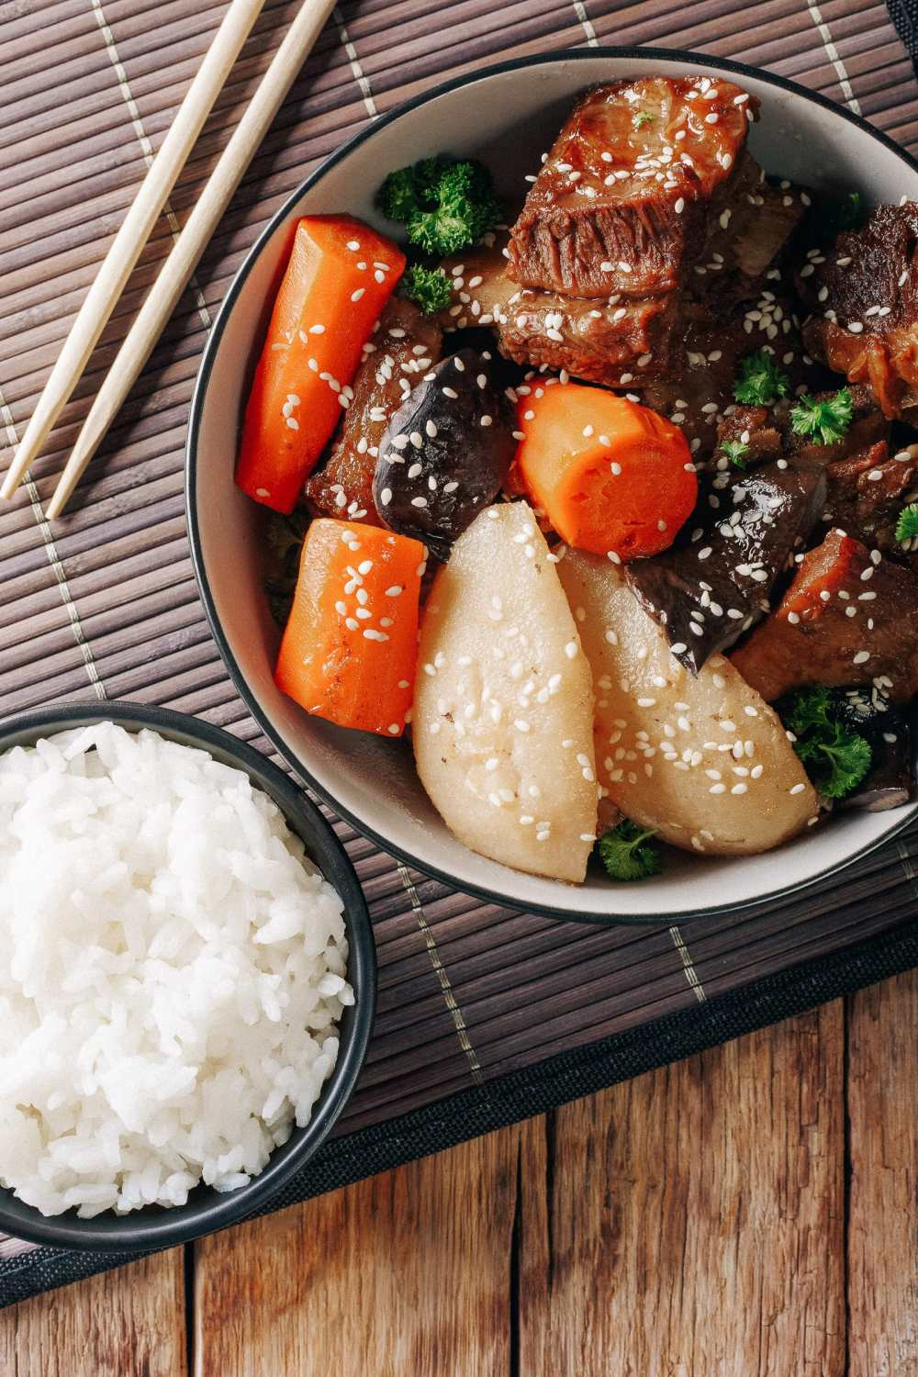
SAMGYETANG
BIBIMBAP
GALBI

Slide 20
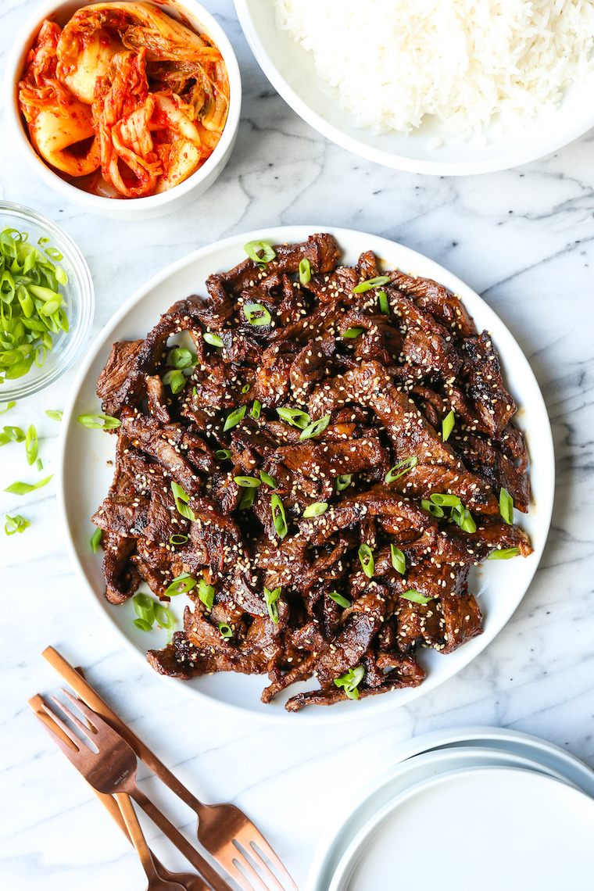
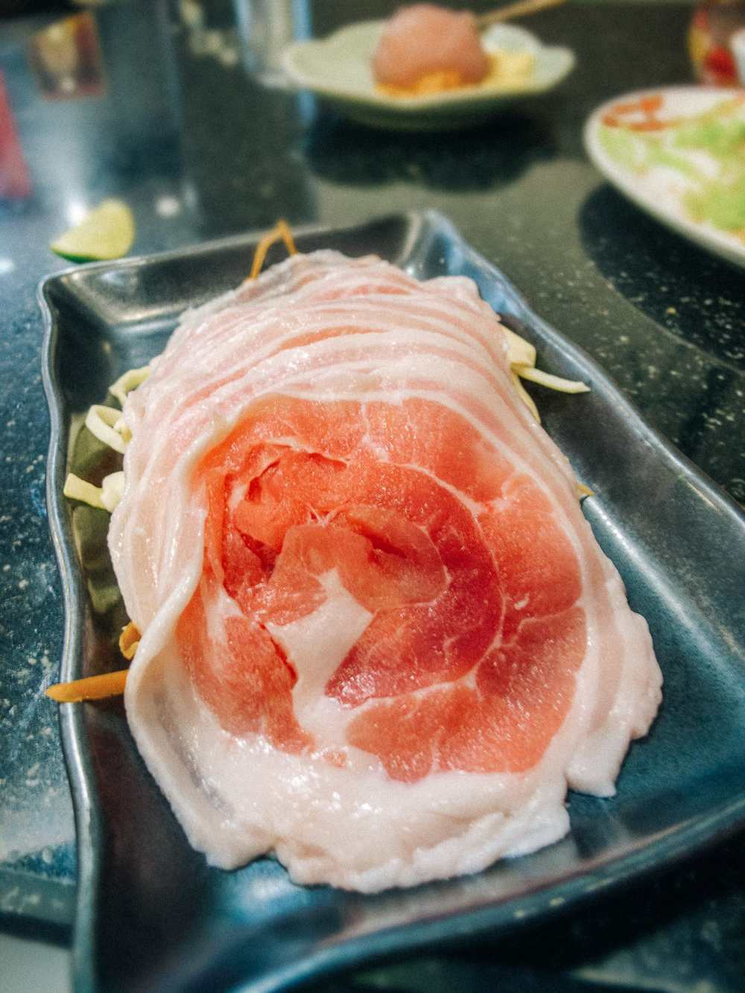
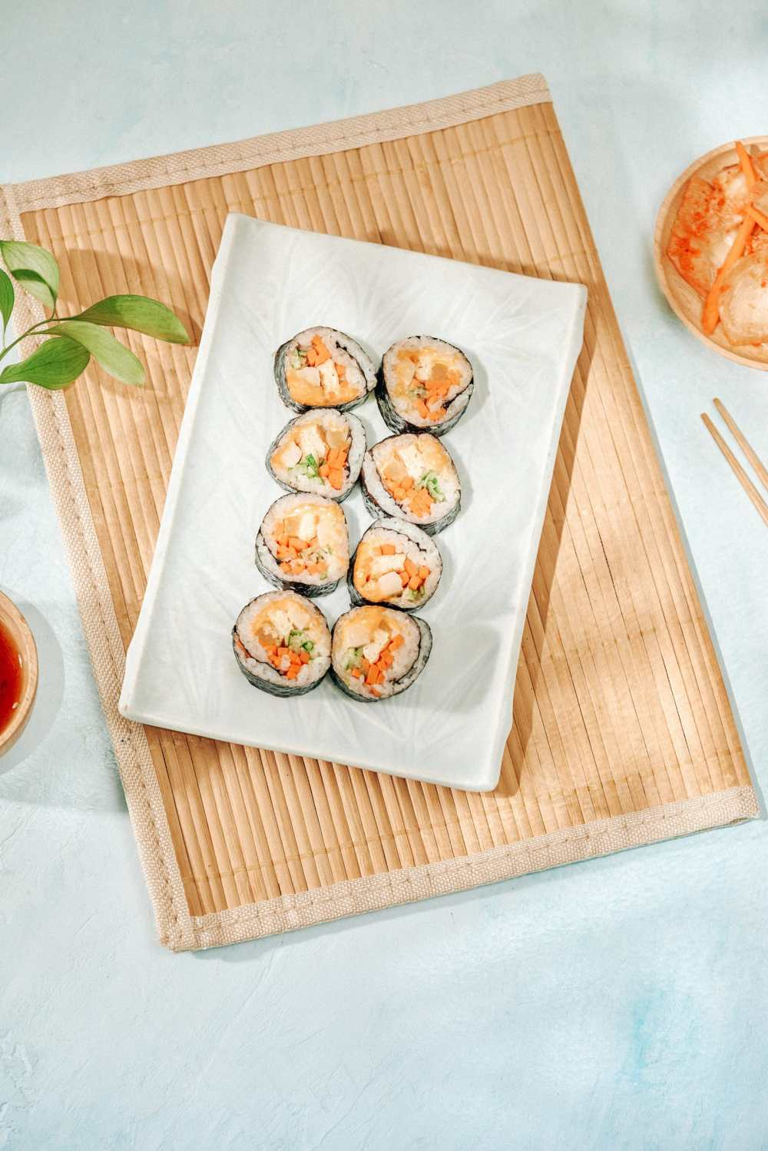
BULGOGI
SAMGYEOPSAL
GIMBAP

Slide 21
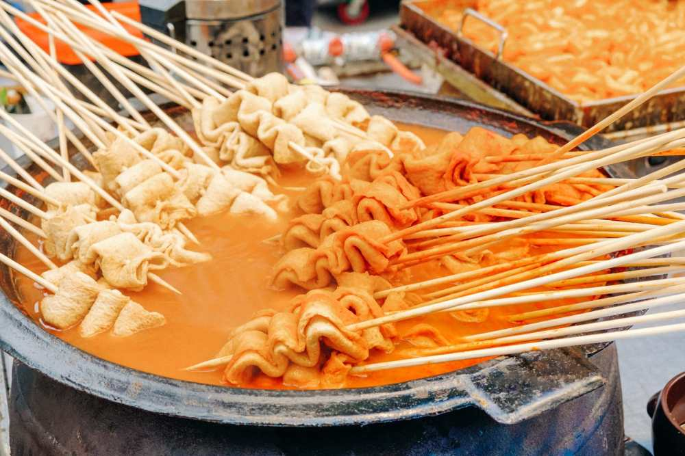
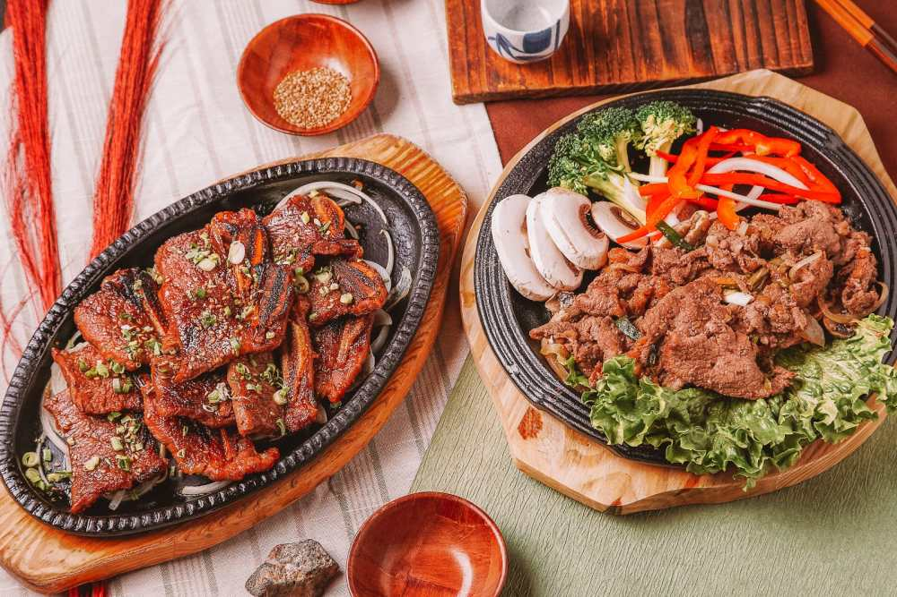
POJANGMACHA
BOSSAM

Slide 22
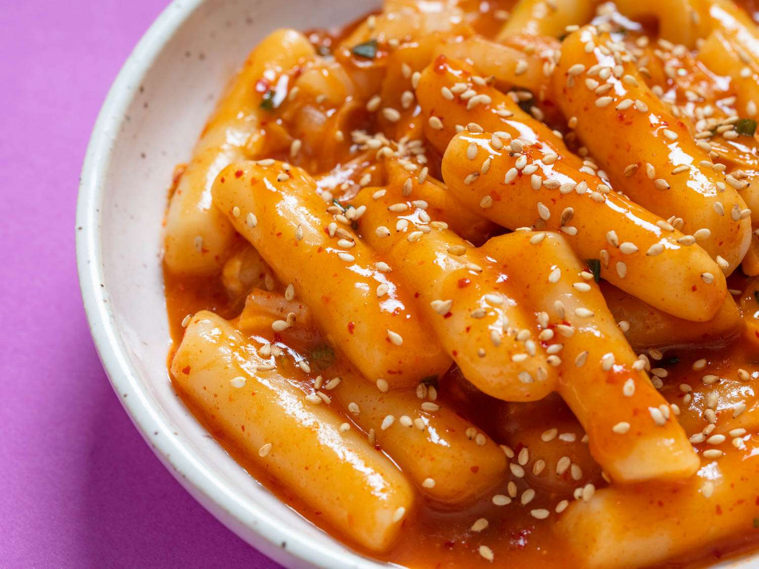
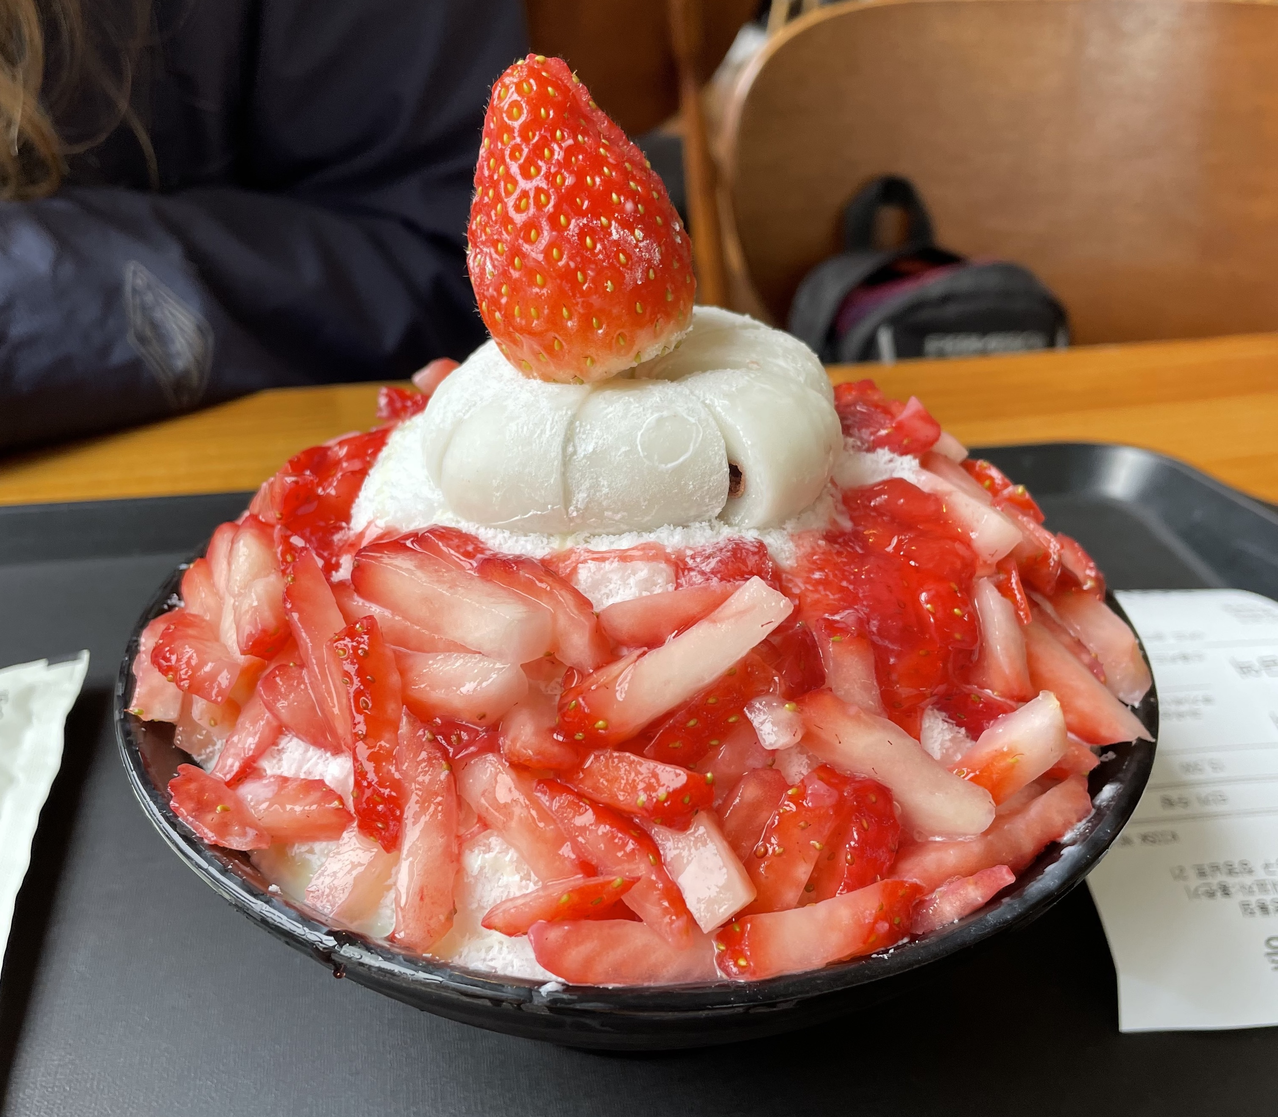
BINGSU
TTEOKBOKKI

Slide 23
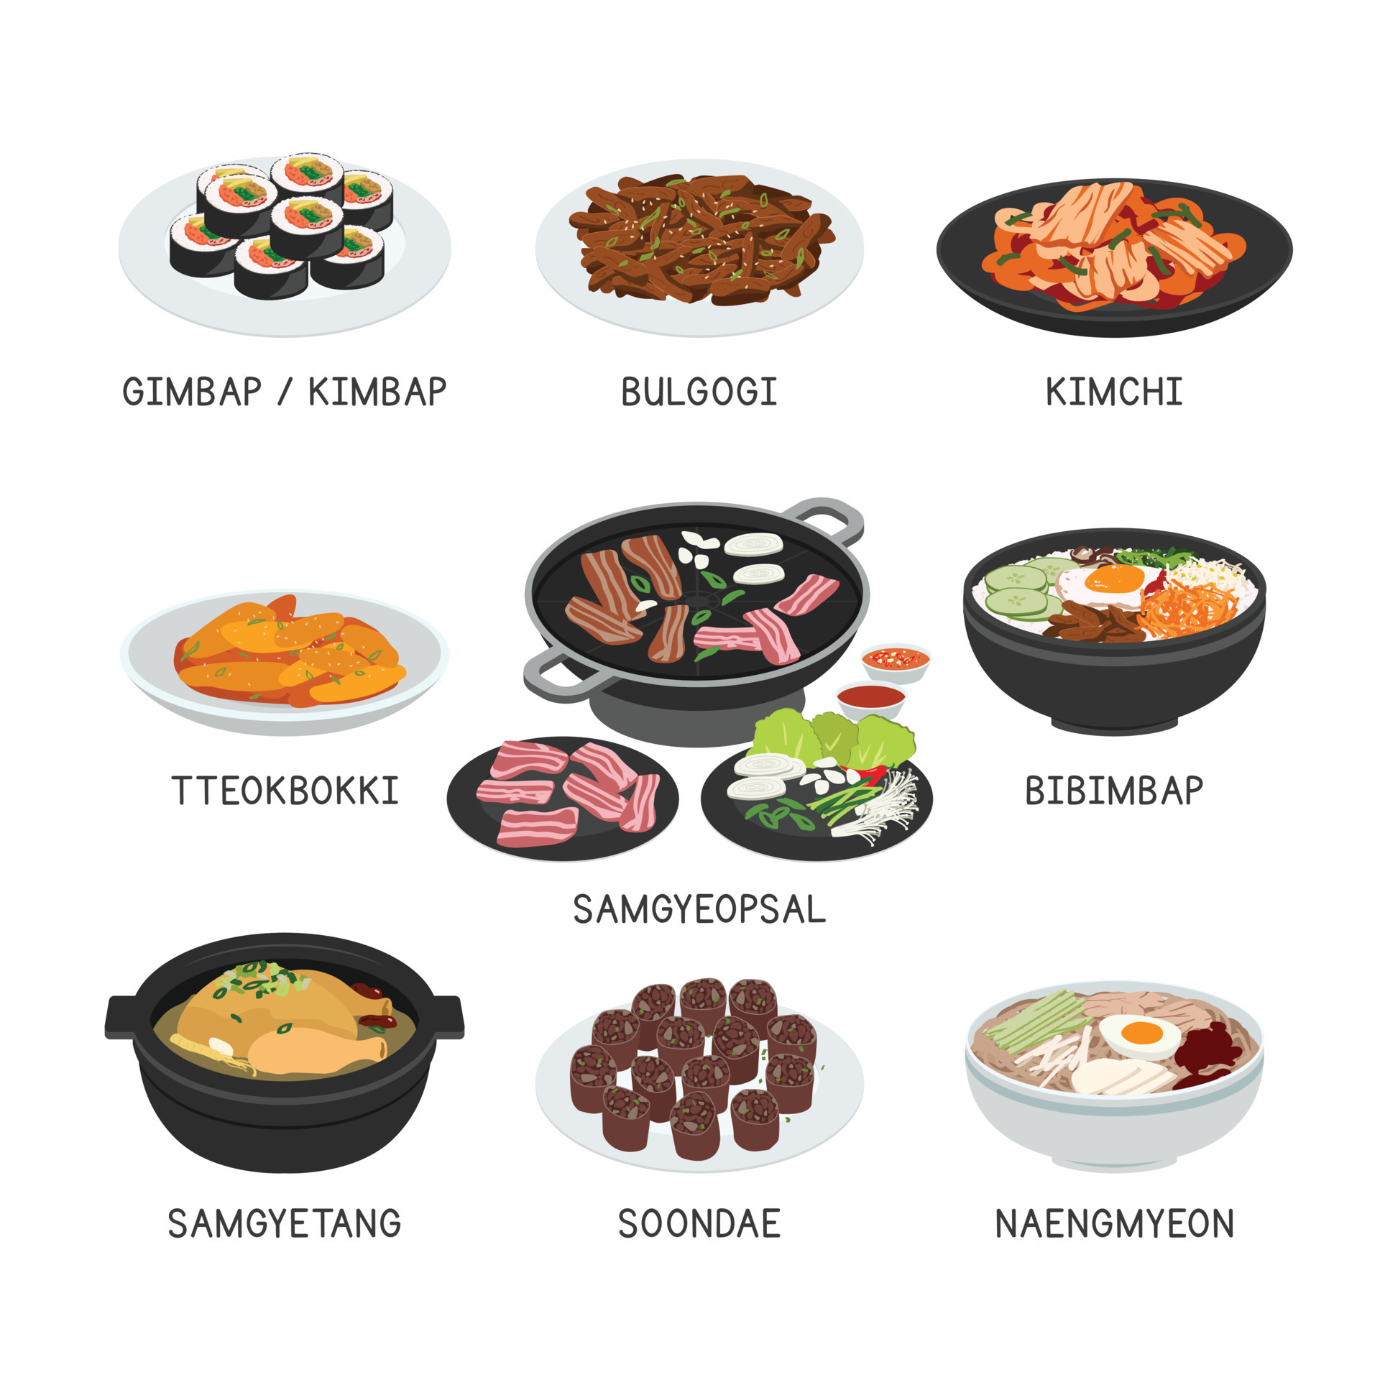
GIMBAP
KI
KI
KI
TTEOKBOKKI
SAMGYETANG
BULGOGI
SAMGYEOPSAL
KI
KI
KI
KIMCHI
BIBIMBAP
KI
KI
KI

Slide 24
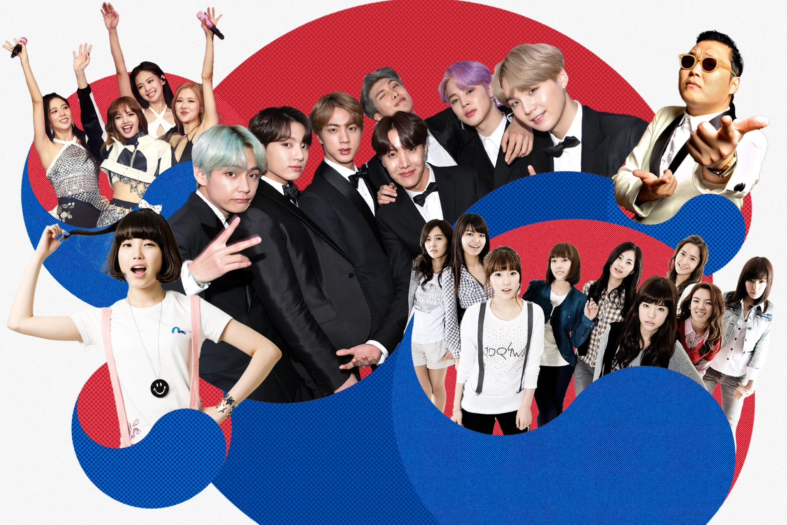
03
K-POP
Idols, Music, Dance

Slide 25

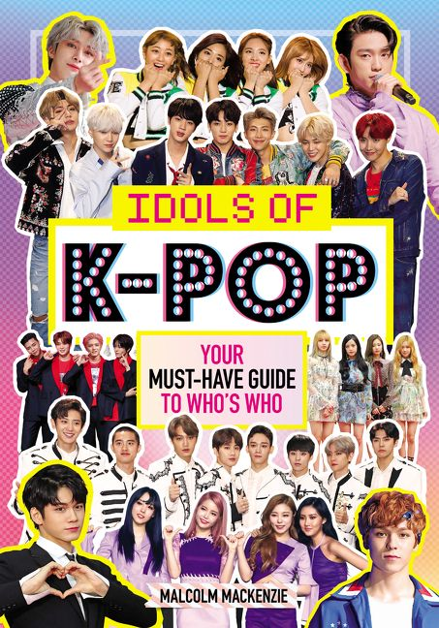

Slide 26

04
Kamsahamnida
Thank you

Slide 27
I want to visit __(country)____ because I want to eat ___(food)____.
I like to play __(sport)______.
I want to go __(country)_______ to see __(animal or bird)___.
I love to see ___(flower)____ in __(country)_____.

Slide 28
QUESTIONS
What food do you want to eat in South Korea?
What places you want to visit in South Korea?
How many colors are in South Korea’s flag?
I want to visit South Korea because ____________?

