Slide 1
INDIA
Here starts the lesson!

Slide 2
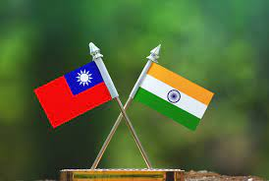
THESE ARE…
TAIWAN AND INDIA FLAGS
FLAG

Slide 3
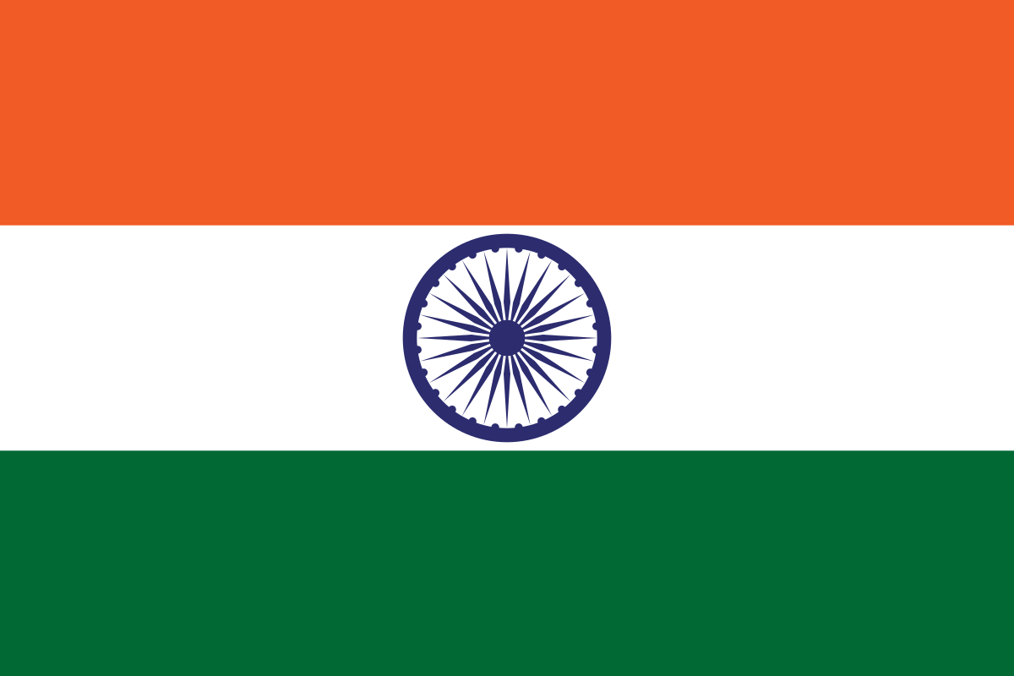
WHAT ARE THE COLORS?
WHAT IS THIS?
WHAT IS THIS?
WHAT SHAPE IS THIS?

Slide 4
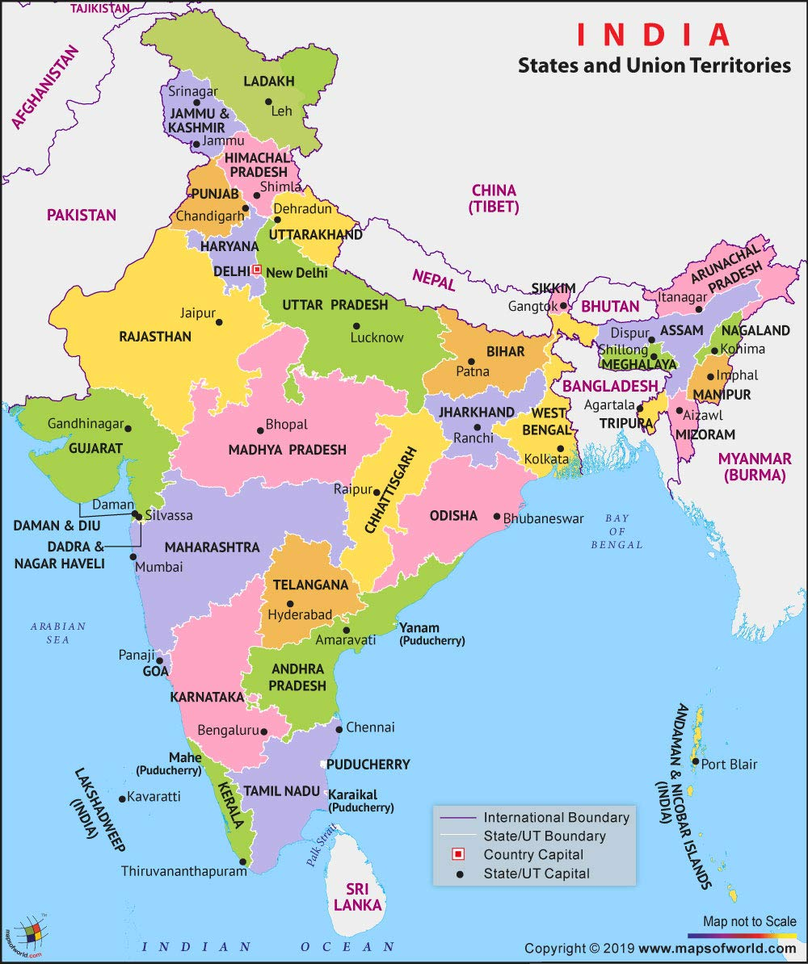
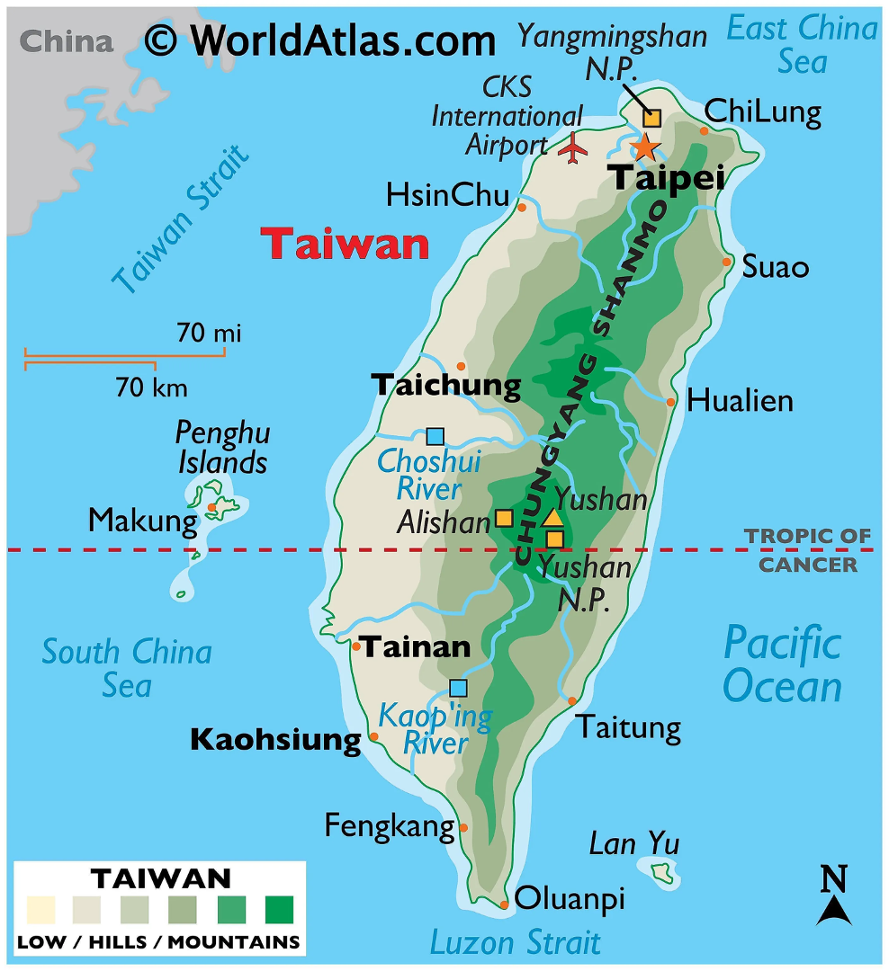
MAPS

Slide 5
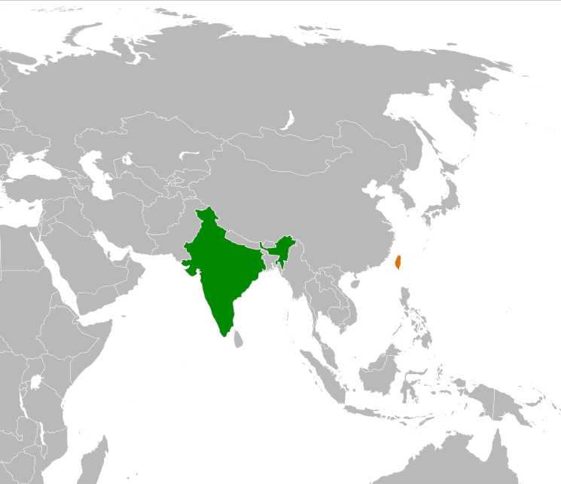
Where is India?
Where is Taiwan?

Slide 6
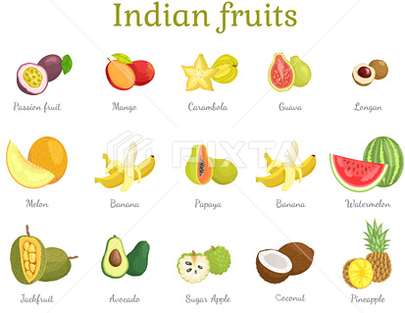
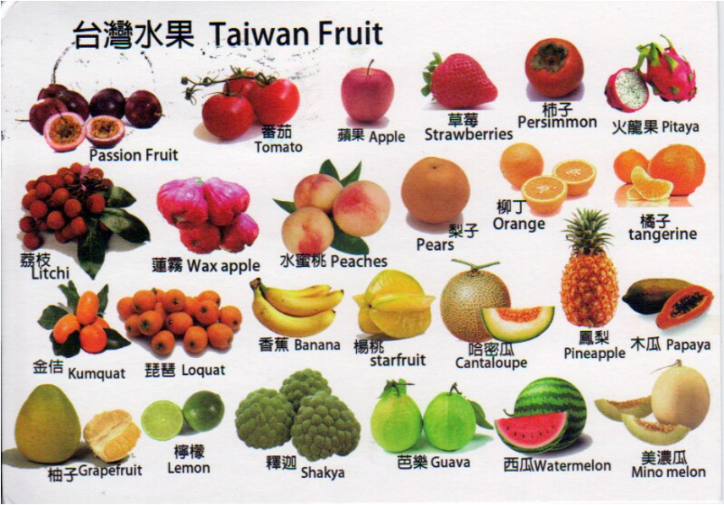
FRUITS

Slide 7
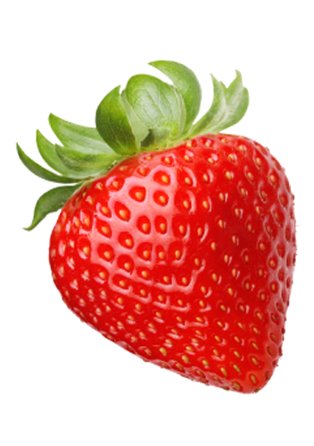
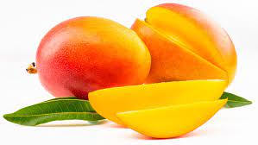
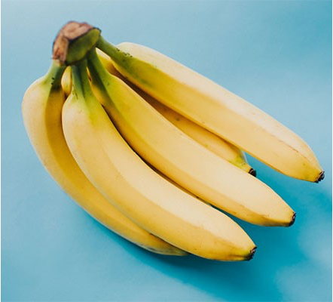
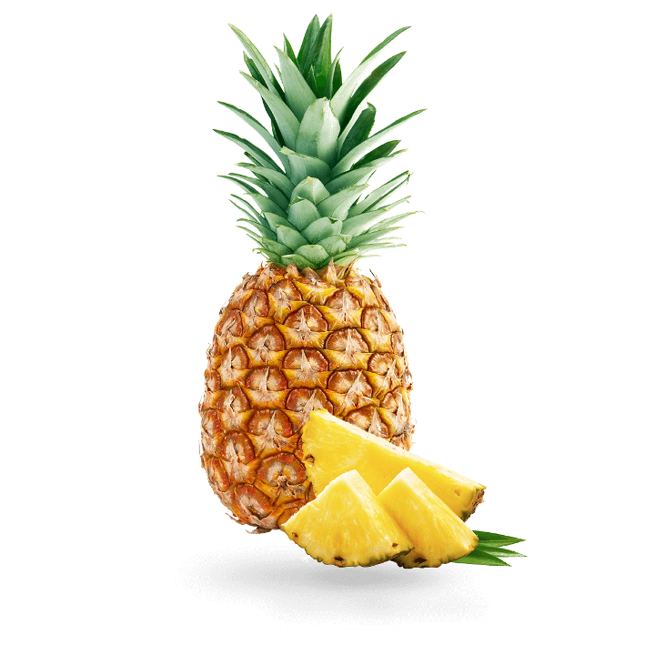
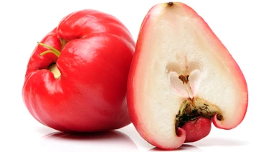
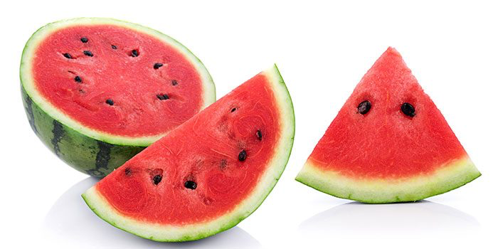
What FRUIT is this?
What COLOR is this?

Slide 8
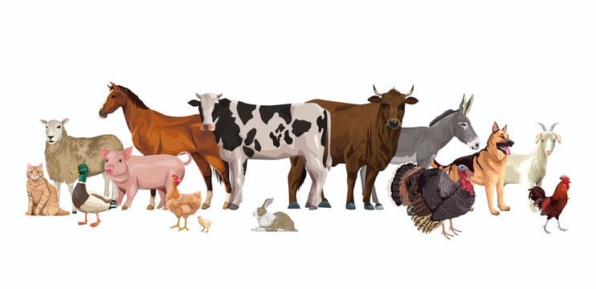
WHAT ARE THESE?

Slide 9
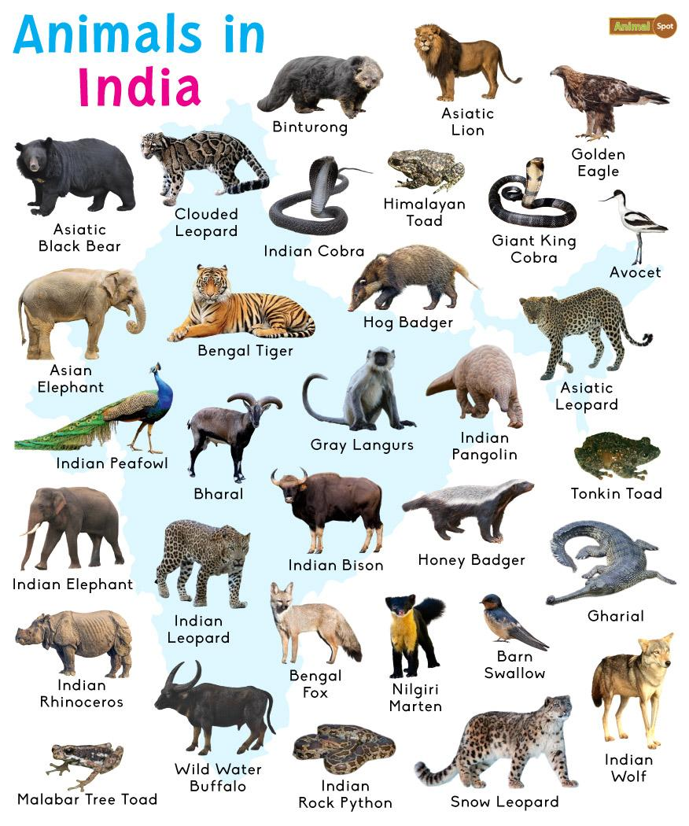
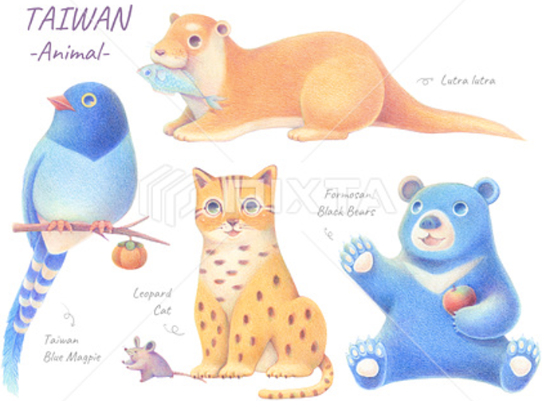
INDIA
TAIWAN

Slide 10
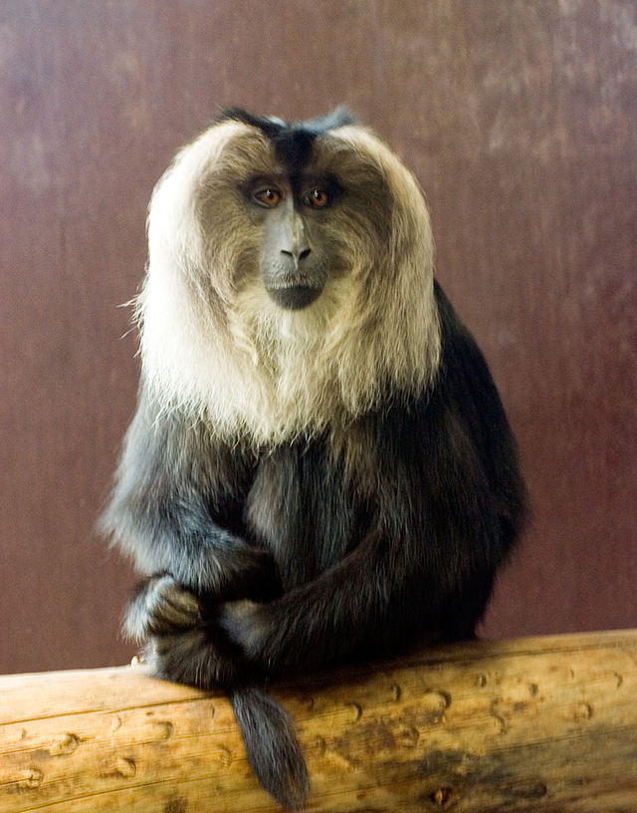
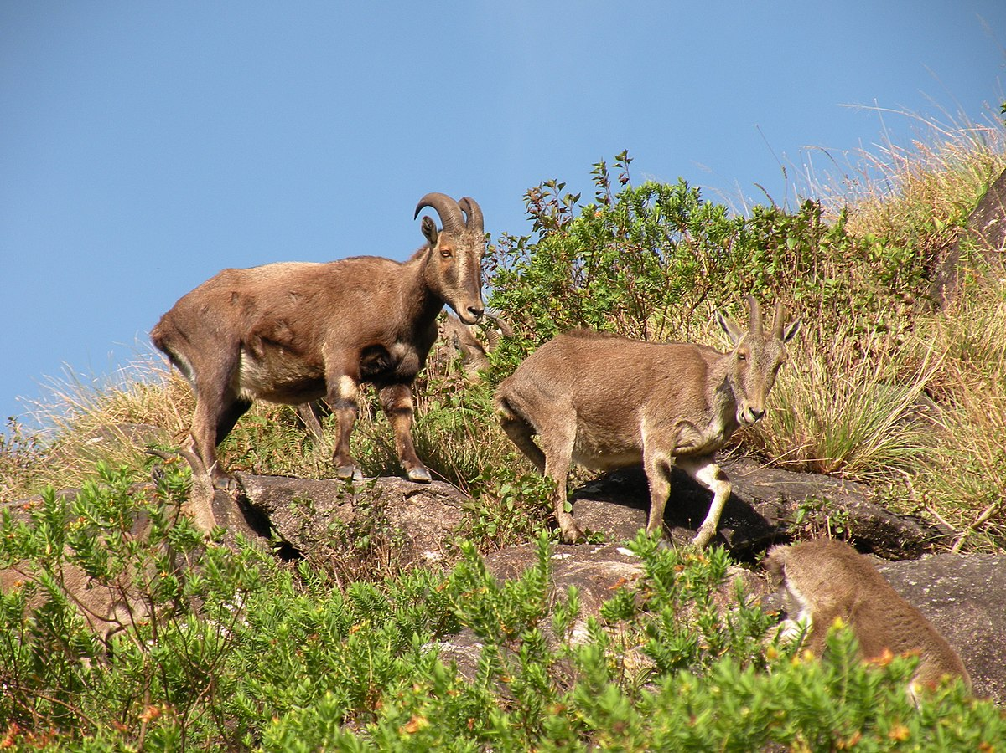
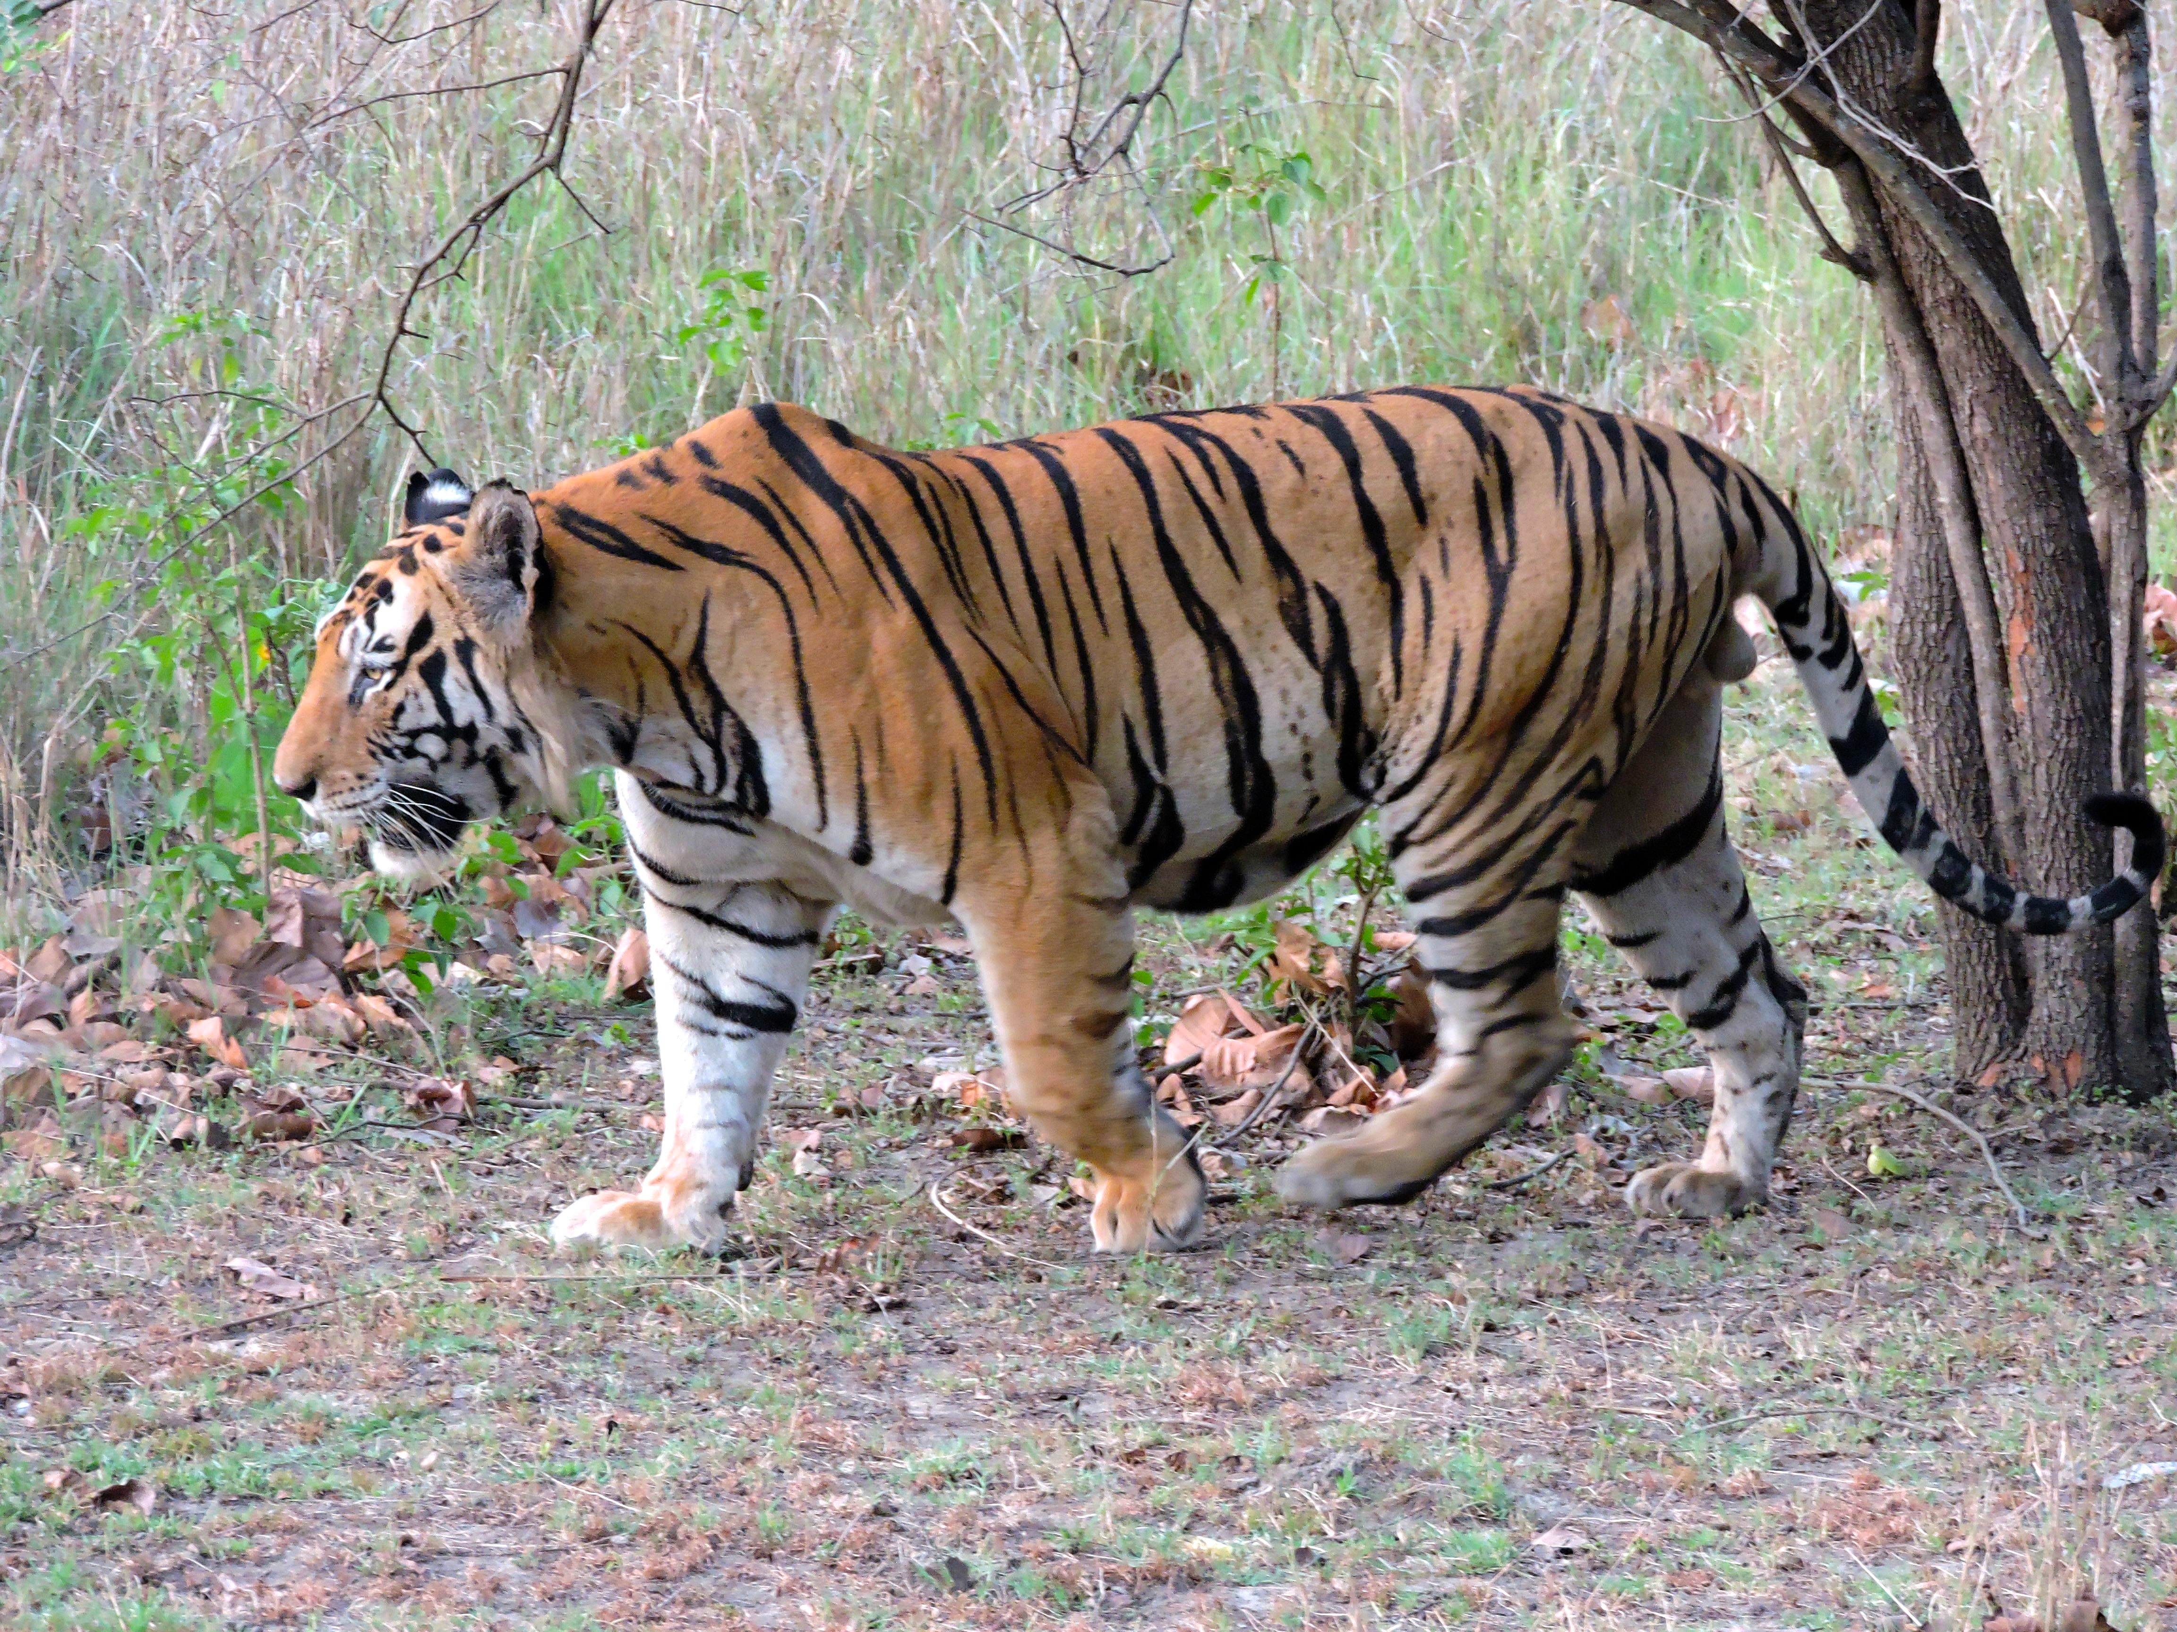
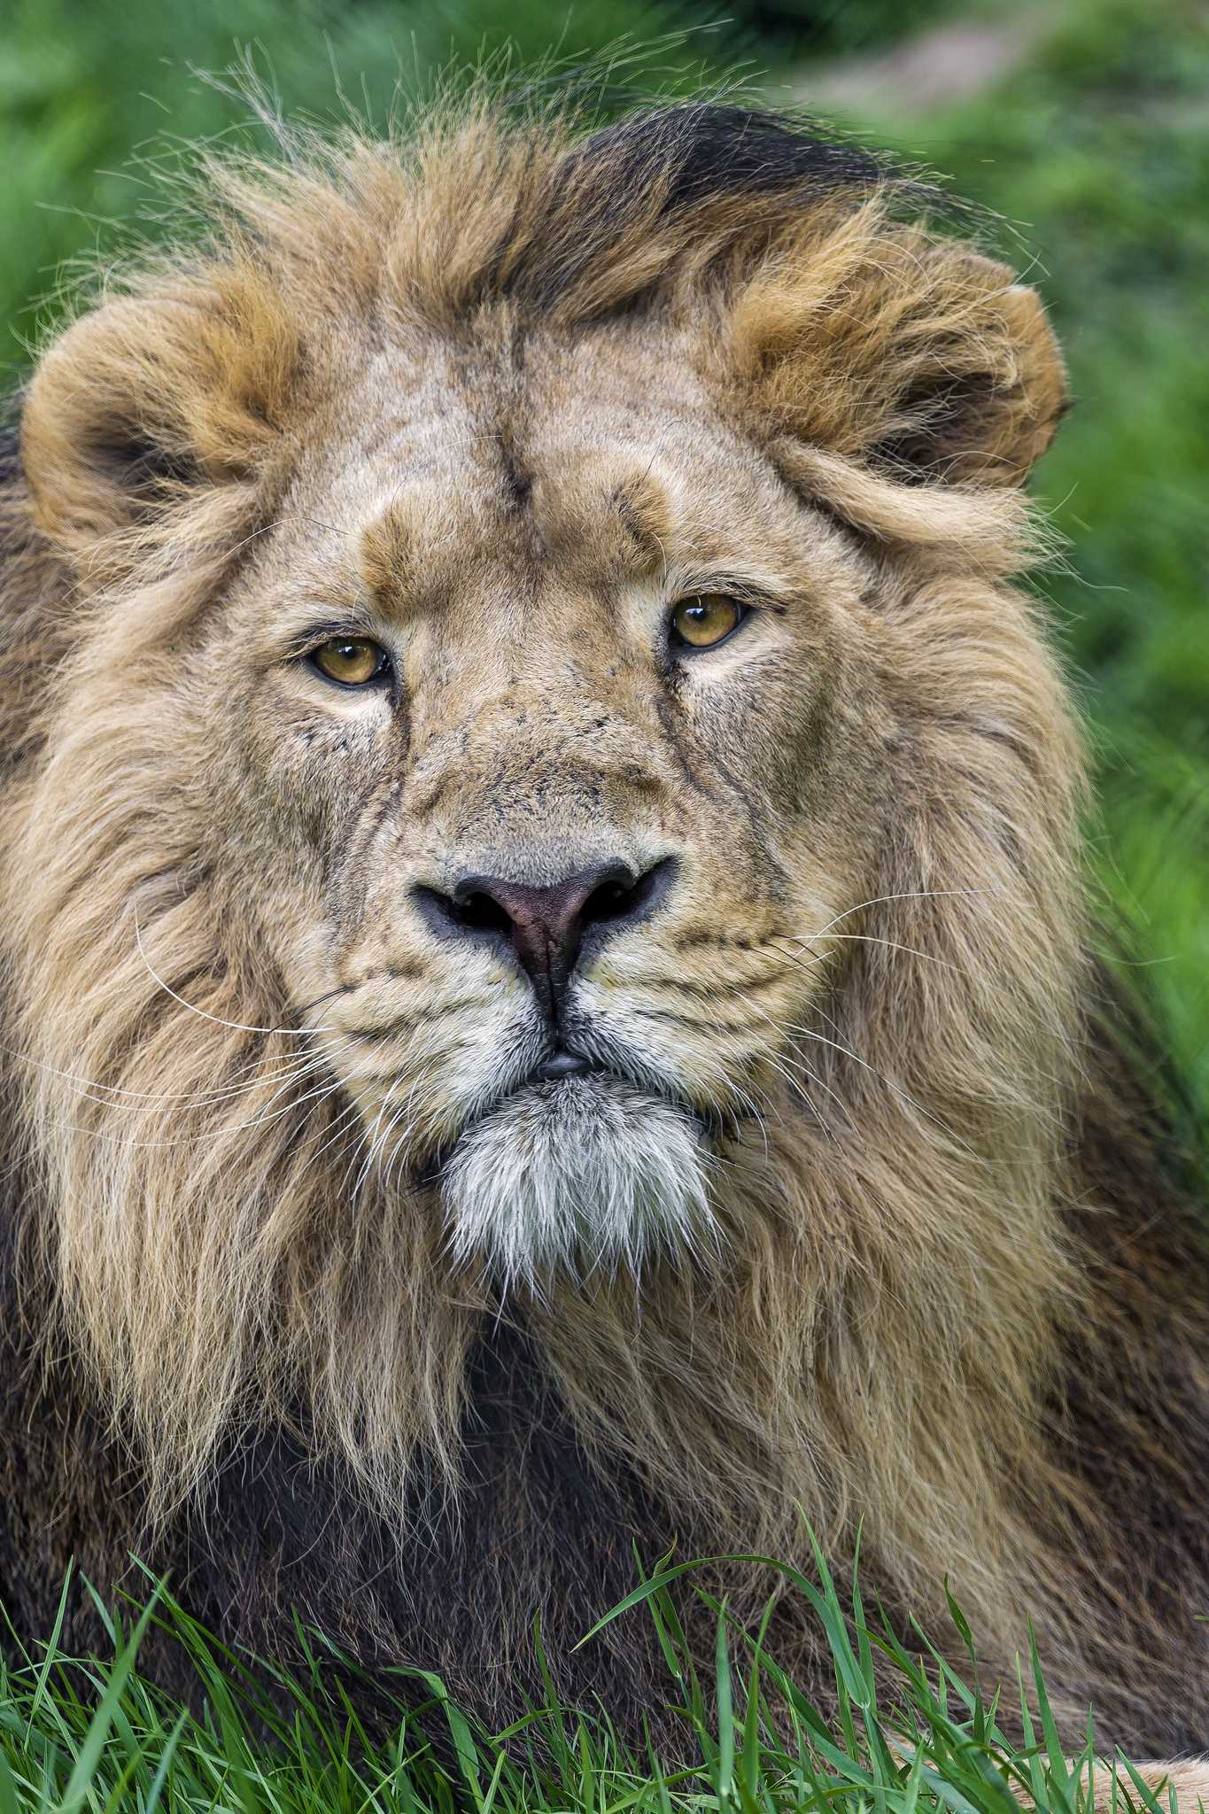
WHAT ANIMALS ARE THESE?
Bengal tiger
Lion-tailed macaque
Nilgiri tahr
Asiatic lion

Slide 11
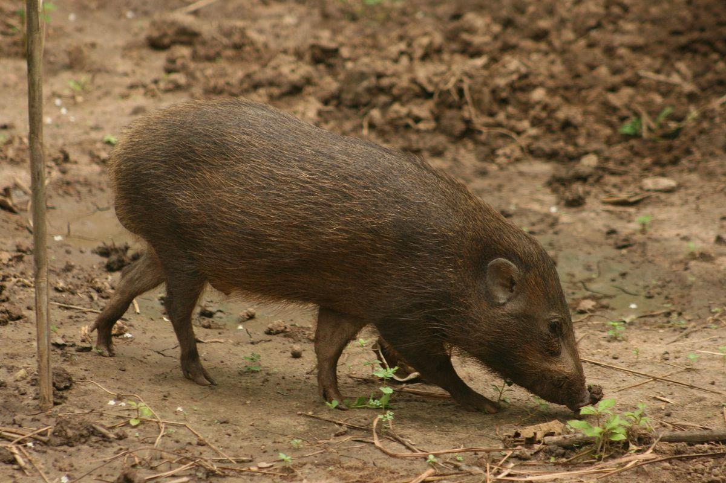
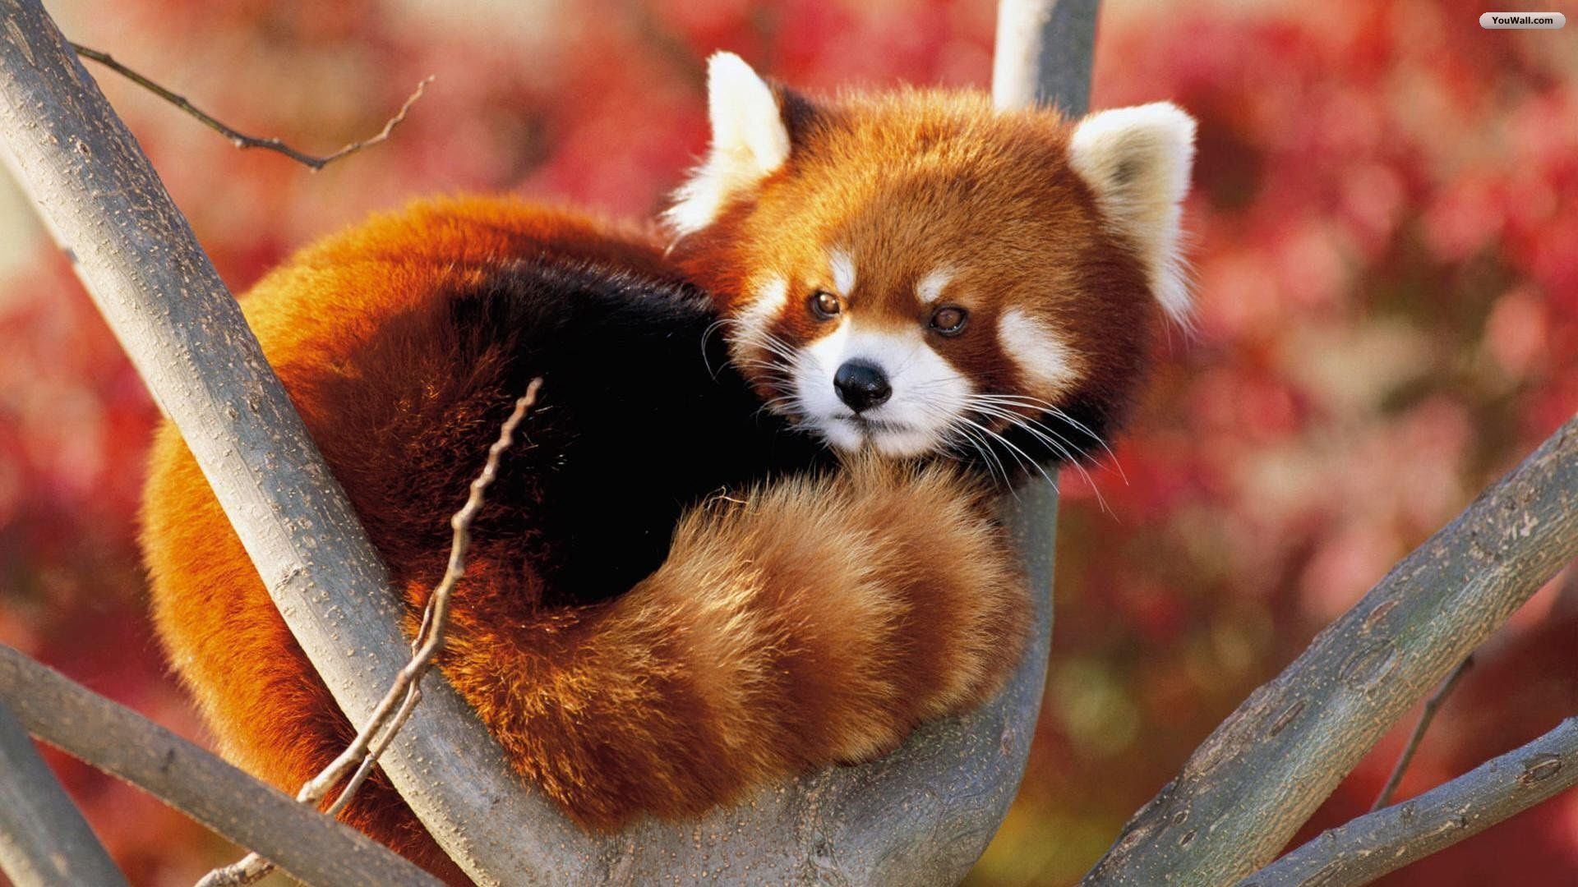
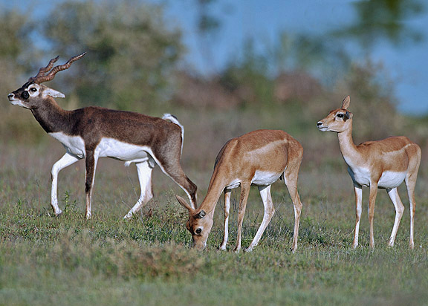
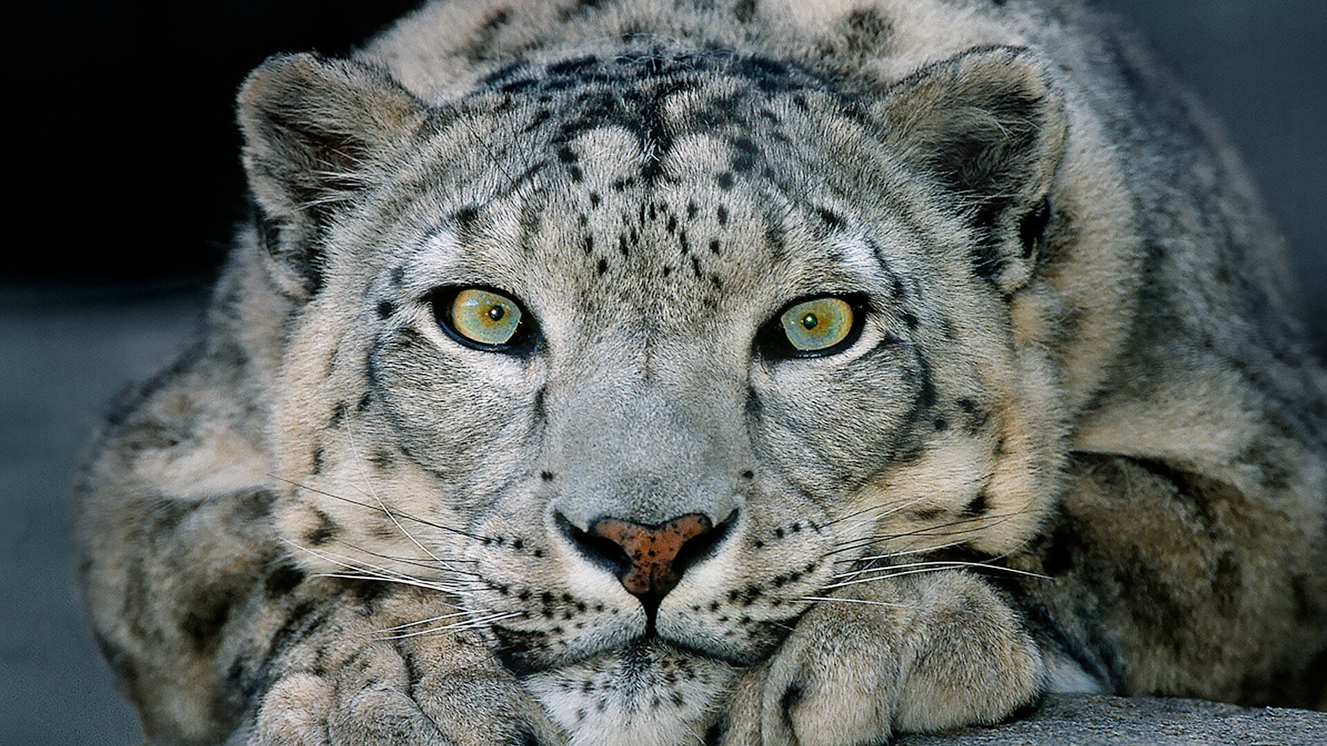
WHAT ANIMALS ARE THESE?
Pygmy hog
Red panda
Blackbuck
Snow leopard

Slide 12
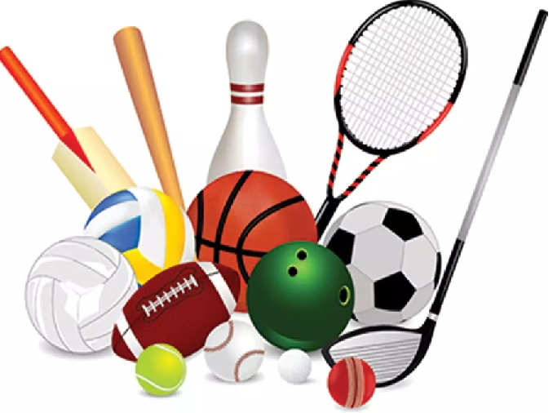
WHAT BALL IS THIS?
BASKETBALL
SOCCER BALL
BASEBALL
TENNIS BALL
RUGBY BALL
BADMINTON
VOLLEYBALL
GOLF
BILLIARD

Slide 13
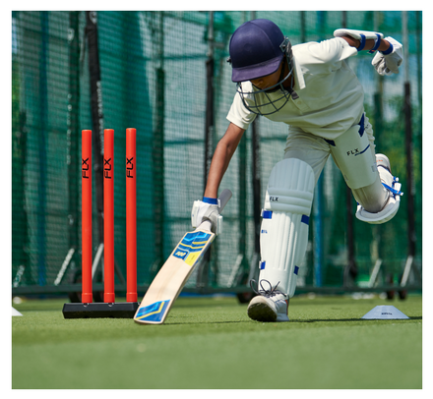
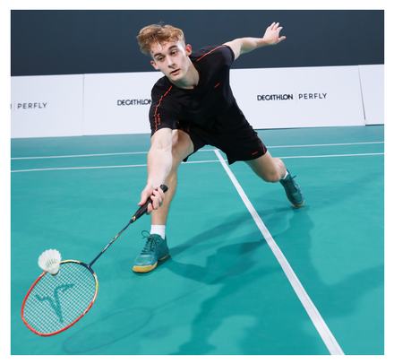
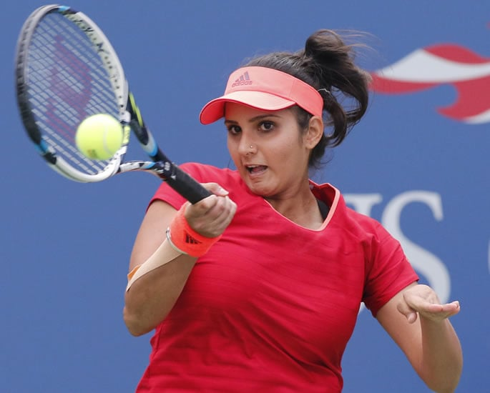
WHAT SPORT IS THIS?
Cricket
Badminton
Tennis

Slide 14
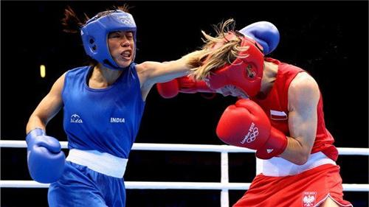
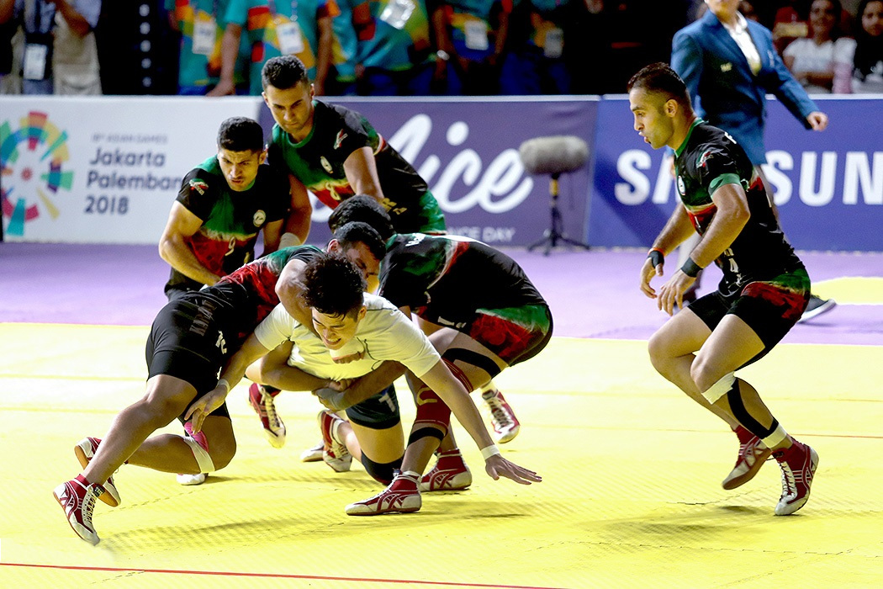
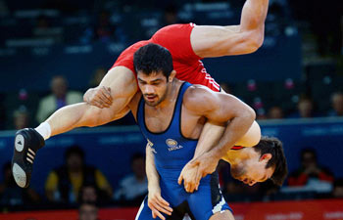
WHAT SPORT IS THIS?
Boxing
Kabaddi
Wrestling

Slide 15
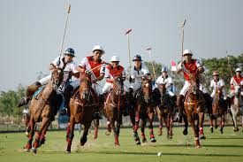
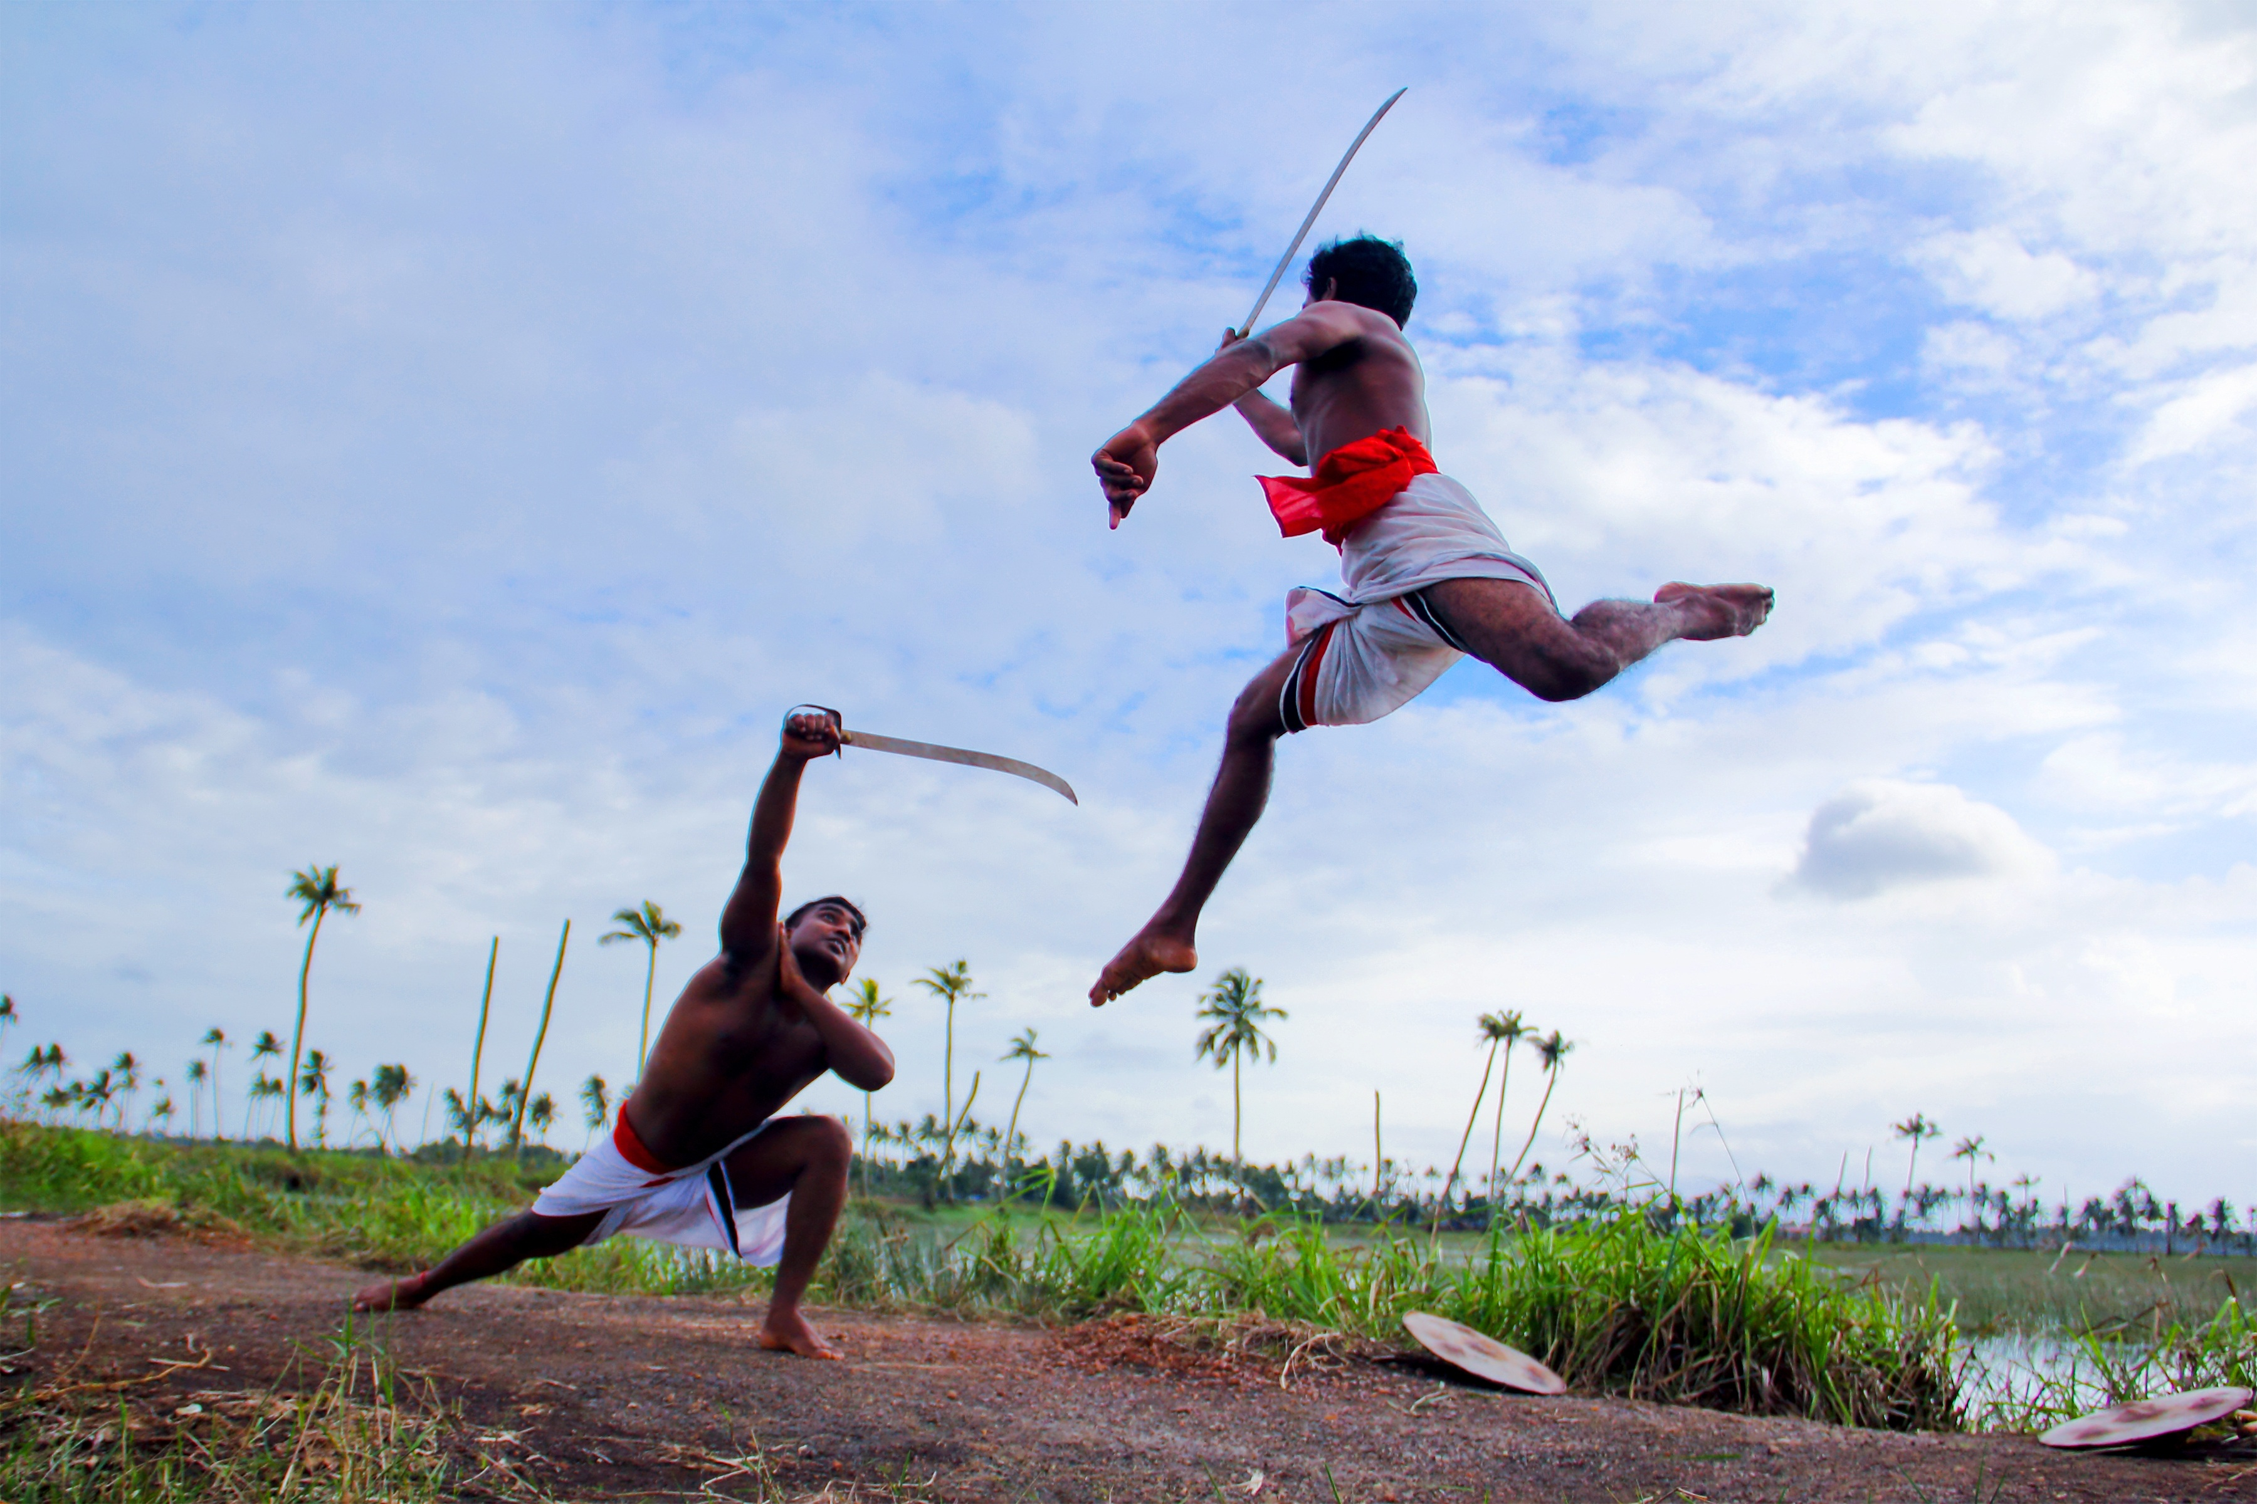
WHAT SPORT IS THIS?
Polo
Kalaripayattu

Slide 16
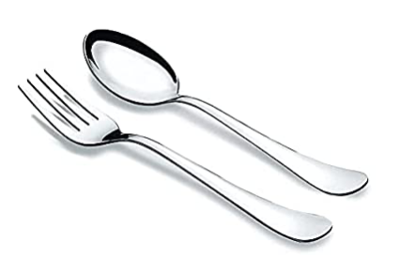
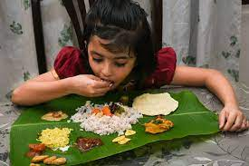
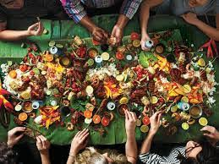
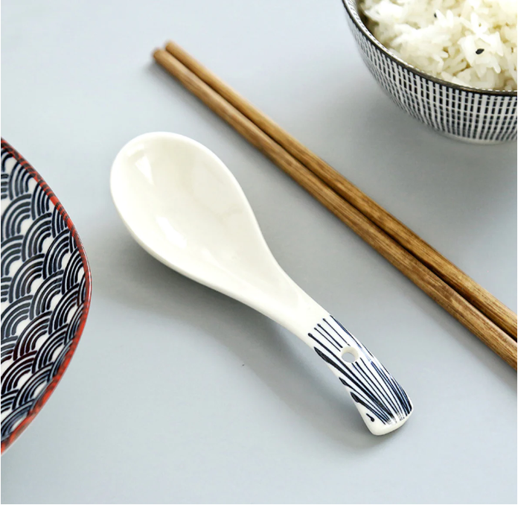
THEY EAT USING?
Spoon and Fork
Hand
INDIA
TAIWAN
Chopstick and spoon
Eating together in banana leaf

Slide 17
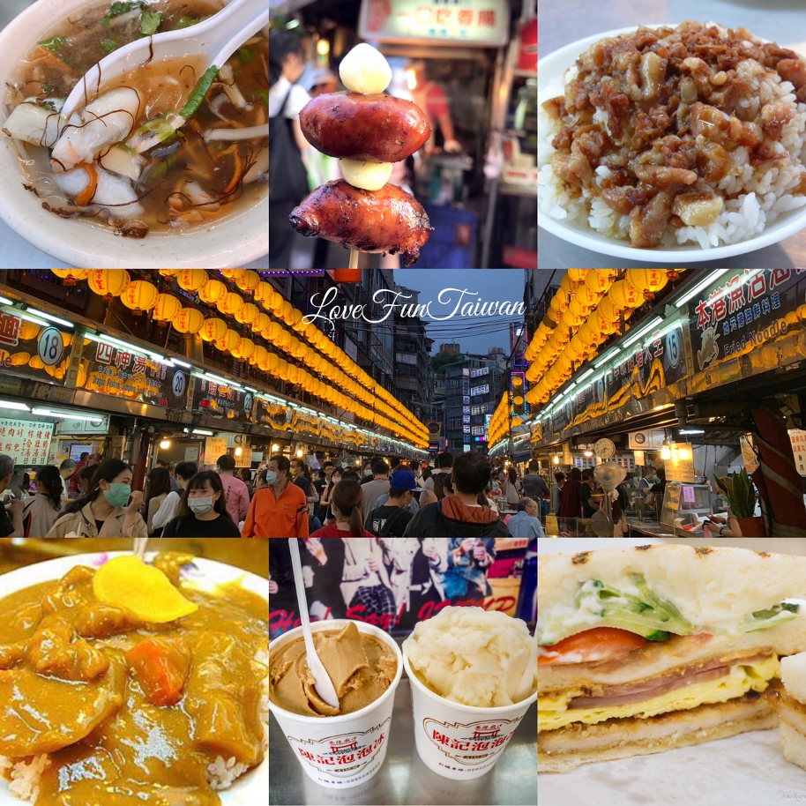
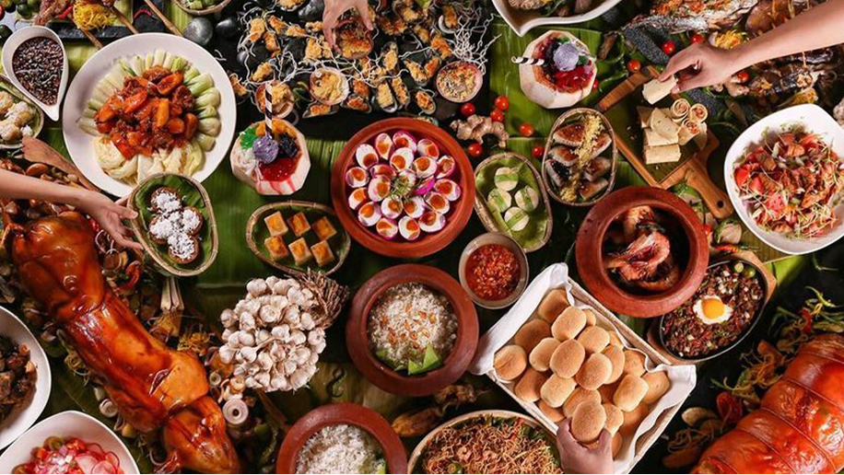
FOOD
TAIWAN

Slide 18
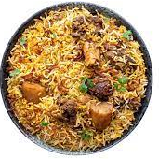
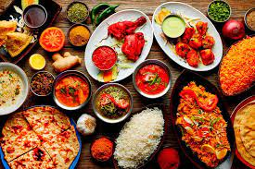
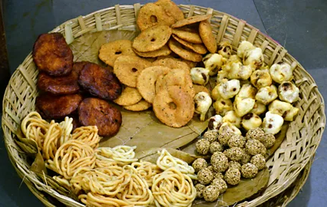
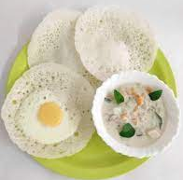
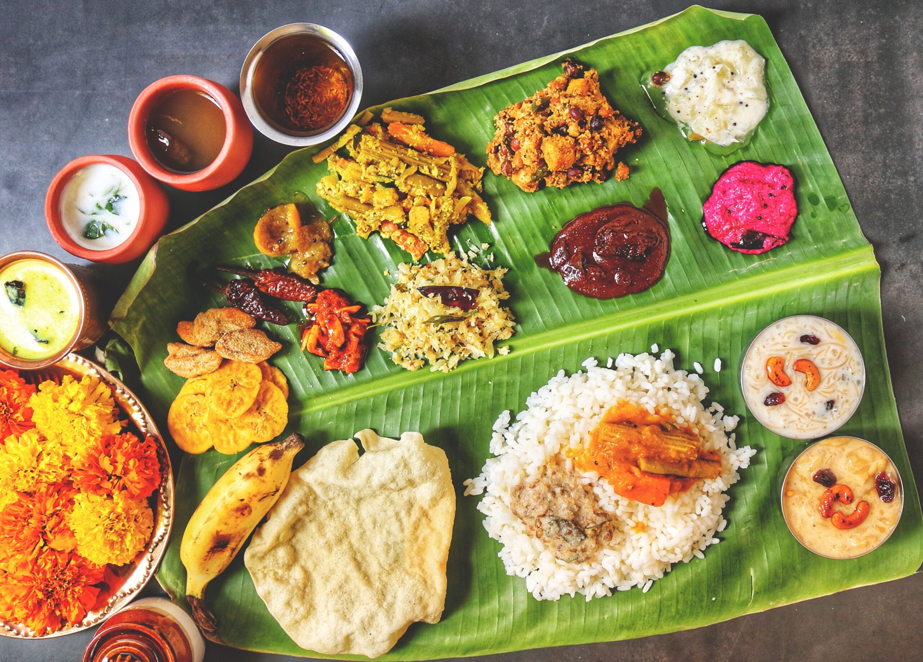
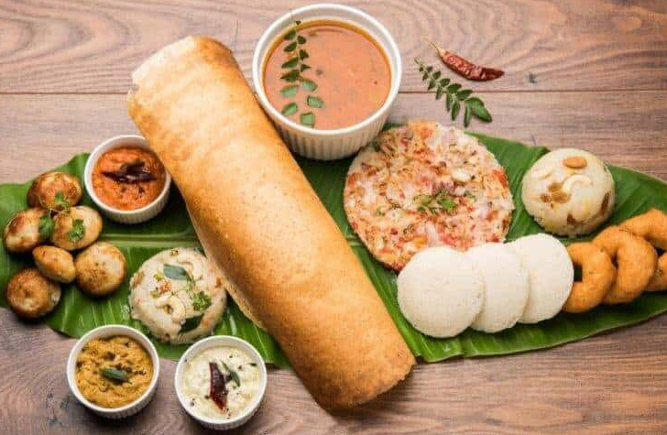
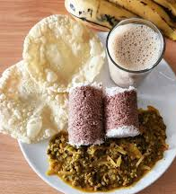
INDIAN FOOD
North Indian meal
Biriyani
Snacks
Appam/ Hoppers
Breakfast
Steamed rice cake/ Puttu
Kerala Sadhya/ meal of Kerala

Slide 19
Let’s watch some interesting facts about India
https://www.youtube.com/watch?v=6J6UpxMxG_8
India Facts for Kids - YouTube

Slide 20
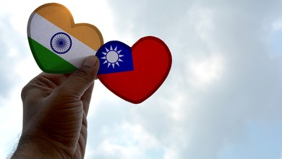
Thanks!
Please keep this slide for attribution.

