Slide 1
TAIWAN-JAPAN-PHILIPPINES

Slide 2
THESE ARE THE FLAGS OF:
TAIWAN
JAPAN
PHILIPPINES

Slide 3
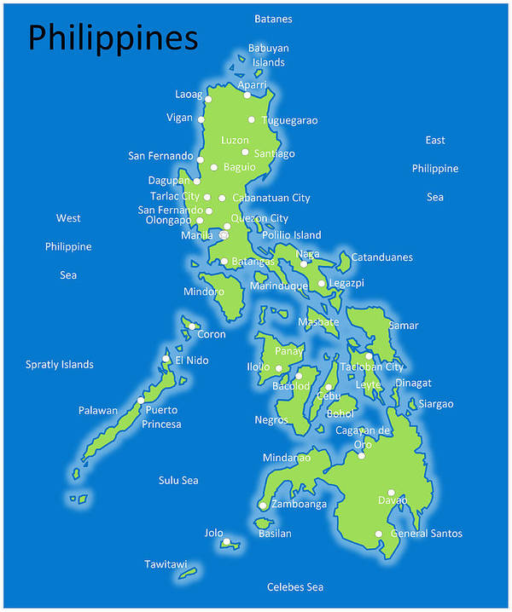
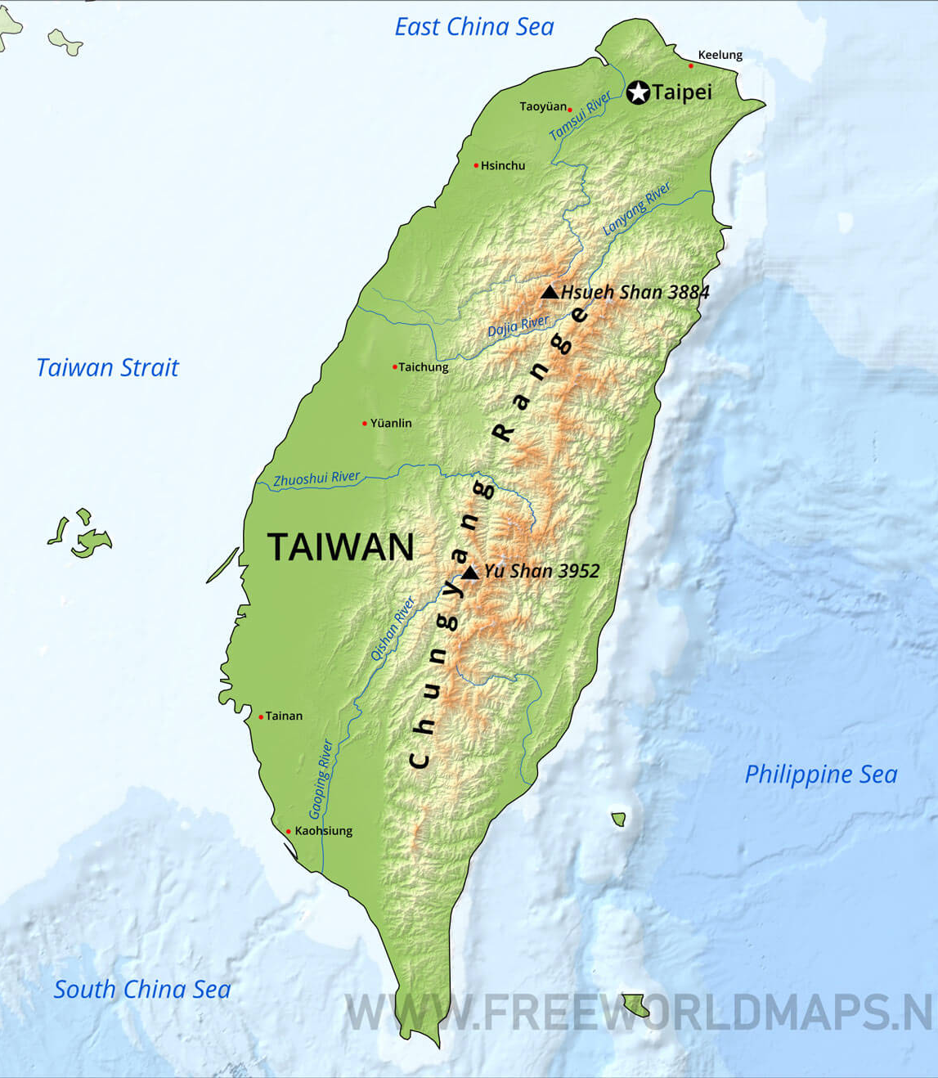
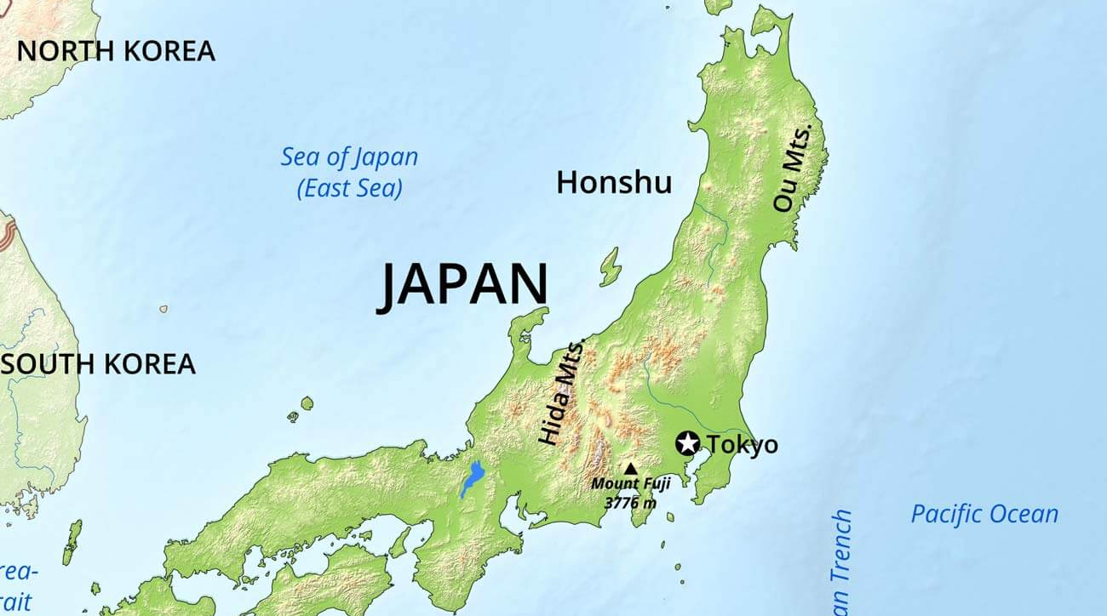
THESE ARE THE MAPS.

Slide 4
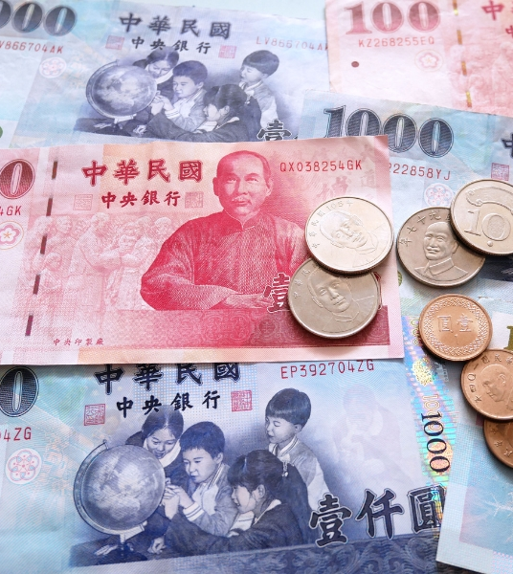
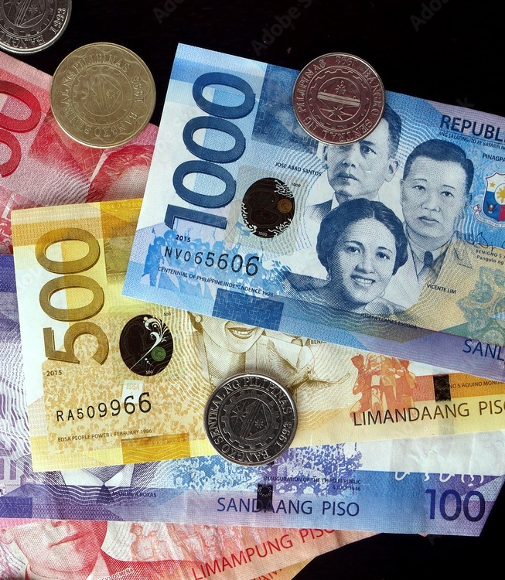
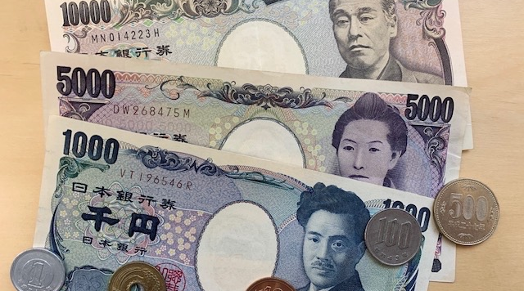
WHAT ARE THESE?

Slide 5
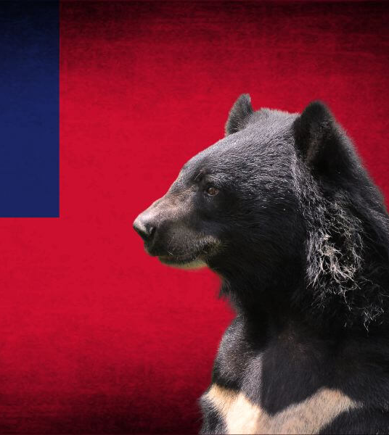
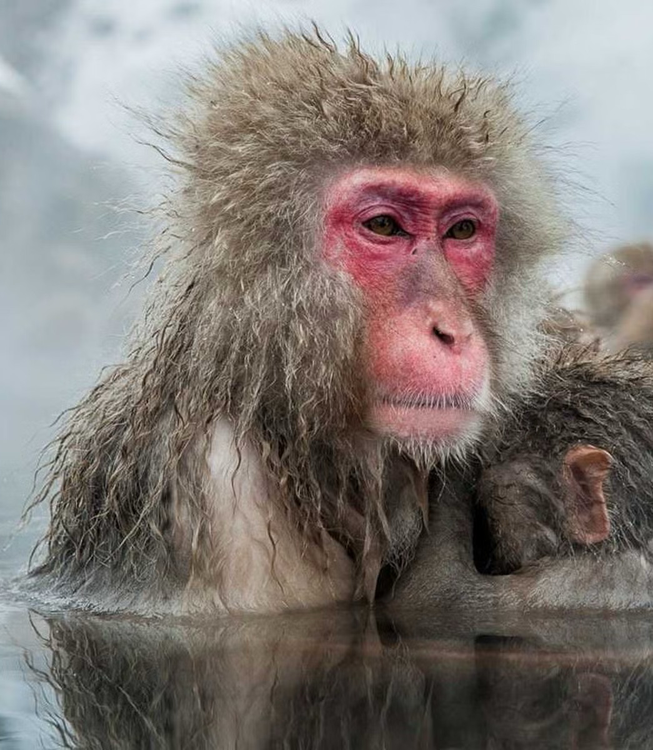
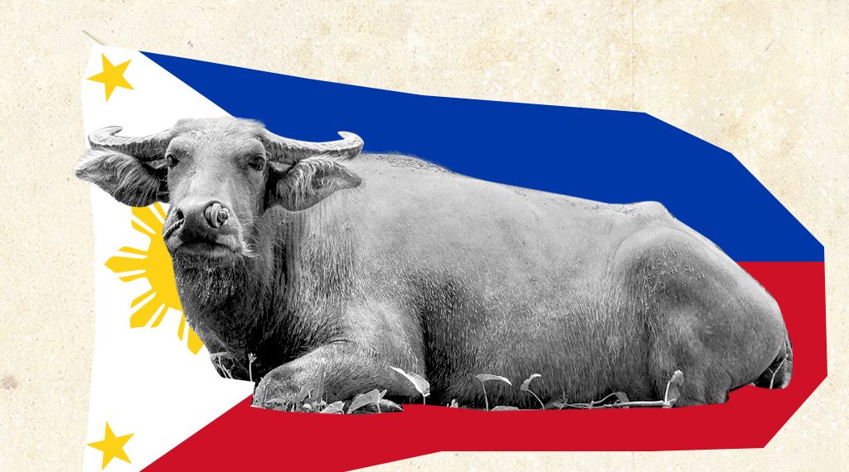
THESE ARE THE NATIONAL ANIMAL.
TAIWAN – Black Bear
JAPAN – Snow Monkey
PHILIPPINES - Carabao

Slide 6
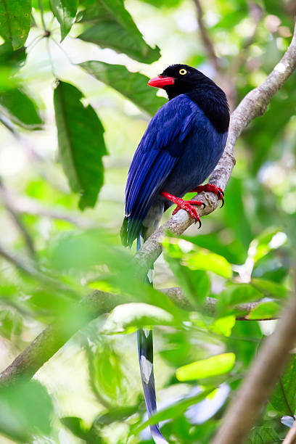
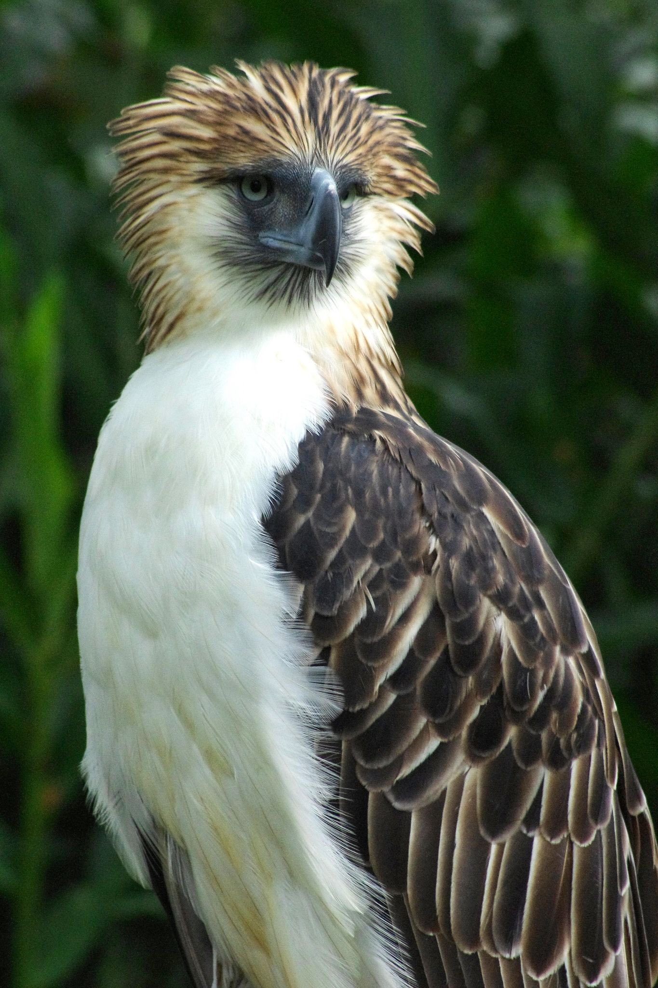
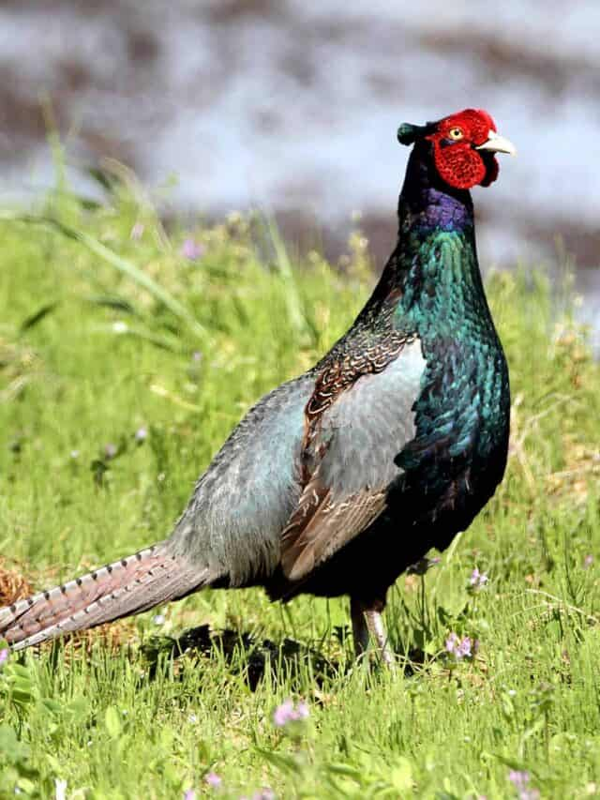
Blue Magpie
Green Pheasant
Eagle

Slide 7
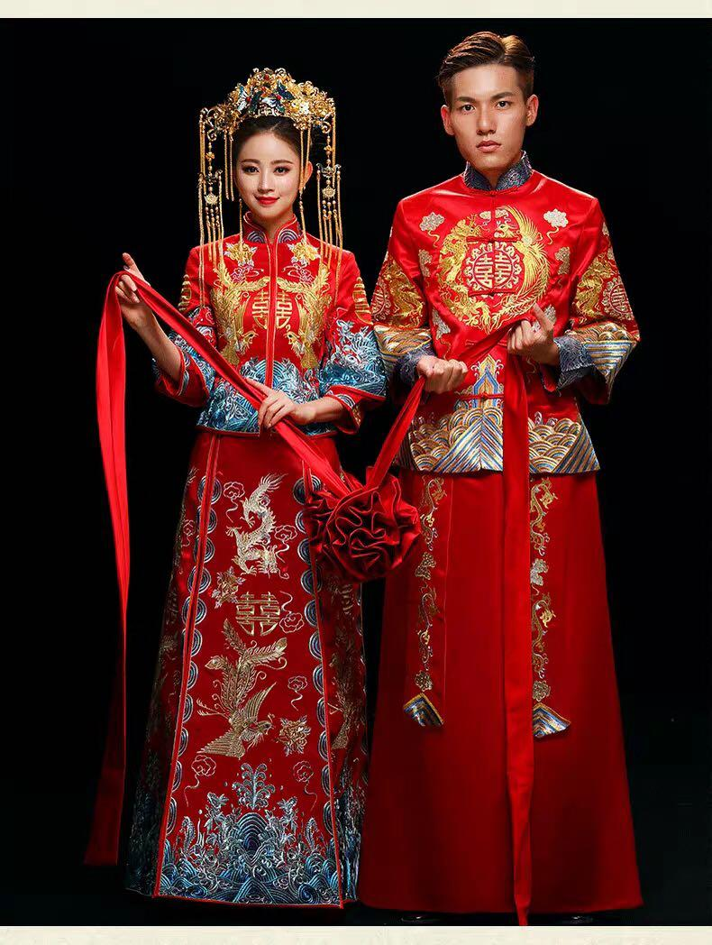
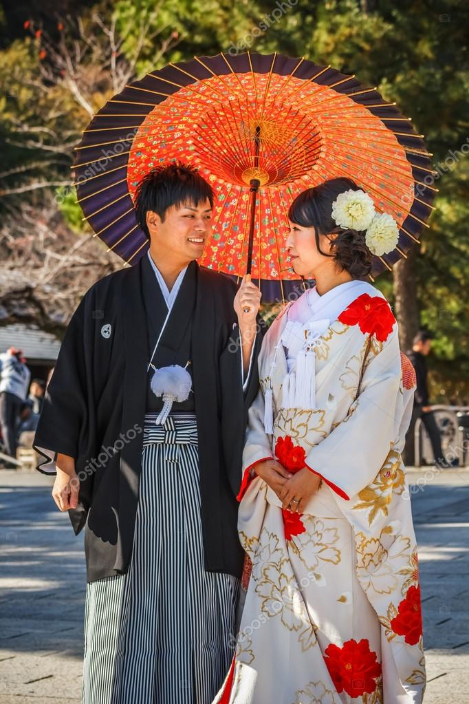
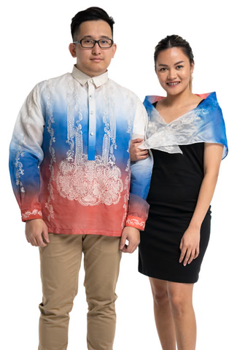
NATIONAL DRESS

Slide 8
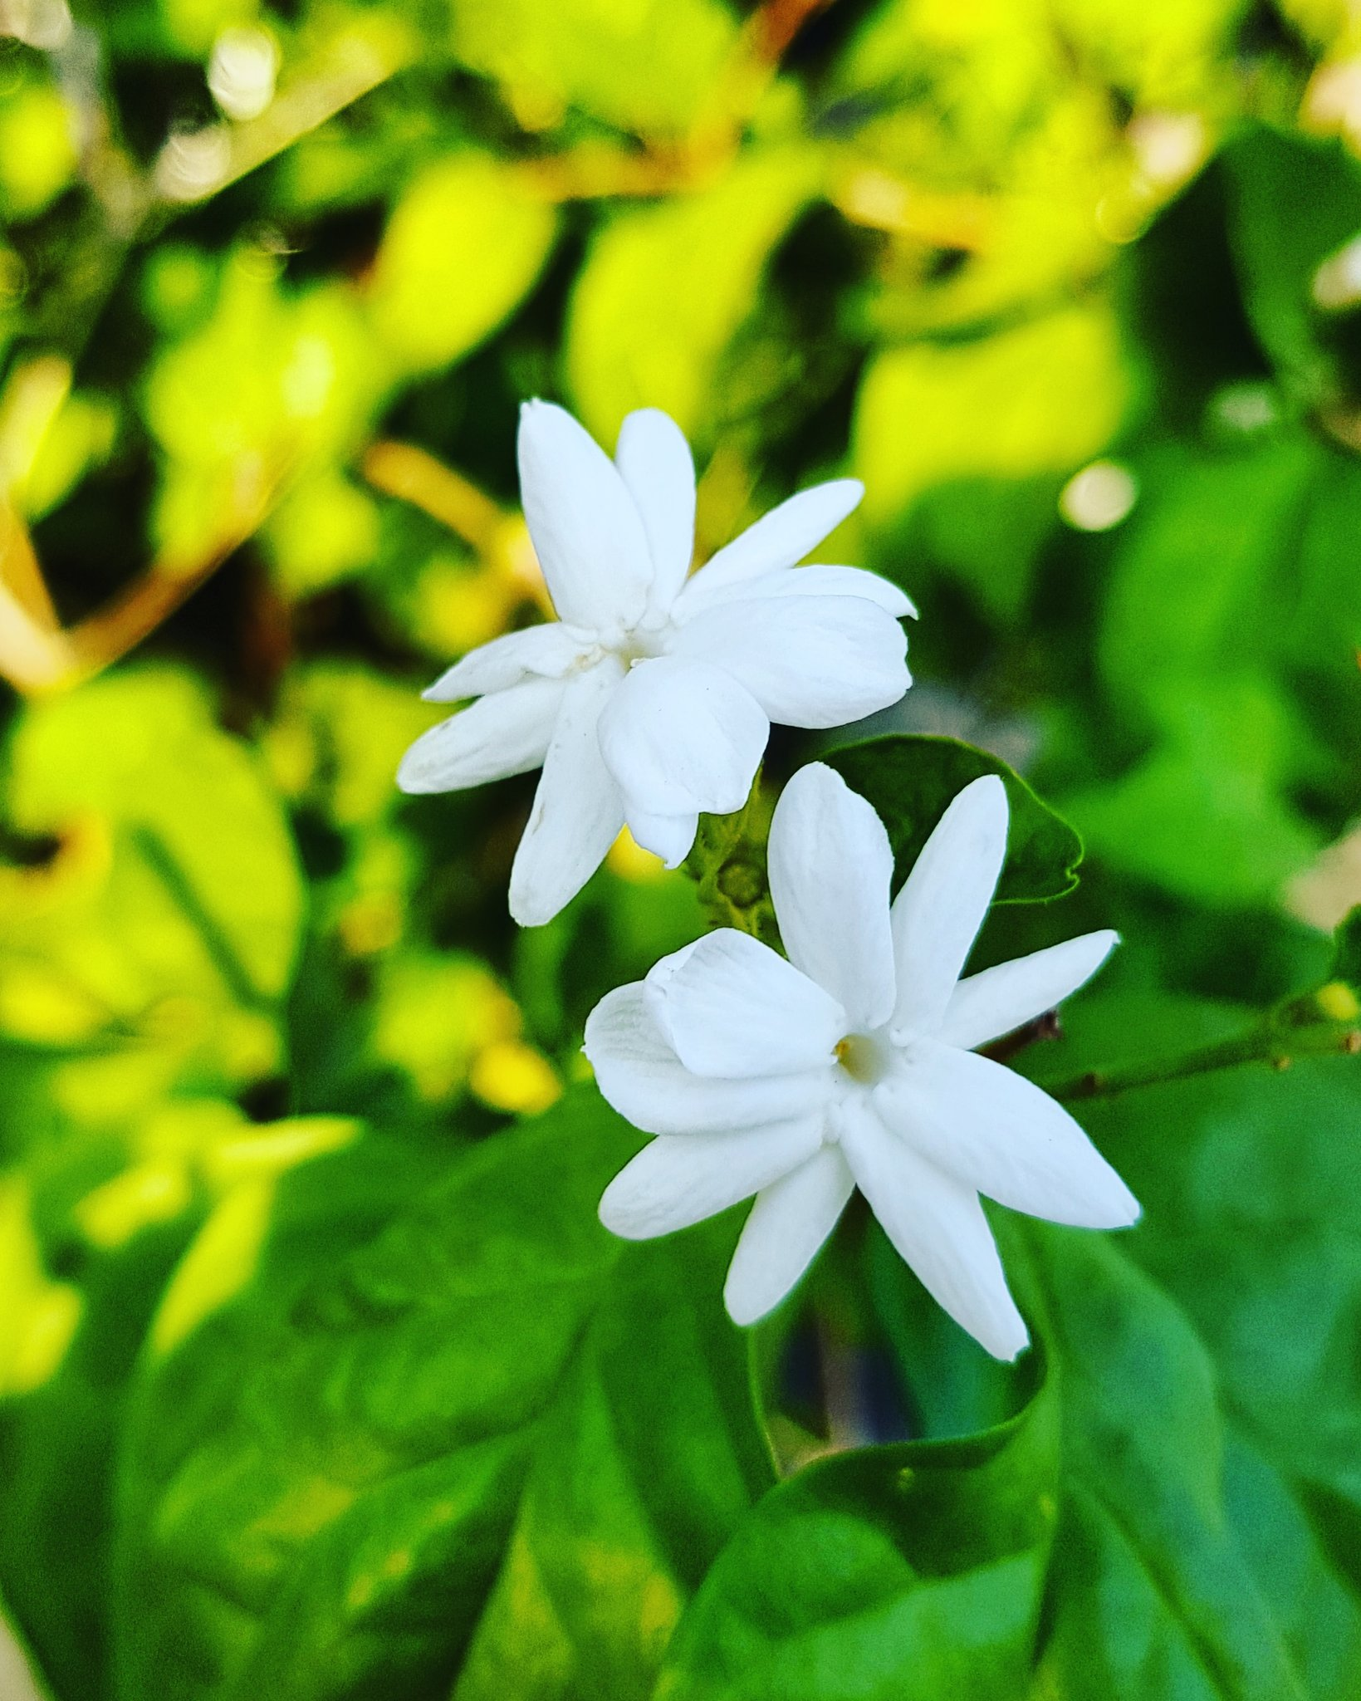
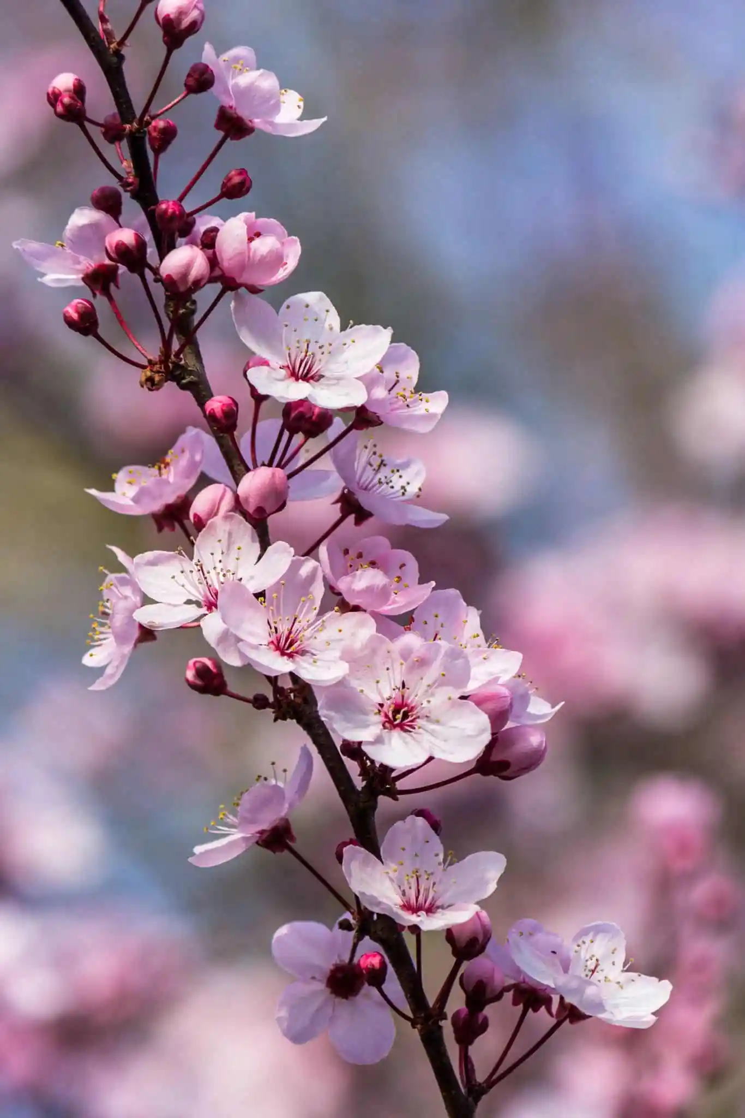
PLUM BLOSSOM
CHERRY BLOSSOM
JASMINE

Slide 9
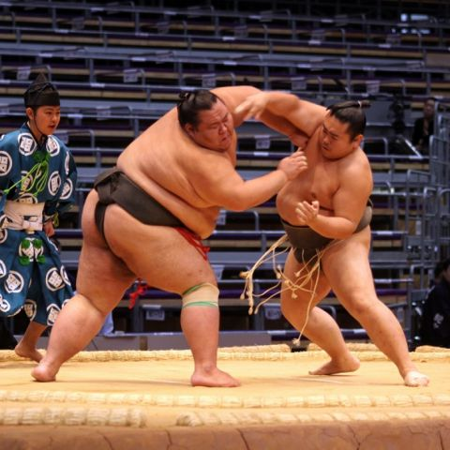
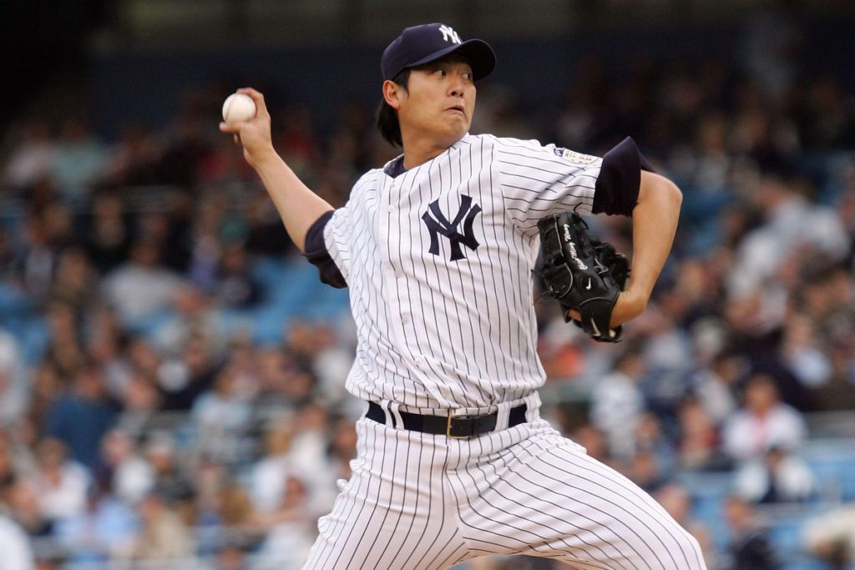
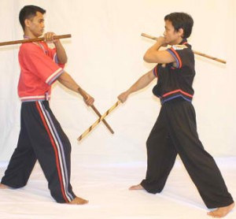
BASEBALL
SUMO
ARNIS

Slide 10
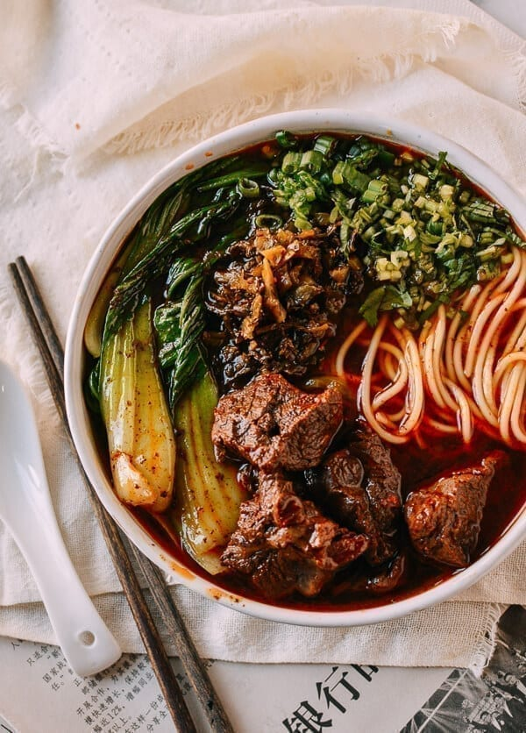
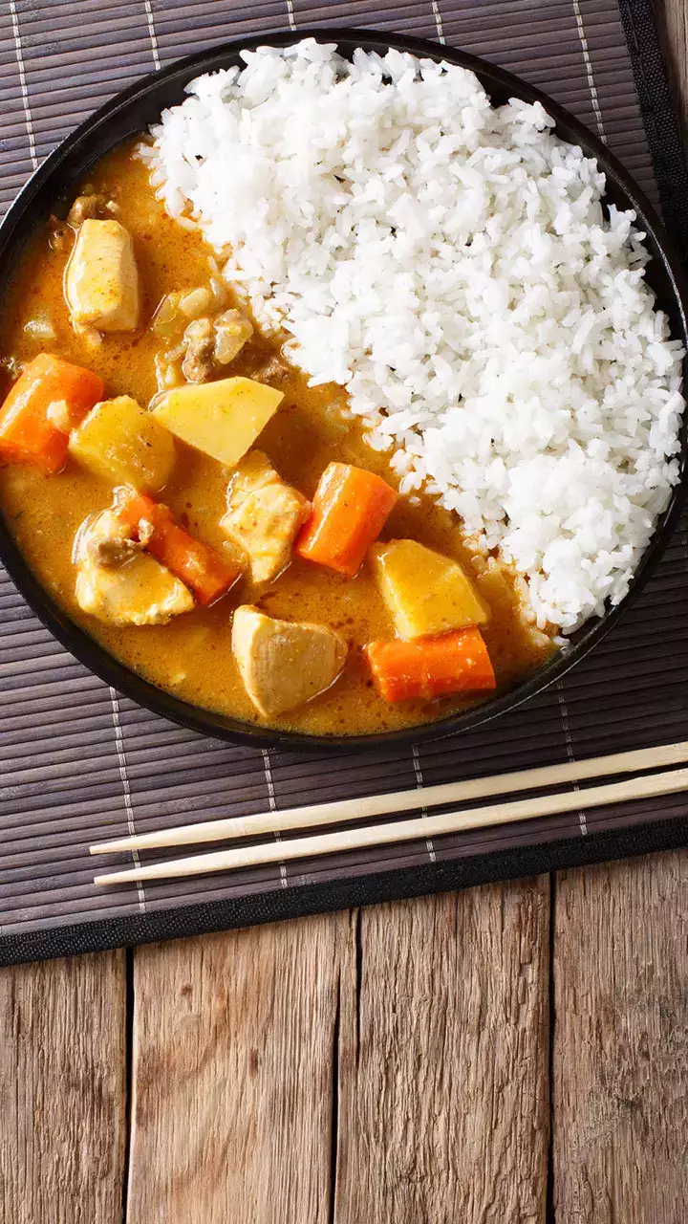
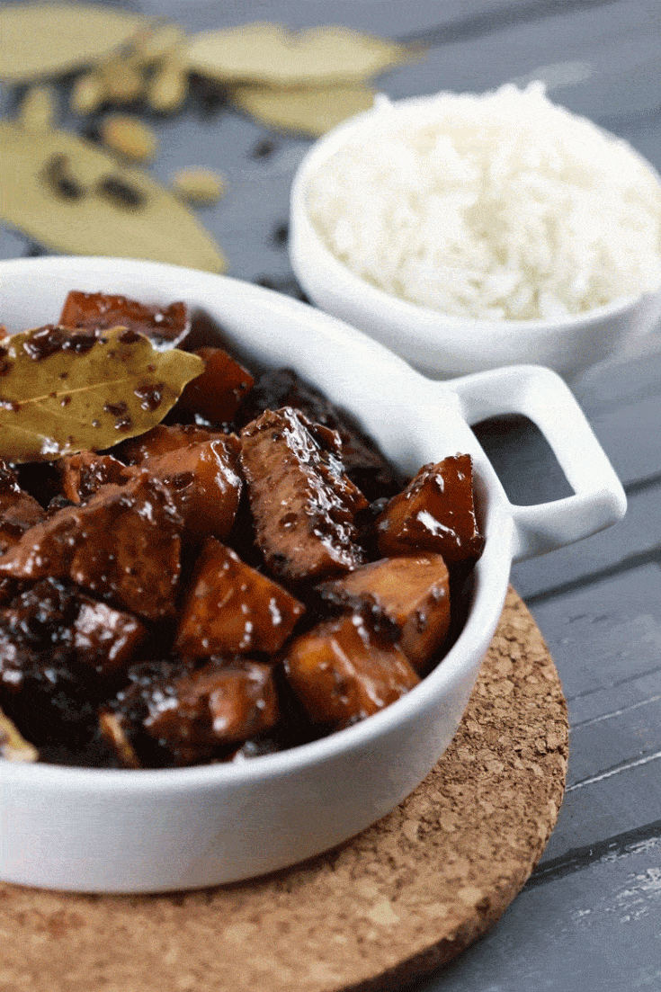
BEEF NOODLE SOUP
ADOBO
CURRY RICE

Slide 11
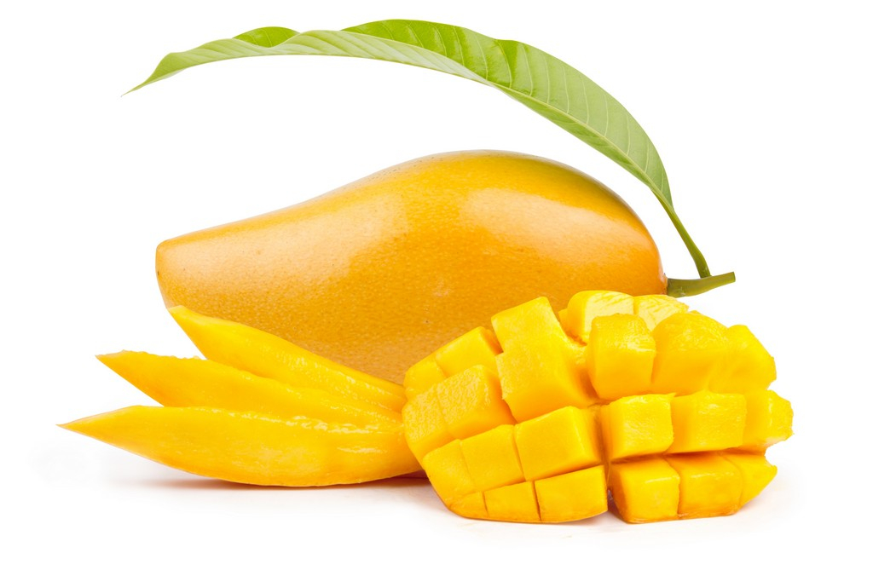
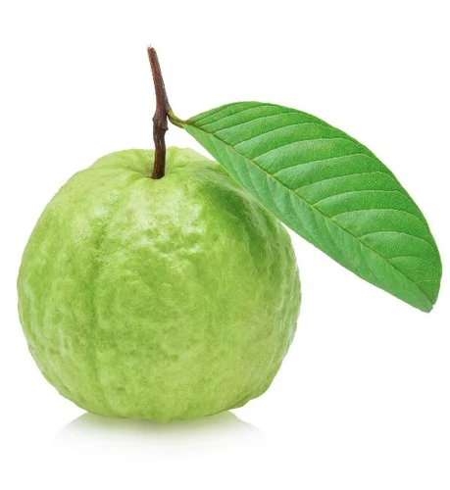
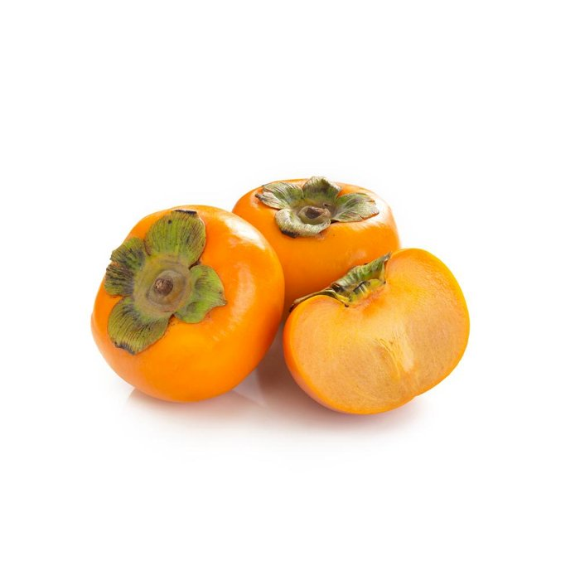
MANGO
GUAVA
PERSIMMON

Slide 12
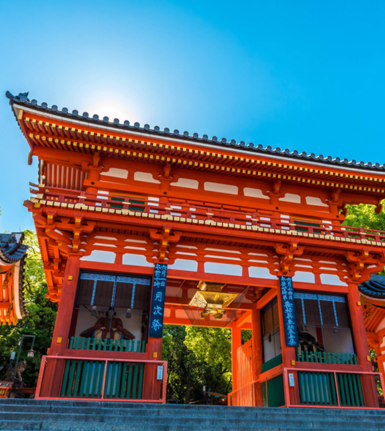
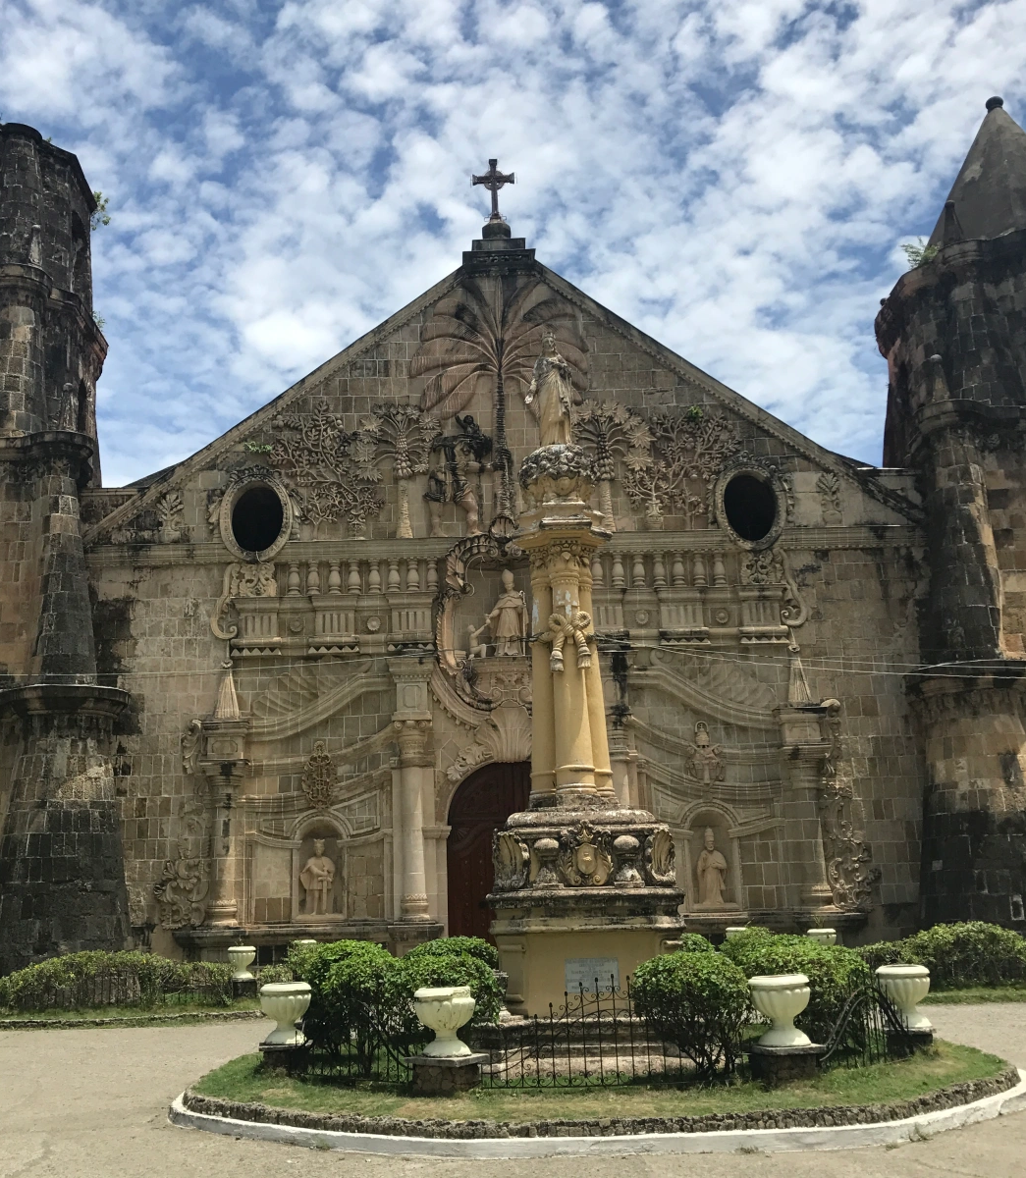
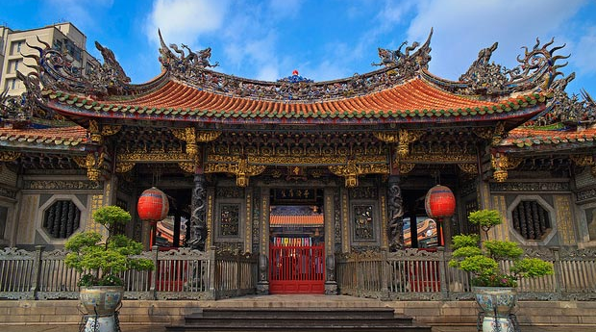
THESE ARE THE TEMPLE OR CHURCH
WHAT PEOPLE DO IN THE TEMPLE?

Slide 13
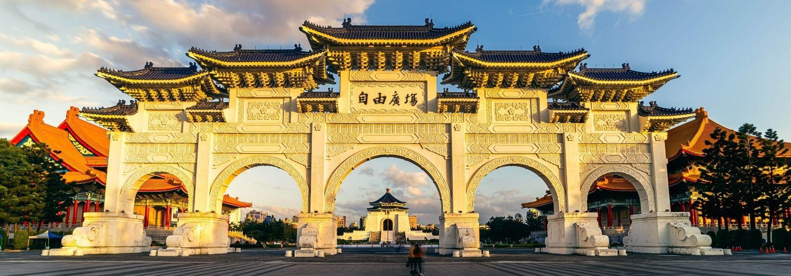
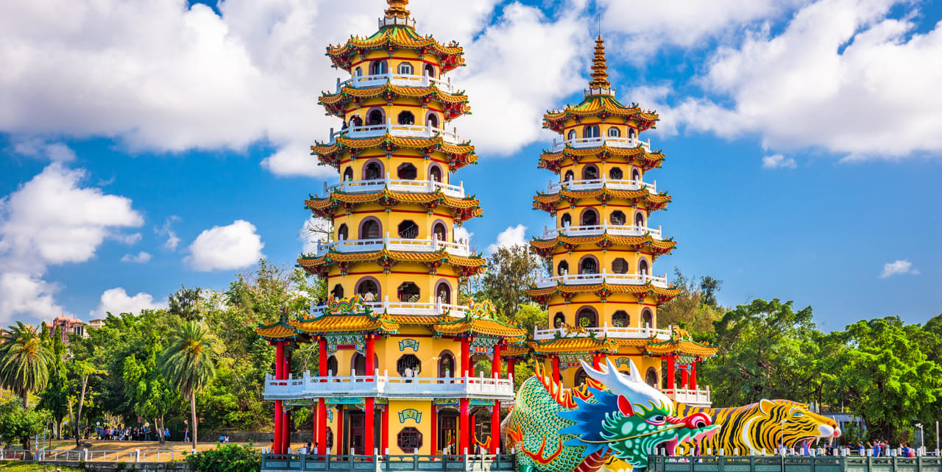
WHERE IS THIS?

Slide 14
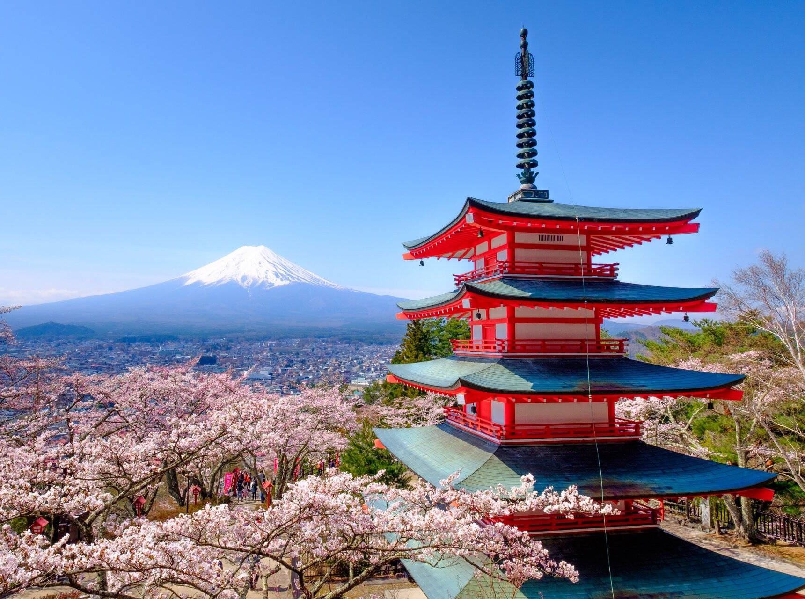
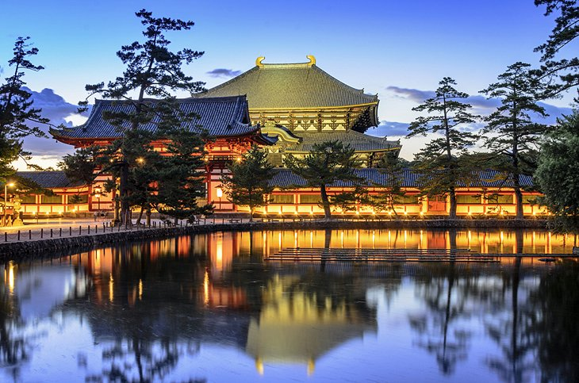
WHERE IS THIS?

Slide 15
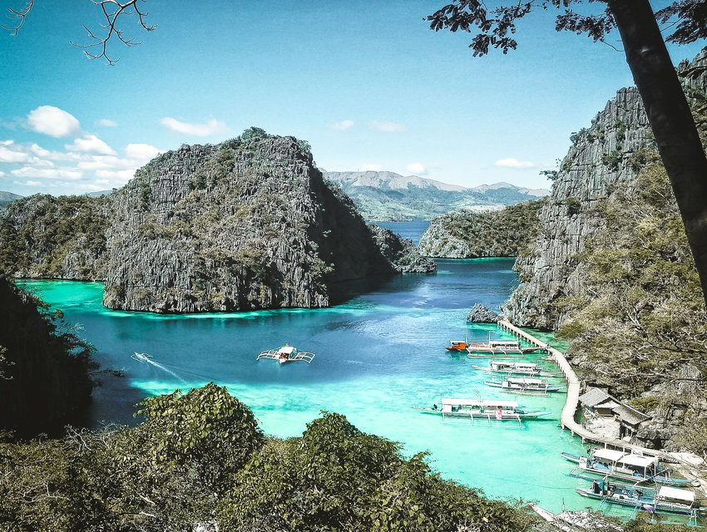
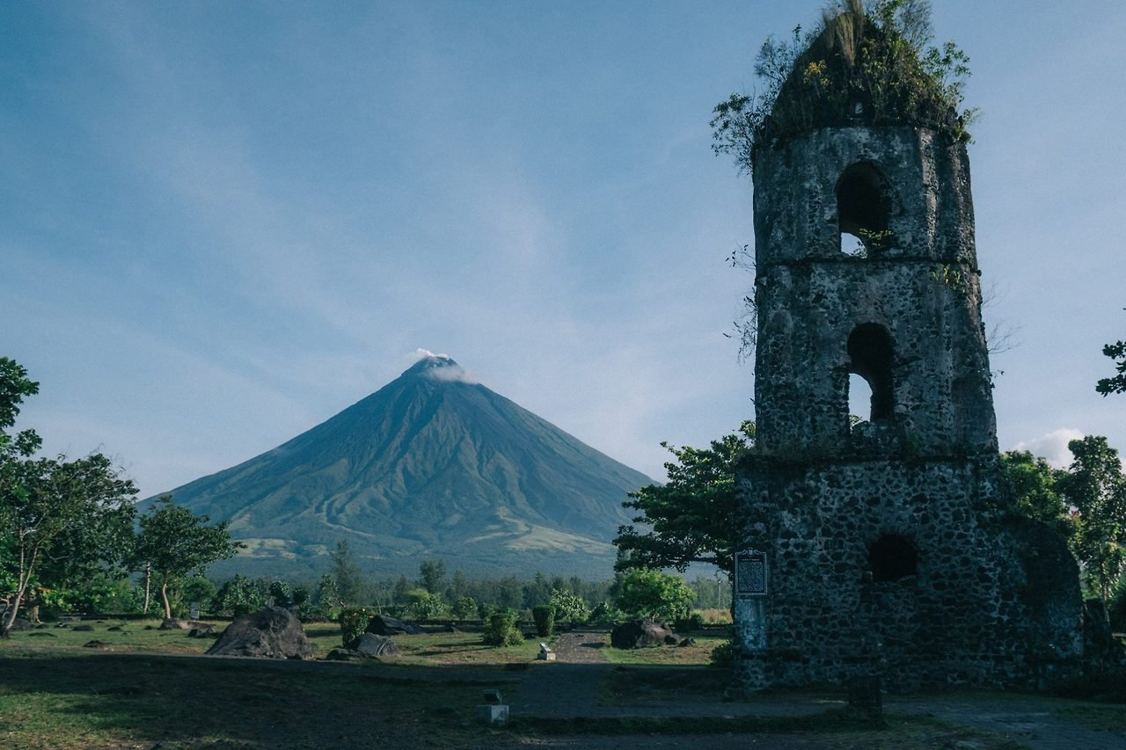
WHERE IS THIS?

Slide 16
I want to visit __(country)____ because I want to eat ___(food)____.
I like to play __(sport)______.
I want to go __(country)_______ to see __(animal or bird)___.
I love to see ___(flower)____ in __(country)_____.

